Slide 1
Treasury Investment Council
Meeting Date: November 20, 2025

Slide 2
Florida Economy &
Pool Balances

Slide 3
Florida Economy
July 2025 unemployment rate:
  U.S. 4.2%
  FL: 3.7%
General Revenue Forecast-- Total revenue collections for FY 2024-25 exceeded expectations since the last conference by $391.8 million (or 0.8 percent). After analyzing this year-to-date performance by source, the Conference increased the estimate for FY 2025-26 by $176.7 million and added $265.8 million to the estimate for FY 2026-27, yielding a two-year combined increase of just $442.5 million.
Population -- Florida’s population is expected to break the 24 million mark in calendar year 2027—and sometime during 2030, the state’s population is expected to reach almost 25 million residents.

Slide 4
FL Treasury Investment Pool Size
(total mkt. value)

Slide 5
FL Treasury Investment Pool Size
(total mkt. value)

Slide 6
State Net Receipts
(Fiscal Year)

Slide 7
State Operating Accounts

Slide 8
Non-State Operating Accounts*
* Subject to Floor Provision

Slide 9
Bond Accounts

Slide 10
Non-State Operating & Bond Accounts by type
Non-State Operating
Bond
Participant | 9/30/25 balance | % of Pool
Universities | $950,947,055.79 | 1.57%
Colleges | $126,845,883.07 | 0.21%
School Boards | $121,804,340.50 | 0.20%
Miscellaneous | $68,941,484.38 | 0.11%
University Component Units | $54,634,116.33 | 0.09%
State Component Units | $21,639,861.98 | 0.04%
College Component Units | $18,383,760.07 | 0.03%
Cities | $5,607,571.50 | 0.01%
Counties | $1,130,819.21 | 0.00%
Grand Total | $1,369,934,892.83 | 2.26%
Participant | 9/30/25 balance | % of Pool
Florida Housing Finance Corp. | $1,532,338,585.76 | 2.53%
Universities | $7,121,324.73 | 0.01%
University Component Units | $4,818,223.82 | 0.01%
School Boards | $565.36 | 0.00%
Grand Total | $1,544,278,699.67 | 2.55%

Slide 11
Investment Pool
Distributed Income
Pool Average Balance (in billions)
Average Return (net of fees)
$23.3 | $24.1 | $26.5 | $32.8 | $48.3 | $62.6 | $64.4 | $63.8 | $62.7
1.66% | 2.32% | 3.16% | 1.61% | 0.73% | 1.64% | 2.90% | 3.84% | 4.18%

Slide 12

Summary of Macro Risks to the Investment Pool
Risk | Status | Risk Level
Florida Economy | Unemployment rate continues to be low Population continues to grow, GR is strong but starting to decrease slightly. Continuing to monitor. | Low
State Net Receipts | Beginning to show early signs of stress. Continuing monitoring and allocating assets, as necessary. | Medium/Low
Pool Balance | The total pool balance has begun to creep downward. We are seeing a more cyclical spending model and are monitoring for a permanent pattern. Continue to watch legislative spending models. | Low
Non-State Agency SPIA | Non-State Agency Operating accounts continues to remain stable at 2.3%. However, we do expect some growth in the near future. | Low

Slide 13
Investment Pool
Updates

Slide 14
Investments Recap / Updates
On July 25th signed the new Custody and Securities Lending Contract:
  A better revenue sharing agreement
  Waiving of the cash collateral management fee of 1.5 bp
  Cash Collateral Reinvestment account Investment Policy significantly revised:
    Investments restricted to only: U.S. Government money market funds and Repurchase Agreements collateralized with U.S. Government securities
    All investments will have a maturity of the next business day
    Result is an elimination of duration and credit risk in this account with a small reduction in overall earnings
  For the first three months under new contract (Aug-Oct25) average monthly earnings of $747 thousand vs. $519 thousand for the previous three months (Apr-Jun25).

Slide 15
Investments Recap / Updates (2)
After a record Fiscal Year in 2024-2025, we continue to generate and distribute strong earnings to Pool participants aided by:
  Reallocation decisions (discussed later) that were driven by the need to fund the Liquidity account and declining Pool Balance
  Reallocation of assets within the Intermediate Duration Mandate (discussed later)
All actively managed portfolios outperforming their respective benchmarks
Continue negotiations to add new Repo counterparties including the potential use of sponsored repo to diversify away from non-bank entities (FICC)

Slide 16
Investments Recap / Updates (3)
In the process of moving wires and ACH capability from BNY treasury (bank) side to the Custody side. Terminating DDA accounts with the Bank.
Eileen Neil (Verus) has indicated her intention to retire next June. Her replacement is Mark Brubaker.
Finished annual review with Standard and Poor’s. Rating expected to be reaffirmed.
Additional changes to CIP to allow for incremental increase in earnings potential without adding significant risk (see next slide):

Slide 17
CIP Review - Most Relevant Updates
Eliminated the peer-based Watch List criteria and the use of 1-year metric. New Watch List criteria are as follows:
    Trailing 5-year annualized net performance below the established benchmark for six of the prior twelve months.
    Trailing 3-year annualized net performance below the established benchmark for nine out of the prior twelve months.
    The Manager’s 3-year Risk-Adjusted return (i.e. Information Ratio) falls below 0.2 for nine out of the prior twelve months.
For non-securitized spread sectors, if the credit quality of the security required two ratings, from now on, one of the ratings can be from any of the NRSRO and not just from the three major rating agencies (S&P, Moody’s or Fitch).
For U.S. Agency Mortgage-Backed (TBA) securities the maximum TBA counterparty exposure restriction was eliminated

Slide 18
Economic Environment

Slide 19
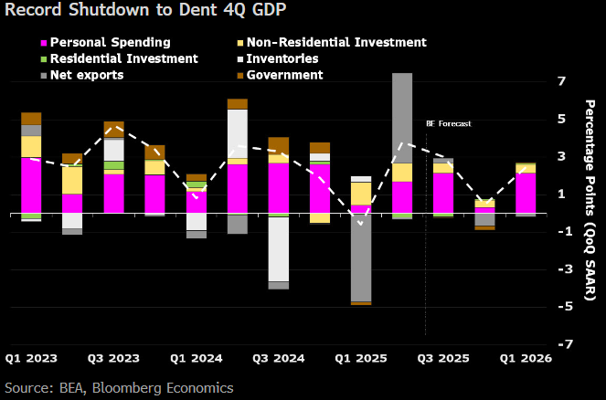
Shutdown a Drag on 4Q GDP
43 Day shutdown expected to result in a 1.3% (ann.) hit to 4Q 2025 GDP. Expected to be recovered in 1Q ’26.
Other concerns: Lack of economic data publication and collection will likely hurt reliability of jobs and inflation data at a critical juncture.

Slide 20
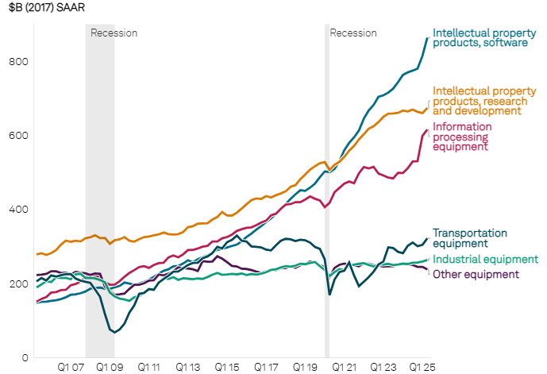
AI Boom Driving Growth
Investments in data centers have become the single largest driver of GDP growth in the first half of 2025, contributing half a percentage point. (per S&P Global)
It is currently estimated that 80% of growth in final private domestic demand (GDP less x-m, govt spending, and inventory) came from investment in data centers, and similar high-tech investment.
Business investment related to AI is offsetting weakness in other investment areas and in the economy at large.
What happens after the buildout is complete? Labor productivity will determine the answer.
CAPEX spending

Slide 21
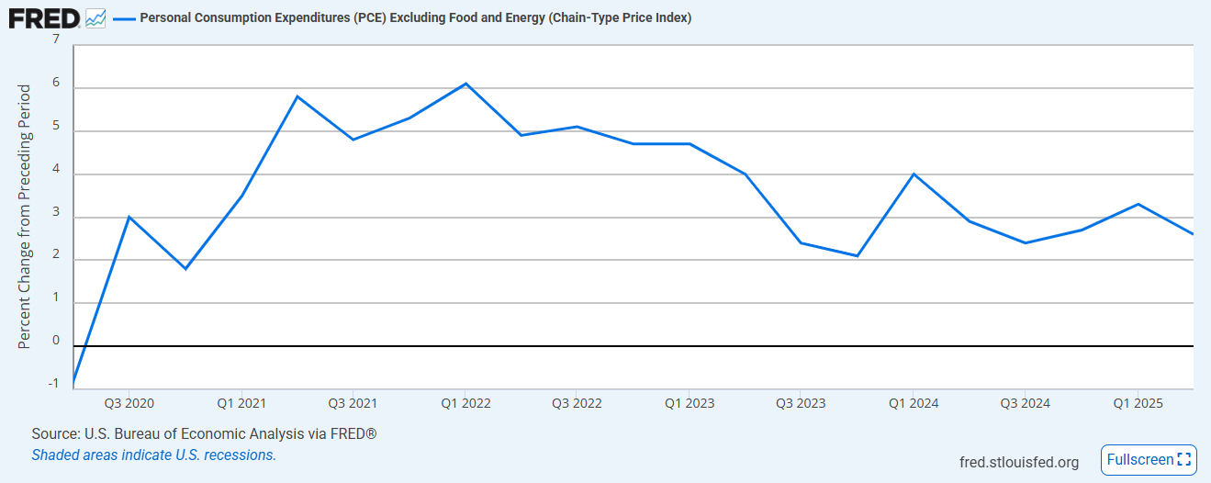
Tariffs and Inflation
The impact of tariffs have not ballooned headline CPI and PCE numbers in the way many economists had projected.
Core goods have bucked their disinflationary trend from prior to ‘liberation day’ and are now increasing at an increasing rate once more.
Disinflation in core services has largely offset the increase in prices of core goods, with services disinflation accelerating.

Slide 22
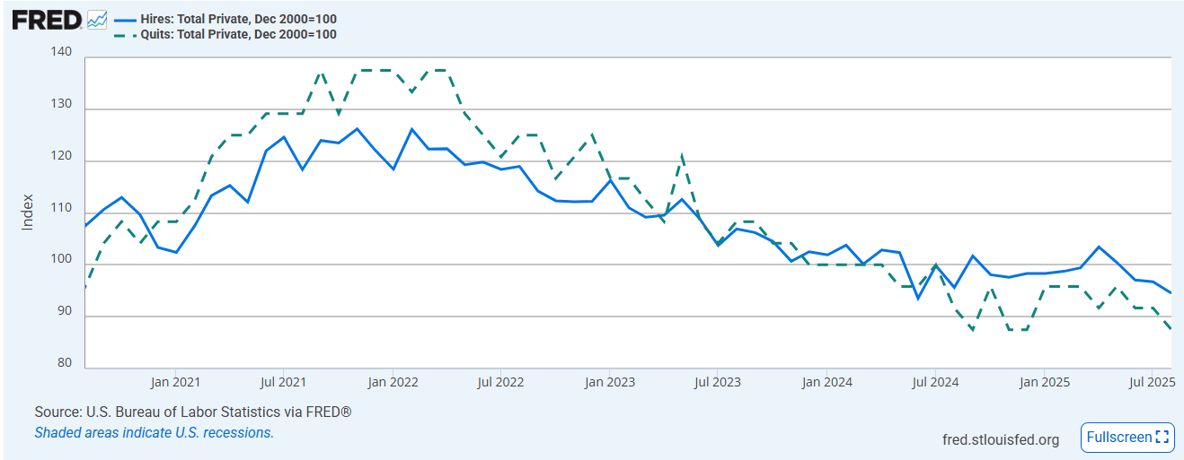
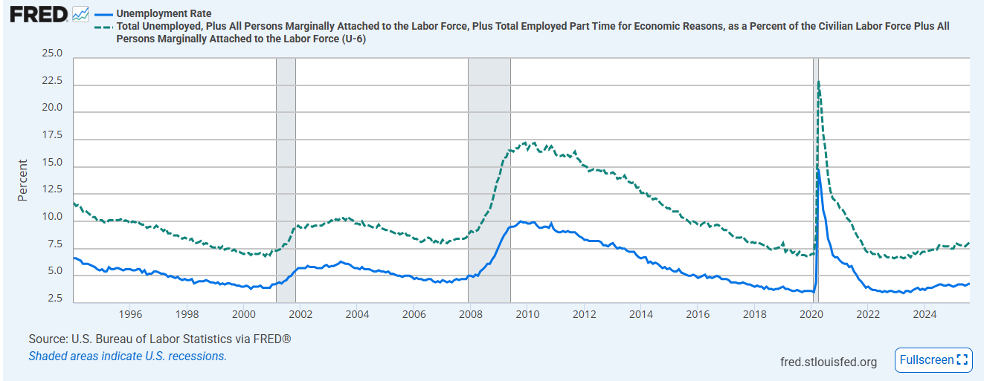
Labor Market
No real changes in the labor picture: low hiring, low firing.
Tough job market for new grads, and recent job cuts announcements potential cause for concern.

Slide 23
Strategy &
Portfolio Positioning

Slide 24
Investment Strategy - Macro level
Positive environment for bonds:
  Federal reserve has been cutting interest rates (150 bps since first cut in Sep. 2024)
  Job growth and consumer spending are slowing, keeping hopes of further cuts alive (although in reduced amounts). Fed policy is now less restrictive and a split between central bank officials have emerged
  However, slowdown is still not pointing to an imminent recession that would threaten corporate balance sheets.
  Result is the best year for the Bloomberg U.S. Aggregate Bond Index since 2020 (6.7% return YTD), easily outpacing returns of short-term T-bills.
Risks:
  Deficit and debt dynamics pressuring the long-end of the yield curve and inflation still above Fed target.
  Riskiest borrowers and lower quality loans exposure higher in the private credit sector. Public debt markets fundamentals remain solid.
  Although IG corporate balance sheets remain strong, and earnings / cash flows continue to beat expectations, credit markets continue to trade at tight levels with reduced compensation for the risks taken. Need to carefully monitor overall Pool credit risk when making further reallocation decisions

Slide 25
Investment Strategy – Macro Level (2)
Rates / Yield curve:
  Yield curve is now positively sloped. Short to Intermediate part of the yield curve offers value
  Taking advantage of any dislocations in the short-term funding markets
Spread sectors:
  Trading at tight levels however, with yields 4%+ (and far above the paltry seen during much of the past decade), there is some degree of protection against adverse rates /credit events
  Continue to favor securitized sectors (ABS) versus same duration corporate bonds for our internally managed accounts.
Used recent reallocations to increase Intermediate and Long Duration Portfolio relative exposure and lock in still attractive yields. Carefully monitoring State Pool balances and the overall Pool credit and duration exposures in any future reallocation decisions.

Slide 26
Benchmark Yields
Change between Inv. Council Meetings

Slide 27
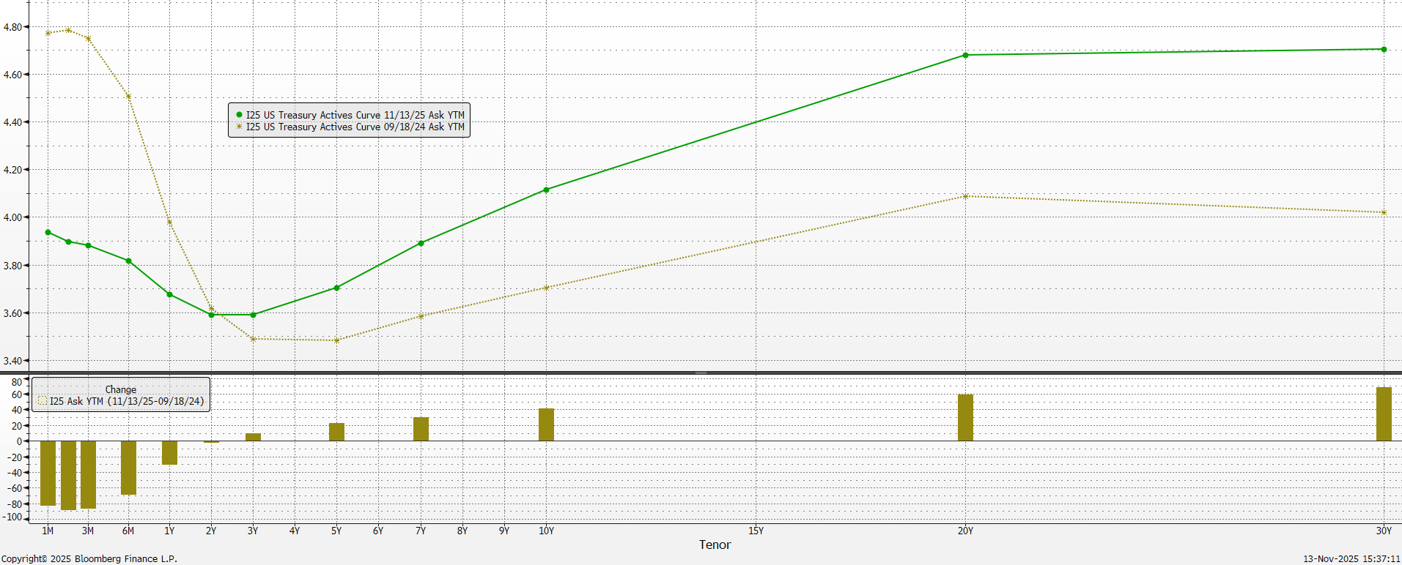
Treasury Yield Curve change (Since first Fed rate cut in Sep 24)

Slide 28
Fixed Income Yields and Spreads
Change between Inv. Council Meetings
Yield (%)

Slide 29
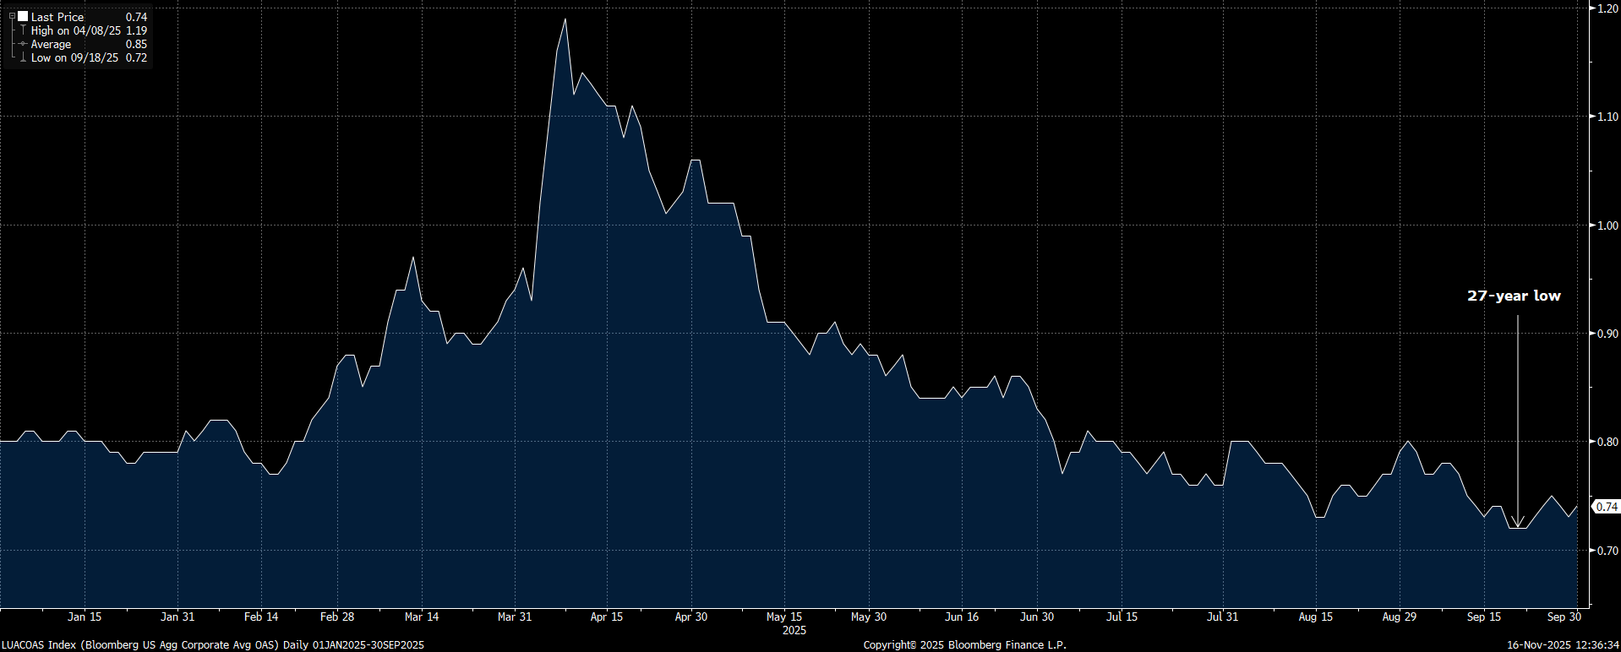
Bloomberg U.S. Corporate Investment Grade Index
*Chart Obtained from Bloomberg

Slide 30
Update on Portfolio Rebalancing Decisions
From | To | When | Total
Liquidity Portfolio | All | 2021, 2022 and 2023 | $34.0 billion
From | To | When | Total
Ultra Short Portfolio | Liquidity Portfolio | April, Sep, Oct and Nov 2025 | $2.5 billion
Short Duration Portfolio | Liquidity Portfolio | Sep, Oct and Nov 2025 | $1.2 billion
 |  | Total | $3.7 billion

Slide 31
Investment Pool Allocation

Slide 32
Portfolio % vs. Allocation Ranges as of Sept. 30, 2025

Slide 33
Total Pool Characteristics

Slide 34
BBB & Lower Exposure
 | Exposure 3/31/2025 | Exposure 9/30/2025 | Limit
Ultra Short Duration | 0.3% | 0.5% | 3%
Short Duration | 2.6% | 3.2% | 7.5%
Intermediate Duration | 8.5% | 8.5% | 13%
Long Duration | 13.4% | 13.8% | 15%
Basket Clause
Statutes allow for 3% in
basket clause items

Slide 35
SASBs Exposure
CMBS backed by individual mortgages or borrowers – known as single asset, single borrower bonds or SASBs.
The table below displays a summary of the holdings within SASBs
that are held within our pool as of Sep. 30,2025
Property Type | Market Value | % of Pool
Industrial | 243,707,758 | 0.42%
Office | 175,999,979 | 0.30%
Retail | 120,114,456 | 0.21%
Multi Family Housing | 111,633,571 | 0.19%
Hospitality | 84,484,136 | 0.15%
Other | 59,239,498 | 0.10%
TOTAL | 795,179,398 | 1.37%

Slide 36
Unrealized Gains / (Losses) and
Net Asset Value
 | U.S. Treasury 10 Year Yield | Total Amount of Unrealized Gains / (Losses) | Net Asset Value
9/30/2021 | 1.49% | $320 million | 1.01
9/30/2023 | 4.57% | ($3.4 billion) | 0.94
9/30/2025 | 4.15% | ($58 million) | 1.01

Slide 37
Pool Rating
Policy requirement: A+ or better using S&P rating matrix
S&P Rating as of September 30, 2025 = AA-f
Credit Score as of September 30, 2025 = 61.55 (AA-f)
S&P rating matrix
Maximum Score | Rating
18.49 | AAAf
37.49 | AA+f
58.49 | AAf
91.49 | AA-f
120.49 | A+f
184.49 | Af
290.49 | A-f
360.49 | BBB+f

Slide 38
Performance Review

Slide 39
U.S. Fixed Income Markets Returns
Q2 & Q3 - 2025
Treasuries
Spread Sectors
 | 3/31/2025 | 9/30/2025 | Period Change
3-month T-Bill | 4.299% | 3.939% | -36.0 b.p.
2 Year T-Note | 3.885% | 3.609% | -27.6 b.p.
5 Year T-Note | 3.950% | 3.742% | -20.9 b.p.
10 Year T-Note | 4.207% | 4.151% | -5.6 b.p.
30 Year T-Note | 4.572% | 4.732% | +16.0 b.p.
 | 03/31/2025 | 09/30/2025 | Period Change
Agency | 16 | 14 | -2
Corp – IG | 94 | 74 | -20
Corp – HY | 347 | 267 | -80
MBS | 36 | 31 | -5
ABS | 60 | 49 | -11
CMBS | 88 | 75 | -13
Source: Bloomberg

Slide 40
Investment Pool Q2 & Q3 2025 Total Returns vs Benchmarks (excl. Time Deposits)

Slide 41
Investment Pool Total Return
(excl. Time Deposits)
* Annualized

Slide 42
Individual Mandates Review

Slide 43
Liquidity & STIF Portfolios (as of September 30, 2025)
LIQUIDITY (total returns)
 | 6 Mo* | 1 Year | 3 Year | 5 Year
Portfolio | 2.22 | 4.50 | 4.89 | 2.98
Benchmark | 2.17 | 4.46 | 4.85 | 3.03
Excess Return | 0.05 | 0.04 | 0.04 | -0.05
Primary goal is to provide funds to cover disbursements and help the entire pool maximize income. Performance versus benchmark is sometimes a secondary concern. Maintaining liquidity to sufficiently cover outflows while choosing the highest yielding investment mix within IP constraints to maintain a slight yield advantage.
Due to a combination of IP, portfolio size, and a still inverted very-front end, investments have been predominantly overnight to one week, which creates a duration gap vs the benchmark index (two months).
We have primarily relied upon repo market to provide carry, with the FED in late stages of QT, and the Treasury upping their issuance of T-Bills this has led to increased borrowing costs. Creating the opportunity for short term picks of as much as 25bps over EFFR.
STIF (total returns)
 | 6 Mo* | 1 Year | 3 Year | 5 Year
Portfolio | 2.19 | 4.57 | 5.12 | 3.14
Benchmark | 2.17 | 4.46 | 4.85 | 3.03
Excess Return | 0.02 | 0.11 | 0.27 | 0.11
Information provided by BNY Mellon.
* not annualized.

Slide 44
Ultra Short Duration Portfolio - Performance and Attribution
ATTRIBUTION NOTES
TOTAL RETURNS
as of September 30, 2025
2nd Quarter and 3rd Quarter of 2025 ( +9.2 b.p.)
++ Yield: The portfolio has increased its yield/carry advantage versus the benchmark during the period due to an increased focus on the very short portion of the curve, along with the continued exposure to the ABS sector.
+ Cross-Sector: Spreads tightened slightly for both IG corporates as well as for ABS during the period which added slightly to performance.
+/- Duration / Yield Curve: We maintained an overall neutral duration stance during the period.
 | 6 Mo* | 1 Year | 3 Year | 5 Year
Portfolio | 2.26 | 4.29 | 4.70 | 2.41
Benchmark | 2.17 | 4.12 | 4.56 | 2.31
Excess Return | 0.09 | 0.17 | 0.14 | 0.10
Information provided by BNY Mellon.
* not annualized.

Slide 45
Ultra Short Duration Portfolio - Current Strategy / Characteristics
Current Strategy
Portfolio Characteristics Summary
Duration / Yield Curve | We will continue to manage duration mostly from a tactical point of view. Regarding yield curve positioning, we expect to gradually reduce the barbell structure.
Credit / Other Spread Sectors | We look for more favorable levels to add to corporate exposure. Continue to favor financials over industrials, maintain an up in quality bias and to prefer ABS versus corporates.
Other | Maximize the use of “swing trades” to save on trading costs.
 | Yield | Duration | Spread Sectors % | BBB %
ICEML 0-2 Yr US Treasuries Index 9/30/2025 | 3.76 | 1.01 | 0.0 | 0.0
PORTFOLIO:
9/30/2025 | 3.81 | 1.02 | 11.50 | 0.50
3/31/2025 | 4.26 | 0.94 | 10.72 | 0.33
9/30/2024 | 4.29 | 1.01 | 9.40 | 0.28
Data obtained from BNYM / Wilshire / Bloomberg

Slide 46
Ultra Short Duration Portfolio – Portfolio Characteristics (continued)

Slide 47
Short Duration Portfolio - Performance and Attribution
TOTAL RETURNS
as of Sep. 30, 2025
ATTRIBUTION NOTES
2nd and 3rd Quarter 2025 (+12 b.p.)
++ Yield: We preserved our benchmark-relative yield advantage through the period driven by curve positioning (specifically our strategic allocation to the very short end of the yield curve) and the continued overweight positioning within the ABS sector.
+ Spread-Sector: The portfolio held a 6% overweight to spread sectors, which benefitted performance as the risk-on environment persisted. We maintained a neutral contribution to duration from corporate bonds, while our overweight positioning in ABS added to performance as spreads tightened over the period.
+/- Duration / Yield Curve: For most of the period, the portfolio maintained a neutral overall duration position and a slight barbell structure. As opportunities arose, we capitalized on the dislocations in the short-term funding market by increasing our exposure to cash instruments.
 | 6 Mo* | 1 Year | 3 Year | 5 Year
Portfolio | 2.52 | 4.24 | 4.74 | 1.85
Benchmark | 2.40 | 4.02 | 4.55 | 1.71
Excess Return | 0.12 | 0.22 | 0.19 | 0.14
Information provided by BNY Mellon.
* not annualized.

Slide 48
Short Duration Portfolio - Current Strategy / Portfolio Characteristics
Current Strategy
Portfolio Characteristics Summary
Duration / Yield Curve | We will use duration positioning only on a tactical basis (currently neutral). We continue to trim the portfolio’s barbell structure as the Fed pursues additional rate cuts.
Spread-Sector | We remain neutral on a contribution to duration basis in the corporate sector with a slight overweight to financials while continuing to look for opportunities to add to the sector at more attractive levels. We favor the ABS sector as it looks more attractive vs. corporates and maintain an overweight positioning to the sector.
 | Yield | Duration | Duration % > 3 Years | % Spread Sectors | % BBB
ICEML 1-3Yr A-AAA US Corp & Gov. Index 9/30/2025 | 3.72 | 1.85 | 0.0 | 22.8 | 0.8
Portfolio:
9/30/2025 | 3.60 | 1.76 | 7.9 | 29.1 | 3.2
3/31/2025 | 4.48 | 1.84 | 3.6 | 29.4 | 2.6
9/30/2024 | 4.06 | 1.84 | 8.6 | 28.5 | 2.4
Data obtained from BNYM / Wilshire / Bloomberg

Slide 49
Short Duration Portfolio – Portfolio Characteristics (continued)

Slide 50
Short Duration Portfolio – Portfolio Characteristics (continued)

Slide 51
Intermediate Duration Portfolio Net of Fees Performance as of September 30, 2025
 | % of |  | Mgr |  |  |  |  |  |  |  |  | Annualized
 | Inv. Pool | Market Value | Rank* | 1 Month |  | 3 Month |  | 6 Month |  | 1 Year |  | 2 Year |  | 3 Year |  | 5 Year |  | 7 Year |  | 10 Year
IR+M | 3.58% | $2,191,749,122.26 | 2 | 0.722% | 4 | 1.930% | 5 | 3.455% | 5 | 4.131% | 3 | 7.472% | 4 | 5.608% | 2 | 0.935% | 2 | 2.712% | 2 | 2.2216% | 3
MetWest | 3.46% | $2,120,506,688.74 | 4 | 0.845% | 1 | 2.082% | 1 | 3.462% | 4 | 3.606% | 6 | 7.053% | 6 | 5.135% | 4 | 0.628% | 4 | 2.464% | 4 | 2.0111% | 4
Galliard | 3.29% | $2,012,797,391.94 | 3 | 0.745% | 2 | 1.971% | 3 | 3.498% | 3 | 4.078% | 4 | 7.615% | 3 | 5.603% | 3 | 0.867% | 3 | 2.640% | 3 | 2.2384% | 2
Sterling Capital | 3.23% | $1,979,017,053.01 | 1 | 0.687% | 6 | 1.951% | 4 | 3.506% | 2 | 4.313% | 2 | 7.645% | 2 | 5.709% | 1 | 1.129% | 1 | 2.785% | 1 | 2.3180% | 1
Reams Asset Mgmt | 2.24% | $1,370,108,021.97 | N/A | 0.742% | 3 | 2.024% | 2 | 3.804% | 1 | 4.518% | 1 | 7.649% | 1
Wellington Mgmt Co | 2.22% | $1,356,660,942.44 | N/A | 0.710% | 5 | 1.885% | 6 | 3.442% | 6 | 3.917% | 5 | 7.224% | 5
Total | 18.02% | $11,030,839,220.36 |  | 0.744% |  | 1.977% |  | 3.515% |  | 4.074% |  | 7.439% |  | 5.515% |  | 0.887% |  | 2.648% |  | 2.199%
Benchmark |  |  |  | 0.658% |  | 1.785% |  | 3.323% |  | 3.823% |  | 7.057% |  | 5.143% |  | 0.494% |  | 2.269% |  | 1.859%
* Based on 1, 3 and 5 Year Risk Adjusted Rankings.

Slide 52
Long Duration Portfolio Net of Fees
Performance as of September 30, 2025
 | % of | Market Value | Mgr |  |  |  |  |  |  |  |  | Annualized
 | Inv. Pool |  | Rank* | 1 Month |  | 3 Month |  | 6 Month |  | 1 Year |  | 2 Year |  | 3 Year |  | 5 Year |  | 7 Year |  | 10 Year |  | 15 Year |  | 20 Year |  | 25 Year
Galliard | 5.31% | $3,250,762,049.77 | 4 | 1.063% | 8 | 2.131% | 7 | 3.457% | 6 | 3.247% | 6 | 7.813% | 2 | 5.464% | 3 | -0.066% | 3 | 2.661% | 1 | 2.327% | 2 | 2.738% | 2
Sterling Capital | 5.17% | $3,167,761,396.15 | 3 | 1.053% | 9 | 2.130% | 8 | 3.367% | 10 | 3.373% | 3 | 7.760% | 5 | 5.403% | 4 | 0.190% | 1 | 2.554% | 2 | 2.353% | 1 | 2.669% | 3 | 3.724% | 2
Amundi | 5.03% | $3,082,743,896.86 | 1 | 1.115% | 6 | 2.264% | 2 | 3.723% | 1 | 3.614% | 1 | 8.010% | 1 | 5.736% | 1 | 0.117% | 2 | 2.528% | 3 | 2.316% | 3 | 2.778% | 1 | 3.800% | 1 | 4.465% | 1
All Spring (Wells) | 4.90% | $2,998,195,027.99 | 7 | 1.202% | 1 | 2.196% | 4 | 3.465% | 5 | 3.103% | 8 | 7.539% | 6 | 5.243% | 7 | -0.080% | 4 | 2.420% | 6 | 2.159% | 6 | 2.480% | 8 | 3.530% | 5
Fidelity | 4.52% | $2,769,712,411.68 | 10 | 1.040% | 10 | 2.045% | 10 | 3.443% | 9 | 3.098% | 9 | 7.396% | 10 | 5.061% | 10 | -0.209% | 9 | 2.430% | 4 | 2.210% | 4 | 2.529% | 5 | 3.696% | 3 | 4.353% | 2
Goldman Sachs | 3.44% | $2,104,623,489.37 | 8 | 1.122% | 5 | 2.142% | 6 | 3.449% | 7 | 3.148% | 7 | 7.415% | 9 | 5.230% | 8 | -0.219% | 10 | 2.430% | 5 | 2.137% | 8 | 2.408% | 9 | 3.440% | 7 | 4.144% | 4
Manulife | 2.75% | $1,685,080,818.14 | 5 | 1.136% | 3 | 2.291% | 1 | 3.693% | 2 | 3.377% | 2 | 7.777% | 4 | 5.272% | 5 | -0.089% | 6 | 2.418% | 7 | 2.188% | 5 | 2.527% | 6 | 3.606% | 4 | 4.292% | 3
PGIM | 2.57% | $1,572,152,154.56 | 2 | 1.154% | 2 | 2.222% | 3 | 3.551% | 3 | 3.373% | 4 | 7.785% | 3 | 5.506% | 2 | -0.083% | 5 | 2.344% | 8 | 2.156% | 7 | 2.588% | 4
Nuveen | 1.45% | $886,913,067.54 | 6 | 1.111% | 7 | 2.114% | 9 | 3.513% | 4 | 3.286% | 5 | 7.418% | 8 | 5.101% | 9 | -0.155% | 7 | 2.274% | 10 | 2.006% | 10 | 2.361% | 10 | 3.451% | 6 | 4.097% | 5
Insight Investment | 1.26% | $771,422,278.93 | 9 | 1.130% | 4 | 2.142% | 5 | 3.444% | 8 | 2.968% | 10 | 7.488% | 7 | 5.270% | 6 | -0.190% | 8 | 2.319% | 9 | 2.033% | 9 | 2.497% | 7
Total | 36.40% | $22,289,366,590.99 |  | 1.107% |  | 2.166% |  | 3.506% |  | 3.233% |  | 7.637% |  | 5.311% |  | -0.082% |  | 2.432% |  | 2.188% |  | 2.533% |  | 3.464% |  | 4.118%
Benchmark |  |  |  | 1.091% |  | 2.030% |  | 3.261% |  | 2.884% |  | 7.138% |  | 4.928% |  | -0.449% |  | 2.064% |  | 1.838% |  | 2.255% |  | 3.228% |  | 3.898%
* Based on 1, 3 and 5 Year Risk Adjusted Rankings.

Slide 53
Fixed Income Characteristics (as of September 30, 2025)
Intermediate Duration Composite
 | Portfolio | Benchmark
Coupon | 3.89% | 3.64%
YTM | 4.44% | 4.24%
Effective Duration | 4.27 years | 4.22 years
Long Duration Composite
 | Portfolio | Benchmark
Coupon | 4.22% | 3.72%
YTM | 4.72% | 4.40%
Effective Duration | 6.05 years | 5.84 years

Slide 54
Sector Allocation

Slide 55
Credit Quality

Slide 56
Recent Actions
Insight still on Watch (March 2025) for qualitative reasons. New management is continuing with new changes in the last 6 months, so we are continuing to monitor and keep them on Watch.
Placed Metwest/TCW on Watch (notified September 2025) and reduced assets by $500mm ($250mm 10/01 and $250mm 11/03).
Changing of criteria for Watch List Factors for External Managers

Slide 57
Watch List Worksheet – Intermediate Duration (September 30, 2025)
Any of the Following Conditions
(#1) Trailing 5-Year Annualized Net Performance Below Benchmark for 6 of 12 Months
Galliard | IR+M |  |  | MetWest/TCW |  |  | Sterling
(#2) Trailing 3-Year Annualized Net Performance Below Benchmark for 9 out of 12 Months
Galliard | IR+M |  |  | MetWest/TCW |  |  | Sterling
 |  |  |  | September, August, July, June, May, April, Mar, Jan 25
(#3) Mgr's 3-Year Info Ratio under 0.2 for 9 out of 12 months
Galliard | IR+M |  |  | MetWest/TCW |  |  | Sterling
 |  |  |  | Oct, Nov, Dec 24 ; Jan, Feb, March, April, May, June, July, August, Sept 25

Slide 58
Watch List Worksheet – Long Duration (September 30, 2025)
Any of the Following Conditions
(#1) Trailing 5-Year Annualized Net Performance Below Benchmark for 6 of 12 Months
AmundiPioneer | Fidelity | Galliard | Goldman | Insight Investment | Manulife | Nuveen | PGIM | Sterling | All Spring (Wells)
(#2) Trailing 3-Year Annualized Net Performance Below Benchmark for 9 out of 12 Months
AmundiPioneer | Fidelity | Galliard | Goldman | Insight Investment | Manulife | Nuveen | PGIM | Sterling | All Spring (Wells)
(#3) Mgr's 3-Year Info Ratio under 0.2 for 9 out of 12 months
AmundiPioneer | Fidelity | Galliard | Goldman | Insight Investment | Manulife | Nuveen | PGIM | Sterling | All Spring (Wells)
 | Feb, Mar, April, June 25 |  |  |  |  | April 25 |  |  | April 25

