Slide 1
Treasury Investment Council
Meeting Date: May 29, 2025

Slide 2
Florida Economy &
Pool Balances

Slide 3
Florida Economy
February 2025 unemployment rate:
  U.S. 4.1%
  FL: 3.6% (398K Jobless persons)
General Revenue Forecast-- Total revenue collections through January 2025 exceeded expectations since the last conference by $595.7 million (or 2.2 percent). After analyzing this year-to-date performance, the Conference added $768.3 million in total to the estimate for FY 2024-25 and $503.5 million to the estimate for FY 2025-26, yielding a two-year combined increase of just under $1.3 billion.

Slide 4
FL Treasury Investment Pool Size
(total mkt. value)

Slide 5
FL Treasury Investment Pool Size
(total mkt. value)

Slide 6
State Net Receipts

Slide 7
State Operating Accounts

Slide 8
Non-State Operating Accounts*
* Subject to Floor Provision

Slide 9
Bond Accounts

Slide 10
Non-State Operating & Bond Accounts by type
Non-State Operating
Bond
Participant | 3/31/25 balance | % of Pool
Universities | $931,710,883.03 | 1.48%
School Boards | $161,784,584.99 | 0.26%
Colleges | $116,757,266.27 | 0.19%
Miscellaneous | $67,528,471.42 | 0.11%
University Component Units | $54,521,399.92 | 0.09%
College Component Units | $25,386,152.91 | 0.04%
State Component Units | $21,255,958.13 | 0.03%
Cities | $5,338,075.15 | 0.01%
Counties | $1,108,476.25 | 0.00%
Grand Total | $1,385,391,268.07 | 2.20%
Participant | 3/31/25 balance | % of Pool
Florida Housing Finance Corp. | $1,503,890,388.86 | 2.39%
University Component Units | $50,044,699.75 | 0.08%
Universities | $23,173,625.77 | 0.04%
School Boards | $554.22 | 0.00%
Grand Total | $1,577,109,268.60 | 2.50%
*Miscellaneous includes various associations, foundations, and finance corporations.

Slide 11
Summary of Macro Risks to the Investment Pool
Risk | Status | Risk Level
Florida Economy | Unemployment rate continues to be low Population continues to grow, GR is strong | Low
State Net Receipts | Continues to be stable but Treasury is monitoring. | Low
Pool Balance | The total pool balance has remained relatively stable in the past year. Continue to watch legislative spending models. | Low
Non-State Agency SPIA | Non-State Agency Operating accounts continues to decrease and has remained at 2.2%. | Low

Slide 12
Investment Pool
Distributed Income
Pool Average Balance (in billions)
Average Return (net of fees)
$24.7 | $23.3 | $24.1 | $26.5 | $32.8 | $48.3 | $62.6 | $64.4 | $63.8
1.45% | 1.66% | 2.32% | 3.16% | 1.61% | 0.73% | 1.64% | 2.90% | 3.82%

Slide 13
Securities Lending Review

Slide 14
SECURITIES LENDING UPCOMING CHANGES
Final stages of procurement process for the new Custody and Securities Lending Agreement which will result in:
  A better revenue sharing agreement
  Waiving of the cash collateral management fee of 1.5 bp
  Cash Collateral Reinvestment account Investment Policy significantly revised:
    Investments restricted to only: U.S. Government money market funds and Repurchase Agreements collateralized with U.S. Government securities
    All investments will have a maturity of the next business day
    Result is an elimination of duration and credit risk in this account with a small reduction in overall earnings
  Expected increase in non-cash lending (US government collateral)

Slide 15
SECURITIES LENDING OVERVIEW
as of March 31, 2025
 | Market Value Securities on Loan | Market Value Collateral Received | Collateral Coverage | Market Value of Cash Reinvestments | NAV
Cash | $1,118,620,424 | $1,146,690,933 | 102.51% | $1,147,056,352 | 1.0003
Non - Cash | $4,261,537,351 | $4,367,199,457 | 102.48% | N/A | N/A
Total | $5,380,157,775 | $5,513,890,390

Slide 16

Securities Lending - Cash Collateral Portfolio As of March 31, 2025
Portfolio Characteristics
Credit Quality (S&P) | % of Cost | Cost (in mil.)
U.S. Govt. Securities* | 63.93% | $733.1
AAA | 0% | $0
AA | 15.13% | $173.5
A | 20.94% | $240.1
Total Market Value $1,146.7 million
NAV 1.0003
Yield (360 basis) 4.515%
WAM 95 days
* Includes Repos that are collateralized by U.S. Govt. Securities.
Asset Class
Final Maturity Schedule

Slide 17
Securities Lending Income

Slide 18
Investment Pool
Review

Slide 19
Investments Recap / Updates
Record earnings being generated and distributed to participants.
No major changes in Pool allocation but did move $1 billion from the Ultra-Short portfolio to the Liquidity portfolio.
Implemented stricter liquidity and funding requirements for Repo counterparties. In the process of adding TD and in initial conversations with two more broker/dealers.
Additional changes to CIP to allow for incremental increase in earnings potential without adding significant risk (see next two slides):

Slide 20
CIP Review - Most Relevant Updates (I)
Intermediate Duration Portfolio:
  Increased the maximum holdings securities within the BBB range by S&P from 10% to 13% of the portfolio’s market value
Risk Management:
  The allocation to any single External Manager increased from 10% to 15% of the total Investment Pool.
  Budgeted amount of active risk reduced by 50 bps for the Intermediate Duration and Long Duration Portfolios:
Portfolio | Benchmark | Target Range (Old) | Target Range (New)
Intermediate Duration | Ice BoA U.S. Int. Agg | 0-150 bps | 0-100 bps
Long Duration | Ice BoA U.S. Agg | 0-200 bps | 0-150 bps

Slide 21
CIP Review - Most Relevant Updates (II)
Liquidity and STIF Portfolios:
  Separated overnight CP from total CP limits:
    Liquidity account: $1 billion max in O/N CP and $1 billion in term CP
    STIF account: $300 million max in O/N CP and $200 million in term CP
  Maintained individual issuer limits

Slide 22
Economic and
Market Environment

Slide 23
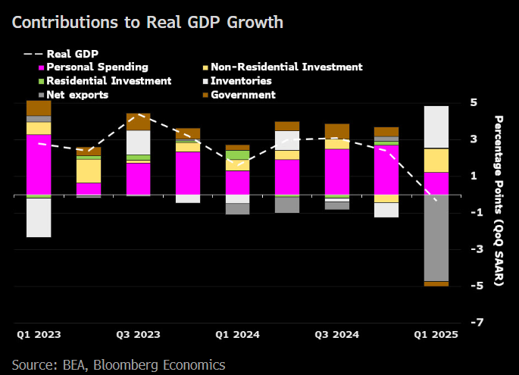
US Real GDP Contracts 0.3% in Q1
As of 04/04/25
Tariff front-running was evident in Q1 as imports to the US surged with firms pulling forward inventory and or component inputs. Subtracting 4.79% from top-line GDP growth.
This is likely to reverse in Q2 and provide a tailwind to growth.
Consumer Spending growth slowed to 1.8%, with some front-running likely present there as well. While soft data suggests discretionary buying purchase intentions have decline substantially.
As of 11/18/24

Slide 24
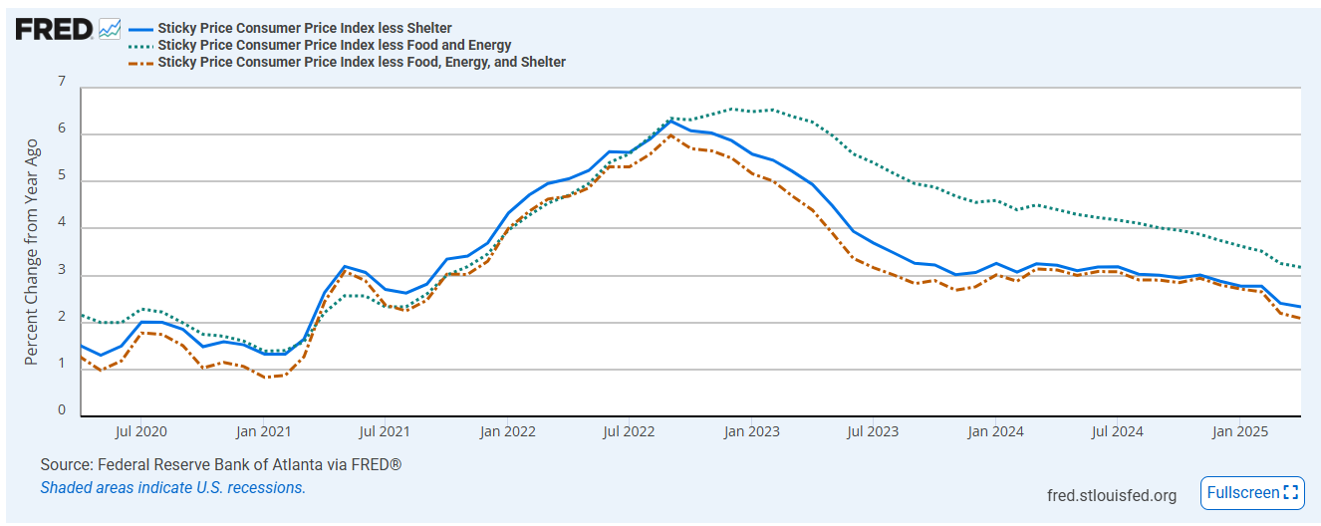
Inflation Update
While much of what we seeing going forward on the inflation front will depend on the outcome of the trade deals being negotiated, there has been some notable progress made in the underlying trends.
Several U.S. retailers have already communicated their intention to pass through as much of these tariff costs as possible, we saw some mild services disinflation in April as consumers may have to reshuffle their stretched budgets.
The sticky price CPI, which excludes more volatile components and once adjusted for the shelter costs that tend to have the longest lag, is already rapidly approaching the Fed’s 2% target.

Slide 25
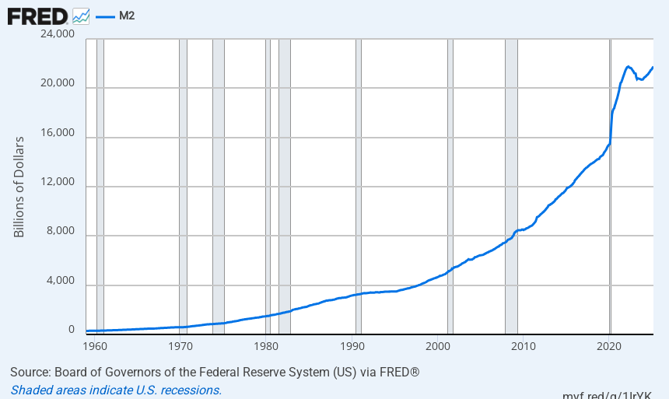
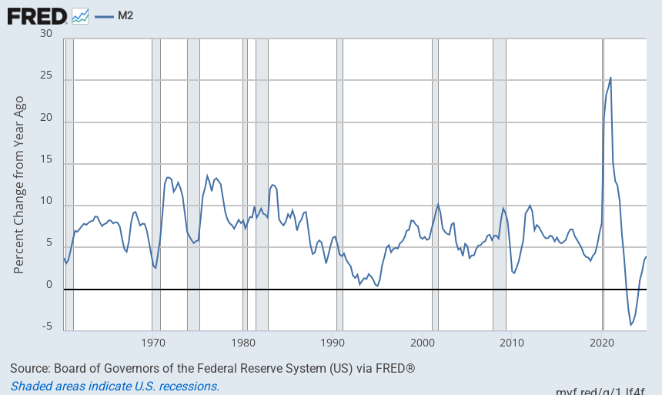
Money Supply
Money supply (M2) has stabilized after the exponential increase experienced in the post pandemic era.

Slide 26
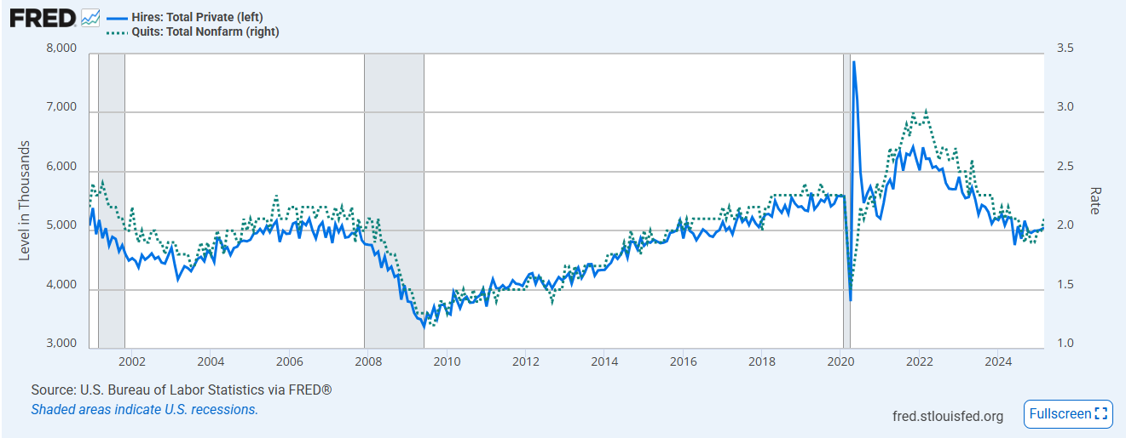
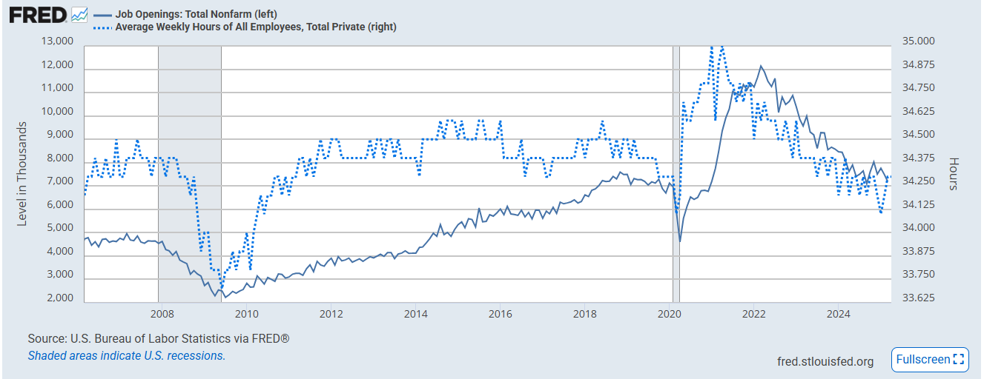
Labor Market “Wait and See”
As of 04/04/25
Both hires and quits remain hovering around recent lows.
Weekly hours and job openings have slowed their downtrend but remain at levels that do not portend any immediate uptick in hiring conditions.
As of 11/18/24

Slide 27
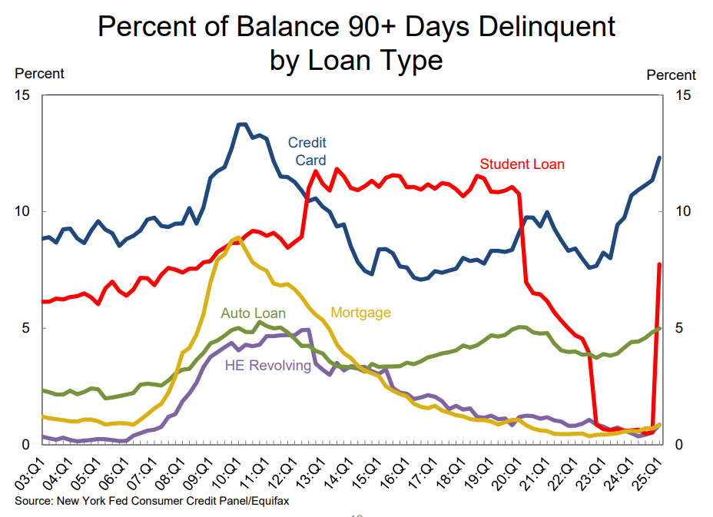
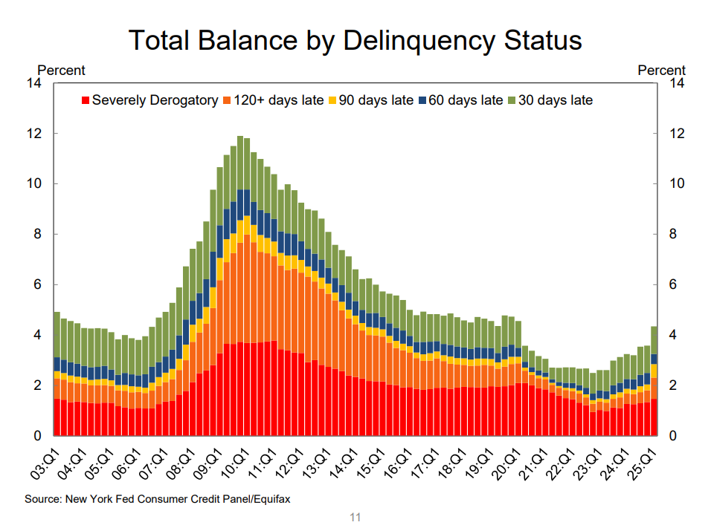
Student Loan Delinquencies Return
With missed student loan payments once again being reported to credit bureaus, roughly 2.2 million borrowers have already seen their credit scores drop by at least 100 points.
As of the end of march, 4.3% of debt was in some stage of delinquency, up from 3.6% prior. Surprisingly enough, the age cohort hit the hardest was 50+ (11.23% 90 days+ on SL).

Slide 28
Benchmark Yields
Change between Inv. Council Meetings
Yield (%)

Slide 29
Fixed Income Yields and Spreads
Change between Inv. Council Meetings
Yield (%)

Slide 30
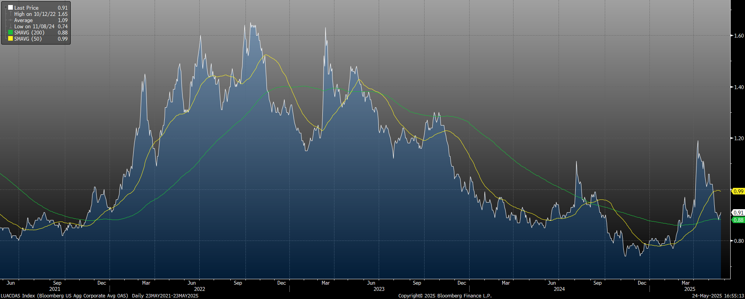
Bloomberg U.S. Corporate Investment Grade Index
*Chart Obtained from Bloomberg

Slide 31
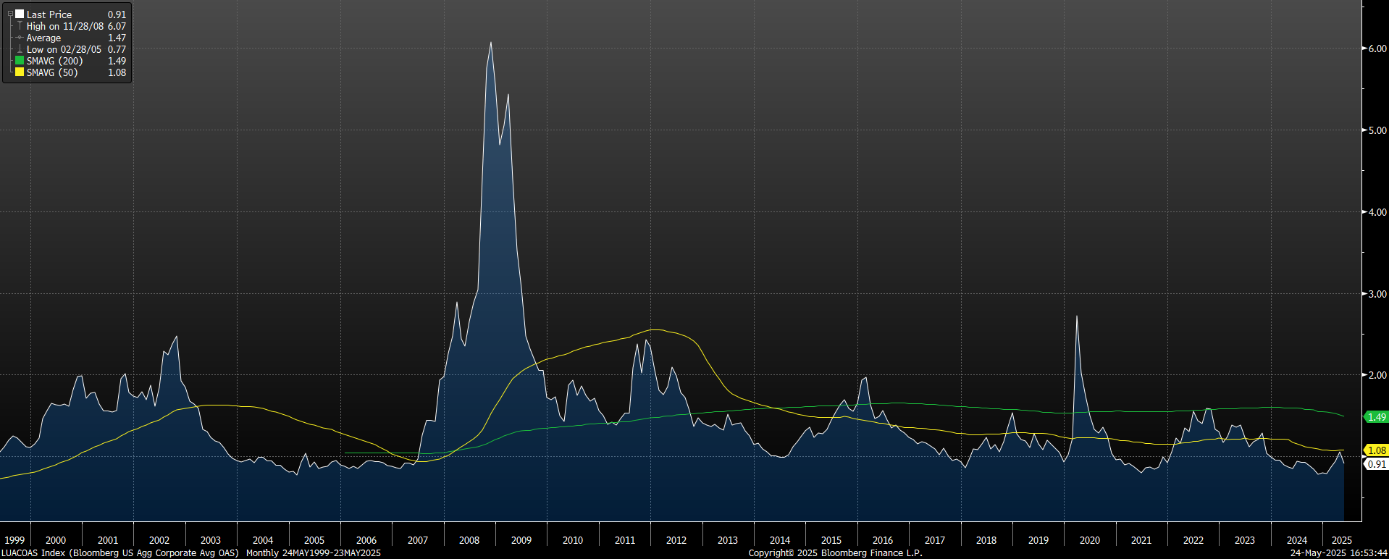
Bloomberg U.S. Corporate Investment Grade Index
*Chart Obtained from Bloomberg

Slide 32
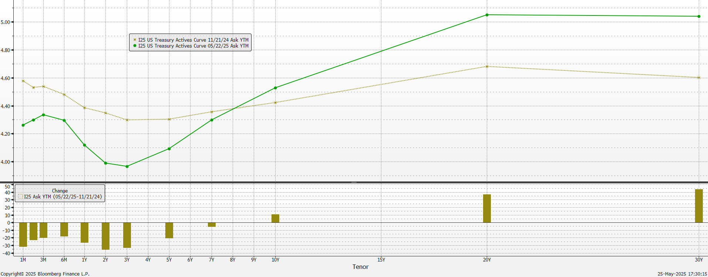
Treasury Yield Curve change (Nov 2024 vs May 2025)

Slide 33
Strategy &
Portfolio Positioning

Slide 34
Investment Strategy (Macro level)
Rates / Yield curve:
  Deficit and debt dynamics pressuring the long-end of the yield curve
  Expectations of rate cuts have been reduced. However, Fed policy is still restrictive and with inflation coming down, rate cuts are expected later in the year. Yield curve still relatively flat. Short to Intermediate part of the yield curve offers value.
Spread sectors:
  Trading at tight levels. IG corporate balance sheets remain strong, and earnings / cash flows continue to beat expectations. No incentive to significantly add credit risk to the Investment Pool at this uncertain time.
Therefore, after reallocating $34.2 billion from 2021 through 2023 from the Liquidity portfolio to higher duration portfolios we are closely monitoring State Pool balances and markets before making any further reallocation decisions.

Slide 35
Investment Pool Allocation

Slide 36
Portfolio % vs. Allocation Ranges as of March 31, 2025
* avg. of previous 12 end-of-month balances for Liquidity Portfolio.

Slide 37
Total Pool Characteristics

Slide 38
BBB & Lower Exposure
 | Exposure 9/30/2024 | Exposure 3/31/2025 | Limit
Ultra Short Duration | 0.3% | 0.3% | 3%
Short Duration | 2.4% | 2.6% | 7.5%
Intermediate Duration | 8.9% | 8.5% | 10%
Long Duration | 14.0% | 13.4% | 15%
Basket Clause
Statutes allow for 3% in
basket clause items

Slide 39
Net Asset Value

Slide 40
Pool Rating
Policy requirement: A+ or better using S&P rating matrix
S&P Rating as of March 31, 2025 = AA-f
Credit Score as of March 31, 2025 = 61.72 (AA-f)
S&P rating matrix
Maximum Score | Rating
18.49 | AAAf
37.49 | AA+f
58.49 | AAf
91.49 | AA-f
120.49 | A+f
184.49 | Af
290.49 | A-f
360.49 | BBB+f

Slide 41
Performance Review

Slide 42
U.S. Fixed Income Markets Returns
Q4 - 2024 & Q1 - 2025
Treasuries
Spread Sectors
 | 9/30/2024 | 3/31/2025 | Period Change
3-month T-Bill | 4.627% | 4.299% | -32.8 b.p.
2 Year T-Note | 3.642% | 3.885% | +24.3 b.p.
5 Year T-Note | 3.559% | 3.950% | +39.1 b.p.
10 Year T-Note | 3.782% | 4.207% | +42.5 b.p.
30 Year T-Note | 4.120% | 4.572% | +45.2 b.p.
 | 09/30/2024 | 03/31/2025 | Period Change
Agency | 19 | 16 | -3
Corp – IG | 89 | 94 | +5
Corp – HY | 295 | 347 | +52
MBS | 42 | 36 | -6
ABS | 64 | 60 | -4
CMBS | 93 | 88 | -5
Source: Bloomberg

Slide 43
Investment Pool Q4 2024 & Q1 2025 Total Returns vs Benchmarks (excl. Time Deposits)

Slide 44
Investment Pool Total Return
(excl. Time Deposits)
* Annualized

Slide 45
Individual Mandates Review

Slide 46
Liquidity & STIF Portfolios (as of March 31, 2025)
LIQUIDITY
 | 6 Mo* | 1 Year | 3 Year | 5 Year
Portfolio | 2.23 | 5.05 | 4.23 | 2.54
Benchmark | 2.24 | 5.02 | 4.31 | 2.60
Excess Return | -0.01 | 0.03 | -0.08 | -0.06
Primary goal is to provide funds to cover disbursements and help the entire pool maximize income. Performance versus benchmark is sometimes a secondary concern.
With rates in the front end higher and uncertainty about timing and magnitude of next Fed funds rate cut, duration was not taken as often and money kept close to overnight, to maximize earnings.
Choosing the highest yielding investments in the space to try to maintain a slight yield advantage. Maximizing use of overnight commercial paper and repurchase agreements, which have been higher yielding than treasury options currently.
We are limiting exposure to the 3-12 month part of the yield curve, as the account has not been as large as in the past and only extending some when extra cash is available.
STIF
 | 6 Mo* | 1 Year | 3 Year | 5 Year
Portfolio | 2.27 | 5.10 | 4.57 | 2.76
Benchmark | 2.24 | 5.02 | 4.31 | 2.60
Excess Return | 0.04 | 0.08 | 0.26 | 0.16
* not annualized.

Slide 47
Ultra Short Duration Portfolio - Performance and Attribution
ATTRIBUTION NOTES
TOTAL RETURNS
as of March 31, 2025
4th Quarter 2024 and 1st Quarter of 2025 ( +7.1 b.p.)
+ Duration / Yield Curve: Tactical duration positioning was additive to performance over the period. Yield curve positioning and the portfolio’s barbell structure was mixed.
- Cross-Sector: Concerns regarding Trump’s tariff policies led to spread widening, which detracted performance slightly.
++ Yield: The portfolio increased its yield/carry advantage versus the benchmark during the period.
 | 6 Mo* | 1 Year | 3 Year | 5 Year
Portfolio | 1.98 | 5.34 | 3.65 | 2.01
Benchmark | 1.91 | 5.23 | 3.54 | 1.90
Excess Return | 0.07 | 0.11 | 0.11 | 0.11
Information provided by BNY Mellon.
* not annualized.

Slide 48
Ultra Short Duration Portfolio - Current Strategy / Characteristics
Current Strategy
Portfolio Characteristics Summary
Duration / Yield Curve | Continue to manage duration tactically. Maintain barbell structure.
Credit / Other Spread Sectors | Looking for additional opportunities to add more securities at attractive levels. Maintain ABS allocation.
Other | Swing trades.
 | Yield | Duration | Non- Treasuries % | BBB %
ICEML 0-2 Yr US Treasuries Index 3/31/2025 | 4.08 | 1.01 | 0.0 | 0.0
PORTFOLIO:
3/31/2025 | 4.26 | 0.94 | 16.41 | 0.33
9/30/2024 | 4.29 | 1.01 | 9.29 | 0.28
3/31/2024 | 5.13 | 0.96 | 9.12 | 0.34
Data obtained from BNYM / Wilshire / Bloomberg

Slide 49
Ultra Short Duration Portfolio – Portfolio Characteristics (continued)

Slide 50
Short Duration Portfolio - Performance and Attribution
TOTAL RETURNS
as of March 31, 2025
ATTRIBUTION NOTES
4th Quarter 2024 and 1st Quarter 2025 (+10 b.p.)
++ / - Duration / Yield Curve:
+Tactical Duration Play 4th Quarter
+Tactical Duration Play 1st Quarter
- Portfolios Barbel Structure
++ / - Spread-Sector:
+CTD Corporate Bonds
+Late March Add
-ABS
++ Yield:
+Corporate Bonds
+ABS
 | 6 Mo* | 1 Year | 3 Year | 5 Year
Portfolio | 1.68 | 5.64 | 3.16 | 1.55
Benchmark | 1.58 | 5.55 | 2.99 | 1.40
Excess Return | 0.10 | 0.09 | 0.17 | 0.15
Information provided by BNY Mellon.
* not annualized.

Slide 51
Short Duration Portfolio - Current Strategy / Portfolio Characteristics
Current Strategy
Portfolio Characteristics Summary
 | Yield | Duration | Duration % > 3 Years | % BBB
ICEML 1-3Yr A-AAA US Corp & Gov. Index 3/31/2025 | 4.06 | 1.83 | 0.0 | 0.7
Portfolio:
3/31/2025 | 4.48 | 1.84 | 3.6 | 2.6
9/30/2024 | 4.06 | 1.84 | 8.6 | 2.4
3/31/2024 | 5.03 | 1.81 | 3.9 | 2.8
Duration / Yield Curve | Tactical Duration Positioning Reducing the Barbell Positioning
Spread-Sector | CTD from Corp. Sector Neutral Opportunities to add Overweight ABS
Data obtained from BNYM / Wilshire / Bloomberg

Slide 52
Short Duration Portfolio – Portfolio Characteristics (continued)

Slide 53
Short Duration Portfolio – Portfolio Characteristics (continued)

Slide 54
Intermediate Duration Portfolio Net of Fees Performance as of March 31, 2025
 | % of |  | Mgr |  |  |  |  |  |  |  |  | Annualized
 | Inv. Pool | Market Value | Rank* | 1 Month |  | 3 Month |  | 6 Month |  | 1 Year |  | 2 Year |  | 3 Year |  | 5 Year |  | 7 Year |  | 10 Year
IR+M | 3.36% | $2,118,555,493.05 | 2 | 0.191% | 4 | 2.662% | 3 | 0.654% | 3 | 5.857% | 4 | 4.460% | 4 | 2.143% | 2 | 1.096% | 2 | 2.263% | 2 | 1.8983% | 3
MetWest | 3.25% | $2,049,553,597.24 | 4 | 0.171% | 6 | 2.703% | 1 | 0.140% | 6 | 5.403% | 6 | 3.825% | 6 | 1.562% | 4 | 0.549% | 4 | 1.993% | 4 | 1.6987% | 4
Galliard | 3.09% | $1,944,772,024.70 | 3 | 0.209% | 2 | 2.694% | 2 | 0.560% | 4 | 6.020% | 3 | 4.608% | 2 | 2.068% | 3 | 0.937% | 3 | 2.198% | 3 | 1.9258% | 2
Sterling Capital | 3.04% | $1,911,987,869.16 | 1 | 0.194% | 3 | 2.583% | 5 | 0.780% | 1 | 6.101% | 1 | 4.735% | 1 | 2.299% | 1 | 1.268% | 1 | 2.338% | 1 | 1.9886% | 1
Reams Asset Mgmt | 2.10% | $1,319,896,810.07 | N/A | 0.179% | 5 | 2.576% | 6 | 0.687% | 2 | 6.055% | 2 | 4.480% | 3
Wellington Mgmt Co | 2.08% | $1,311,520,132.87 | N/A | 0.249% | 1 | 2.601% | 4 | 0.460% | 5 | 5.712% | 5 | 4.150% | 5
Total | 16.92% | $10,656,285,927.09 |  | 0.197% |  | 2.643% |  | 0.540% |  | 5.849% |  | 4.377% |  | 2.006% |  | 0.968% |  | 2.193% |  | 1.876%
Benchmark |  |  |  | 0.297% |  | 2.612% |  | 0.484% |  | 5.584% |  | 3.931% |  | 1.641% |  | 0.356% |  | 1.824% |  | 1.559%
* Based on 1, 3 and 5 Year Risk Adjusted Rankings.

Slide 55
Long Duration Portfolio Net of Fees
Performance as of March 31, 2025
 | % of | Market Value | Mgr |  |  |  |  |  |  |  |  | Annualized
 | Inv. Pool |  | Rank* | 1 Month |  | 3 Month |  | 6 Month |  | 1 Year |  | 2 Year |  | 3 Year |  | 5 Year |  | 7 Year |  | 10 Year |  | 15 Year |  | 20 Year |  | 25 Year
Galliard | 4.99% | $3,142,143,609.90 | 3 | -0.030% | 3 | 2.984% | 1 | -0.203% | 4 | 5.464% | 3 | 3.967% | 4 | 0.952% | 3 | 0.281% | 4 | 2.160% | 1 | 1.987% | 1
Sterling Capital | 4.87% | $3,064,587,962.98 | 2 | -0.048% | 6 | 2.679% | 9 | 0.007% | 1 | 5.536% | 1 | 4.084% | 2 | 1.152% | 1 | 0.588% | 2 | 2.086% | 2 | 1.986% | 2 | 2.819% | 2 | 3.681% | 2
Amundi | 4.72% | $2,972,100,233.58 | 1 | -0.021% | 2 | 2.886% | 4 | -0.105% | 2 | 5.494% | 2 | 4.181% | 1 | 1.053% | 2 | 0.617% | 1 | 2.002% | 3 | 1.881% | 3 | 2.989% | 1 | 3.730% | 1 | 4.528% | 1
All Spring (Wells) | 4.60% | $2,897,774,705.13 | 7 | -0.085% | 10 | 2.642% | 10 | -0.351% | 9 | 5.128% | 6 | 3.770% | 5 | 0.646% | 9 | 0.102% | 6 | 1.911% | 6 | 1.751% | 6 | 2.673% | 6 | 3.480% | 5
Fidelity | 4.25% | $2,677,517,972.29 | 9 | 0.076% | 1 | 2.949% | 2 | -0.334% | 8 | 5.124% | 7 | 3.536% | 9 | 0.576% | 10 | 0.062% | 8 | 1.942% | 4 | 1.763% | 4 | 2.709% | 4 | 3.649% | 3 | 4.403% | 2
Goldman Sachs | 3.23% | $2,034,451,438.17 | 5 | -0.049% | 7 | 2.762% | 5 | -0.291% | 6 | 4.953% | 9 | 3.572% | 8 | 0.670% | 7 | 0.083% | 7 | 1.940% | 5 | 1.746% | 7 | 2.593% | 7 | 3.391% | 7 | 4.195% | 4
Manulife | 2.58% | $1,625,072,264.49 | 6 | -0.058% | 8 | 2.925% | 3 | -0.304% | 7 | 5.224% | 4 | 3.709% | 6 | 0.734% | 5 | 0.047% | 10 | 1.899% | 7 | 1.762% | 5 | 2.688% | 5 | 3.544% | 4 | 4.343% | 3
PGIM | 2.41% | $1,518,246,748.57 | 4 | -0.070% | 9 | 2.755% | 6 | -0.172% | 3 | 5.223% | 5 | 3.969% | 3 | 0.830% | 4 | 0.352% | 3 | 1.831% | 8 | 1.738% | 8 | 2.763% | 3
Nuveen | 1.36% | $856,809,585.35 | 8 | -0.031% | 4 | 2.748% | 7 | -0.219% | 5 | 5.078% | 8 | 3.476% | 10 | 0.656% | 8 | 0.106% | 5 | 1.772% | 10 | 1.575% | 10 | 2.481% | 8 | 3.393% | 6 | 4.152% | 5
Insight Investment | 1.18% | $745,735,812.50 | 10 | -0.032% | 5 | 2.737% | 8 | -0.461% | 10 | 4.842% | 10 | 3.641% | 7 | 0.678% | 6 | 0.048% | 9 | 1.820% | 9 | 1.619% | 9
Total | 34.20% | $21,534,440,332.96 |  | -0.032% |  | 2.809% |  | -0.263% |  | 5.205% |  | 3.782% |  | 0.788% |  | 0.235% |  | 1.932% |  | 1.777% |  | 2.700% |  | 3.403% |  | 4.166%
Benchmark |  |  |  | 0.038% |  | 2.781% |  | -0.366% |  | 4.879% |  | 3.276% |  | 0.517% |  | -0.397% |  | 1.577% |  | 1.464% |  | 2.437% |  | 3.180% |  | 3.960%
* Based on 1, 3 and 5 Year Risk Adjusted Rankings.

Slide 56
Fixed Income Characteristics (as of March 31, 2025)
Intermediate Duration Composite
 | Portfolio | Benchmark
Coupon | 3.80% | 3.52%
YTM | 5.07% | 4.54%
Effective Duration | 4.46 years | 4.28 years
Long Duration Composite
 | Portfolio | Benchmark
Coupon | 4.07% | 3.61%
YTM | 5.08% | 4.66%
Effective Duration | 5.97 years | 5.96 years

Slide 57
Sector Allocation

Slide 58
Credit Quality (Moody’s)

Slide 59
Recent Actions
Removed Manulife from Watch – January 2025 as performance, stipulations and all requirements were met.
Insight still on Watch (March 2025) for qualitative reasons. New management is continuing with new changes in the last 6 months, so we are continuing to monitor and keep them on Watch.
Terminated Western Asset (December 2024). Assets distributed to top performers in the Long Duration mandate.

Slide 60
Watch List Worksheet – Intermediate Duration (March 31, 2025)
Any of the Following Conditions
(#1) Trailing 5-Year Annualized Net Performance Below Benchmark for 6 of 12 Months
Galliard | IR+M |  |  | MetWest/TCW |  |  | Sterling
(#2) Trailing 3-Year Annualized Net Performance Below Benchmark for 9 out of 12 Months
Galliard | IR+M |  |  | MetWest/TCW |  |  | Sterling
 |  |  |  | Mar, Jan 25, April 24
(#3) Mgr's (1 & 3 Year) Risk-Adjusted Ranking LAST for 9 out of 12 Months
Galliard | IR+M |  |  | MetWest/TCW |  |  | Sterling
 |  |  |  | Mar, Feb, Jan 25, Dec, Nov, Oct, Sept, Aug, July, June, May, April 24
(#4) Trailing 1-Year Net Performance Below Benchmark & Bottom Quartile (Last) of Mandate for 9 out of 12 Months
Galliard | IR+M |  |  | MetWest/TCW |  |  | Sterling
 |  |  |  | Mar, Jan 25, Dec, Aug, July, June, May, April 24

Slide 61
Watch List Worksheet – Long Duration (March 31, 2025)
Any of the Following Conditions
(#1) Trailing 5-Year Annualized Net Performance Below Benchmark for 6 of 12 Months
AmundiPioneer | Fidelity | Galliard | Goldman | Insight Investment | Manulife | Nuveen | PGIM | Sterling | All Spring (Wells) | Western Asset
(#2) Trailing 3-Year Annualized Net Performance Below Benchmark for 9 out of 12 Months
AmundiPioneer | Fidelity | Galliard | Goldman | Insight Investment | Manulife | Nuveen | PGIM | Sterling | All Spring (Wells) | Western Asset
(#3) Mgr's (1 & 3 Year) Risk-Adjusted Ranking in Bottom Two for 9 out of 12 Months
AmundiPioneer | Fidelity | Galliard | Goldman | Insight Investment | Manulife | Nuveen | PGIM | Sterling | All Spring (Wells) | Western Asset
 | Mar, Feb, Jan 25, Dec, Nov, Oct, Aug, July, June, May, April 24 |  | Nov, June 24 | Mar, Feb, Jan 25 | April 24 | Oct, Sept, Aug, July, May 24 | Sept 24 |  |  | Dec 24
(#4) Trailing 1-Year Net Performance Below Benchmark & Bottom Quartile (Bottom 2) of Mandate for 9 out of 12 Months
AmundiPioneer | Fidelity | Galliard | Goldman | Insight Investment | Manulife | Nuveen | PGIM | Sterling | All Spring (Wells) | Western Asset
 | July, May 24 |  |  | Mar 25

