Slide 1
Florida State Treasury Investments
October 31, 2023

Slide 2
Treasury Investment Portfolio
 | October 31, 2023
Treasury Investment Portfolio
(Internally and Externally Managed Portfolios) | $60,531,644,215.25

Slide 3
Portfolio Allocation as of
October 31, 2023

Slide 4
Treasury Participants as of October 31, 2023

Slide 5
Net Earnings Rate
(past 12 months)
Rates are unaudited

Slide 6
Annualized Net Earnings Rate as of October 31, 2023
Rates are unaudited

Slide 7
Total Treasury Investment Portfolio Monthly Sector Distribution

Slide 8
Total Treasury Investment Portfolio
Quality Distribution
S&P Ratings
*Includes Repos collateralized with US Government securities

Slide 9
Total Treasury Investment Portfolio
Effective Duration

Slide 10
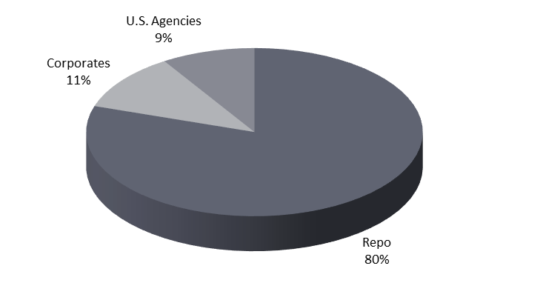
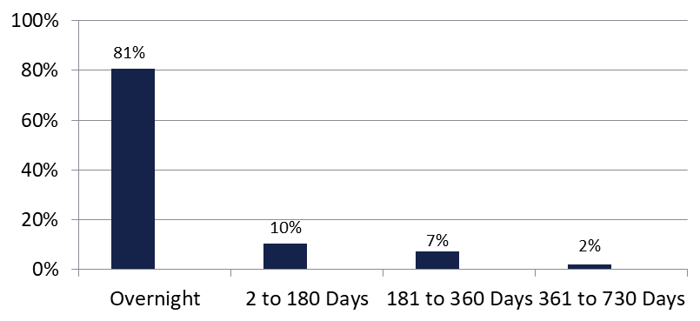

Securities Lending - Cash Collateral Portfolio As of October 31, 2023
Portfolio Characteristics
Credit Quality (S&P) | % of Cost | Cost (in mil.)
U.S. Govt. Securities* | 88.83% | $2,027.5
AAA | 0% | $0
AA | 4.58% | $104.5
A | 6.60% | $150.5
Total Market Value $2,282.5 million
NAV 1.0001
Yield (360 basis) 5.374%
WAM 41 days
* Includes Repos that are collateralized by U.S. Govt. Securities.
Asset Class
Final Maturity Schedule

