Slide 1
Florida State Treasury Investments
October 31, 2022

Slide 2
Treasury Investment Portfolio
 | October 31, 2022
Treasury Investment Portfolio
(Internally and Externally Managed Portfolios) | $57,140,657,604.60 (*Includes $49 million in Rent Assistance Federal funds)

Slide 3
Portfolio Allocation as of
October 31, 2022

Slide 4
Treasury Participants as of October 31, 2022

Slide 5
Net Earnings Rate
(past 12 months)
Rates are unaudited

Slide 6
Annualized Net Earnings Rate as of October 31, 2022
Rates are unaudited

Slide 7
Total Treasury Investment Portfolio Monthly Sector Distribution

Slide 8
Total Treasury Investment Portfolio
Quality Distribution
S&P Ratings
*Includes Repos collateralized with US Government securities

Slide 9
Total Treasury Investment Portfolio
Effective Duration

Slide 10
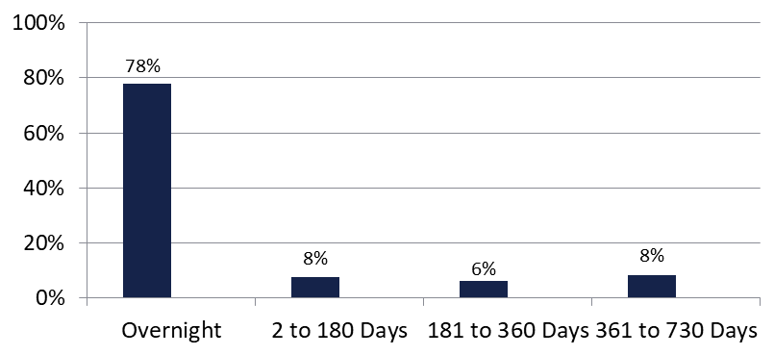

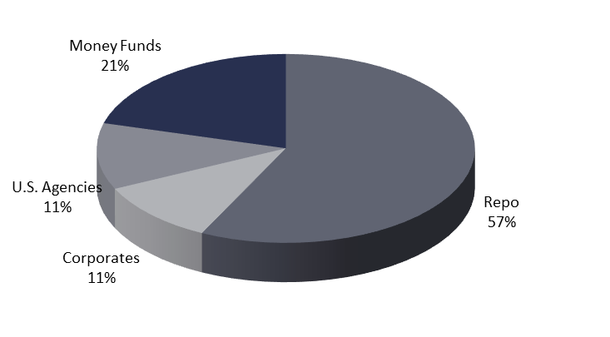
Securities Lending - Cash Collateral Portfolio As of October 31, 2022
Portfolio Characteristics
Credit Quality (S&P) | % of Cost | Cost (in mil.)
U.S. Govt. Securities* | 82.04% | $3,398.3
AAA | 0% | $0
AA | 4.66% | $130.9
A | 13.30% | $273.8
Total Market Value $3,803.0 million
NAV .9999
Yield (360 basis) 3.061%
WAM 1 day
* Includes Repos that are collateralized by U.S. Govt. Securities.
Asset Class
Final Maturity Schedule

