Slide 1
Florida State Treasury Investments
September 30, 2026

Slide 2
Treasury Investment Portfolio
 | September 30, 2026
Treasury Investment Portfolio
(Internally and Externally Managed Portfolios) | $59,710,413,537.53

Slide 3
Portfolio Allocation as of
September 30, 2026

Slide 4
Treasury Participants
as of September 30, 2026

Slide 5
Net Earnings Rate
(past 12 months)

Slide 6
Annualized Net Earnings Rate
as of September 30, 2026

Slide 7
Total Treasury Investment Portfolio Monthly Sector Distribution

Slide 8
Total Treasury Investment Portfolio
Quality Distribution

Slide 9
Total Treasury Investment Portfolio
Effective Duration

Slide 10
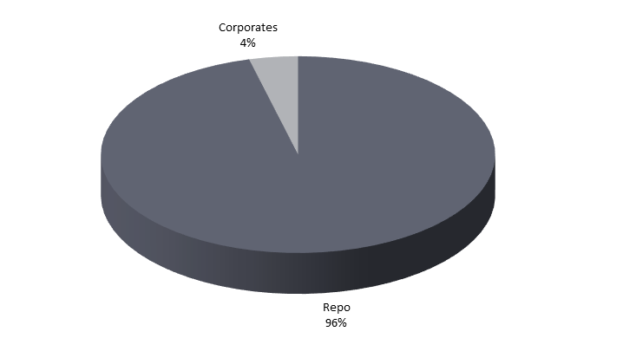

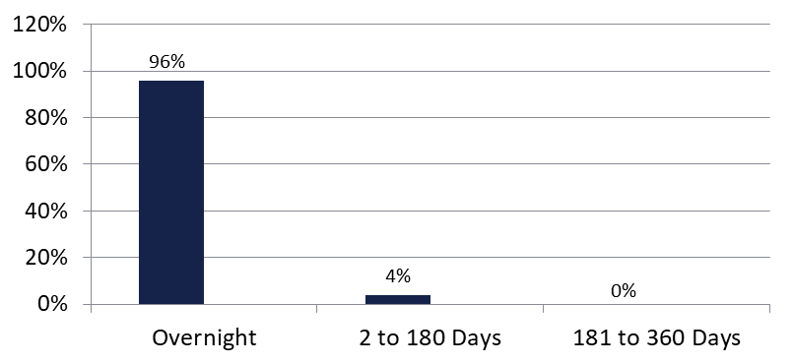
Securities Lending - Cash Collateral Portfolio
As of September 30, 2026
Portfolio Characteristics
Credit Quality (S&P) | % of Cost | Cost (in mil.)
U.S. Govt. Securities* | 96.24% | $508.6
AAA | 0% | $0
AA | 3.76% | $19.9
A | 0% | $0.00
Total Market Value $528.5 million
NAV 1.0000
Yield (360 basis) 3.978%
WAM 2 days
* Includes Repos that are collateralized by U.S. Govt. Securities.
Asset Class
Final Maturity Schedule

