Slide 1
Florida State Treasury Investments
August 31, 2023

Slide 2
Treasury Investment Portfolio
 | August 31, 2023
Treasury Investment Portfolio
(Internally and Externally Managed Portfolios) | $60,960,255,590.56

Slide 3
Portfolio Allocation as of
August 31, 2023

Slide 4
Treasury Participants as of August 31, 2023

Slide 5
Net Earnings Rate
(past 12 months)
Rates are unaudited

Slide 6
Annualized Net Earnings Rate as of August 31, 2023
Rates are unaudited

Slide 7
Total Treasury Investment Portfolio Monthly Sector Distribution

Slide 8
Total Treasury Investment Portfolio
Quality Distribution
S&P Ratings
*Includes Repos collateralized with US Government securities

Slide 9
Total Treasury Investment Portfolio
Effective Duration

Slide 10
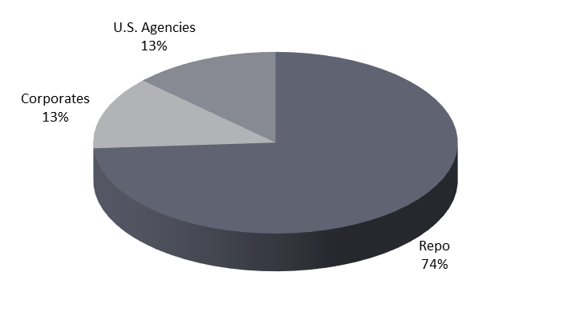
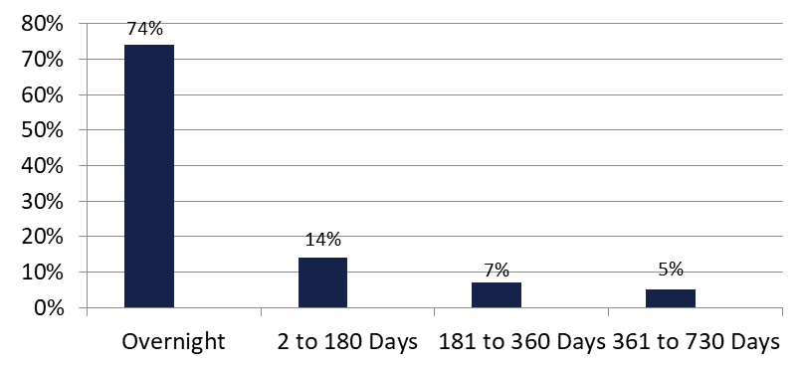

Securities Lending - Cash Collateral Portfolio As of August 31, 2023
Portfolio Characteristics
Credit Quality (S&P) | % of Cost | Cost (in mil.)
U.S. Govt. Securities* | 86.73% | $1,787.8
AAA | 0% | $0
AA | 5.26% | $108.4
A | 8.01% | $165.2
Total Market Value $2,061.4 million
NAV 1.0002
Yield (360 basis) 5.377%
WAM 56 days
* Includes Repos that are collateralized by U.S. Govt. Securities.
Asset Class
Final Maturity Schedule

