Slide 1
Florida State Treasury Investments
June 30, 2025

Slide 2
Treasury Investment Portfolio
 | June 30, 2025
Treasury Investment Portfolio
(Internally and Externally Managed Portfolios) | $64,396,526,452.67

Slide 3
Portfolio Allocation as of
June 30, 2025

Slide 4
Treasury Participants as of June 30, 2025

Slide 5
Net Earnings Rate
(past 12 months)

Slide 6
Annualized Net Earnings Rate as of June 30, 2025
Rates are unaudited

Slide 7
Total Treasury Investment Portfolio Monthly Sector Distribution

Slide 8
Total Treasury Investment Portfolio
Quality Distribution
S&P Ratings
*Includes Repos collateralized with US Government securities

Slide 9
Total Treasury Investment Portfolio
Effective Duration

Slide 10
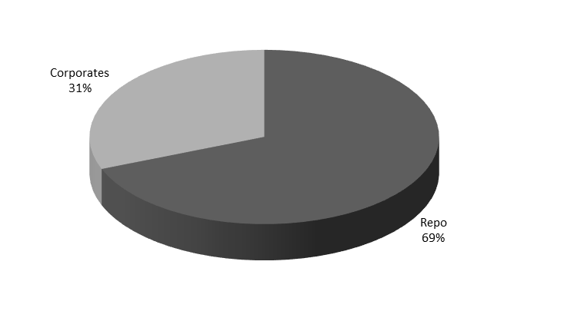
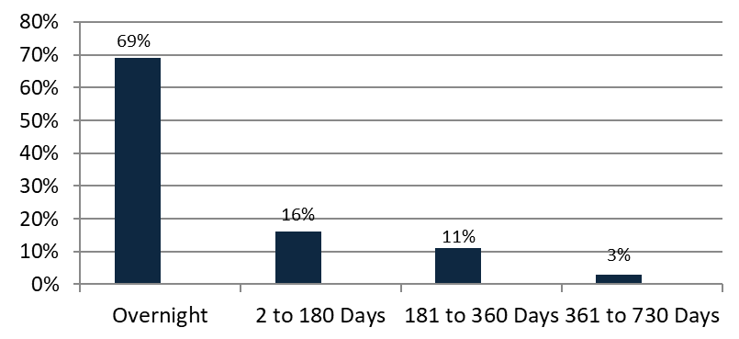

Securities Lending - Cash Collateral Portfolio
As of June 30 , 2025
Portfolio Characteristics
Credit Quality (S&P) | % of Cost | Cost (in mil.)
U.S. Govt. Securities* | 68.94% | $832.8
AAA | 0% | $0
AA | 11.76% | $142.10
A | 19.30% | $233.2
Total Market Value $1,208.1 million
NAV 1.0003
Yield (360 basis) 4.511%
WAM 60 days
* Includes Repos that are collateralized by U.S. Govt. Securities.
Asset Class
Final Maturity Schedule

