Slide 1
Florida State Treasury Investments
May 31, 2026

Slide 2
Treasury Investment Portfolio
 | May 31, 2026
Treasury Investment Portfolio
(Internally and Externally Managed Portfolios) | $63,058,270,327.75

Slide 3
Portfolio Allocation as of
May 31, 2026

Slide 4
Treasury Participants
as of May 31, 2026

Slide 5
Net Earnings Rate
(past 12 months)

Slide 6
Annualized Net Earnings Rate
as of May 31, 2026

Slide 7
Total Treasury Investment Portfolio Monthly Sector Distribution

Slide 8
Total Treasury Investment Portfolio
Quality Distribution

Slide 9
Total Treasury Investment Portfolio
Effective Duration

Slide 10
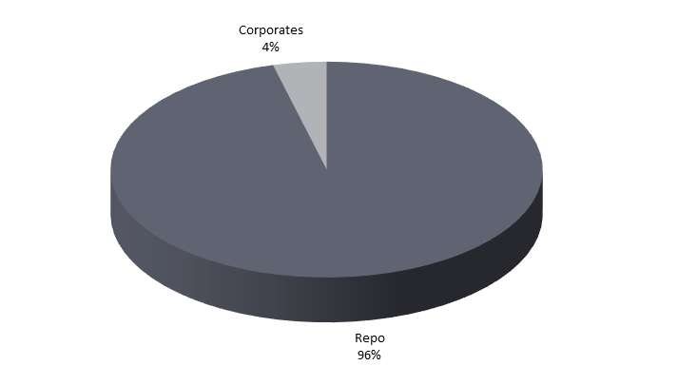
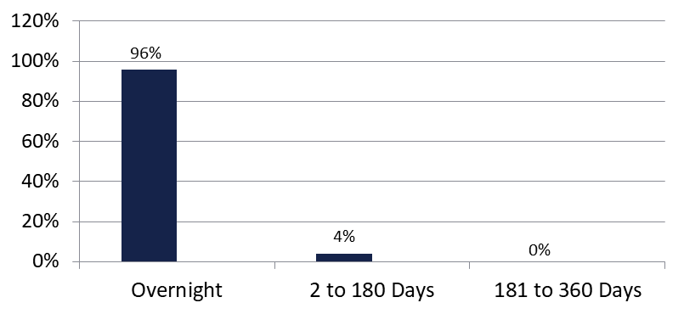

Securities Lending - Cash Collateral Portfolio
As of May 31, 2026
Portfolio Characteristics
Credit Quality (S&P) | % of Cost | Cost (in mil.)
U.S. Govt. Securities* | 95.76% | $989.3
AAA | 0% | $0
AA | 4.24% | $43.8
A | 0% | $0.00
Total Market Value $1,033.1 million
NAV 1.0000
Yield (360 basis) 3.728%
WAM 5 days
* Includes Repos that are collateralized by U.S. Govt. Securities.
Asset Class
Final Maturity Schedule

