Slide 1
Florida State Treasury Investments
March 31, 2026

Slide 2
Treasury Investment Portfolio
 | March 31, 2026
Treasury Investment Portfolio
(Internally and Externally Managed Portfolios) | $60,039,069,849.79

Slide 3
Portfolio Allocation as of March 31, 2026

Slide 4
Treasury Participants as of March 31, 2026

Slide 5
Net Earnings Rate (past 12 months)

Slide 6
Annualized Net Earnings Rate as of March 31, 2026

Slide 7
Total Treasury Investment Portfolio Monthly Sector Distribution

Slide 8
Total Treasury Investment Portfolio Quality Distribution

Slide 9
Total Treasury Investment Portfolio Effective Duration

Slide 10
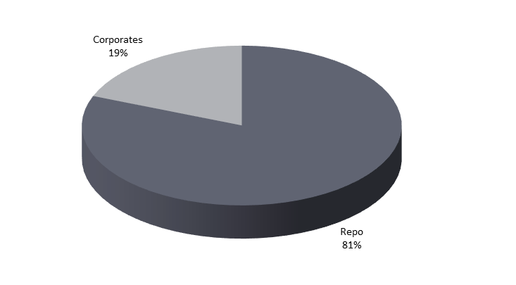
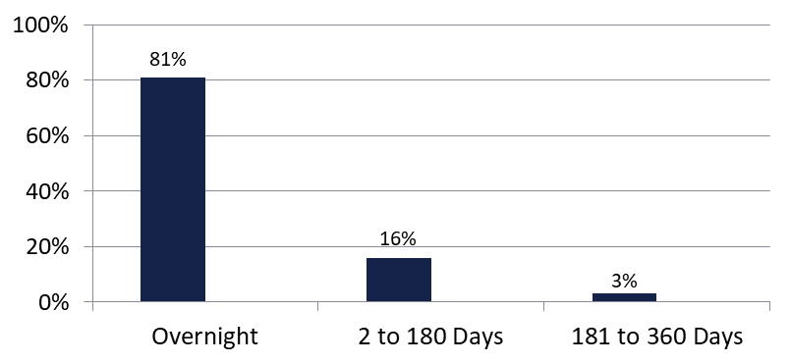

Securities Lending - Cash Collateral Portfolio
As of March 31, 2026
Portfolio Characteristics
Credit Quality (S&P) | % of Cost | Cost (in mil.)
U.S. Govt. Securities* | 80.80% | $555.7
AAA | 0% | $0
AA | 16.00% | $110.0
A | 3.20% | $22.0
Total Market Value $687.7 million
NAV 1.0001
Yield (360 basis) 3.789%
WAM 12 days
* Includes Repos that are collateralized by U.S. Govt. Securities.
Asset Class
Final Maturity Schedule

