Slide 1
Florida State Treasury Investments
February 28, 2023

Slide 2
Treasury Investment Portfolio
 | February 28, 2023
Treasury Investment Portfolio
(Internally and Externally Managed Portfolios) | $61,223,039,439.03 (*Includes $49 million in Rent Assistance Federal funds)

Slide 3
Portfolio Allocation as of
February 28, 2023

Slide 4
Treasury Participants as of February 28, 2023

Slide 5
Net Earnings Rate
(past 12 months)
Rates are unaudited

Slide 6
Annualized Net Earnings Rate as of February 28, 2023
Rates are unaudited

Slide 7
Total Treasury Investment Portfolio Monthly Sector Distribution

Slide 8
Total Treasury Investment Portfolio
Quality Distribution
S&P Ratings
*Includes Repos collateralized with US Government securities

Slide 9
Total Treasury Investment Portfolio
Effective Duration

Slide 10
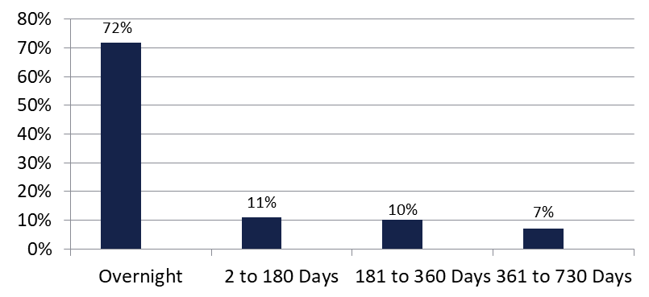

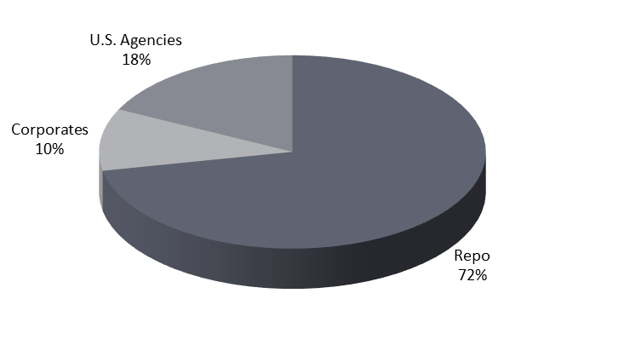
Securities Lending - Cash Collateral Portfolio As of February 28, 2023
Portfolio Characteristics
Credit Quality (S&P) | % of Cost | Cost (in mil.)
U.S. Govt. Securities* | 89.62% | $2,051.9
AAA | 0% | $0
AA | 3.84% | $88.0
A | 6.54% | $149.7
Total Market Value $2,289.6 million
NAV 1.0002
Yield (360 basis) 4.608%
WAM 75 days
* Includes Repos that are collateralized by U.S. Govt. Securities.
Asset Class
Final Maturity Schedule

