Slide 1
Treasury Investment Council
Meeting Date: May 12, 2022

Slide 2
Topics
Florida Economy and Pool Balance
Update on Team
Treasury Initiatives
Markets Review / Allocation of Assets
Relative Performance and Distributed Earnings and
Pool characteristics (risks)

Slide 3
Florida Economy
The unemployment rate spiked to 14.2 percent in May 2020, handily surpassing the prior peak of 10.9% in 2010.
December unemployment rate:
  U.S. 4.5%
  FL: 5.6%
    Employment dropped by over 1.2 million jobs from February 2020 to April 2020, a decline of 14.0 percent
Population growth is typically the state’s primary engine of economic growth, fueling both employment and income growth.
  Florida’s population growth was strong over the second half of the decade. Between April 1, 2018 and 2019 population grew by 334,904 residents (1.61%), while between April 1, 2019 and 2020 the state added 348,338 residents (1.64%).

Slide 4
FL Treasury Investment Pool Size
(past 10 years)

Slide 5
Federal Money Received
Portfolio | Total Amount | Dates
CARES ACT Money | $5.9 billion | April 2020
CARE ACT - Rent Assistance Program | $871 million | January 2021
American Rescue Plan | $4.8 billion | May 2021
Total | $11.6 billion
Future Inflows: approx. $5 billion in May / June 2022 (part II of ARP money)

Slide 6
State Net Receipts
(Including Federal Stimulus)

Slide 7
Team Update
  Jackson Vescelus and Andrew Davis joined the Investments team in February and March respectively.
  Open positions:
      Administrator of the External Managers Program.
      Compliance Officer
      New Credit Analyst position being created in July

Slide 8
Current Initiatives
Investment Accounting system:
  PALM for general State accounting / new providers for Investment Accounting solution
  Currently evaluating two Investment Accounting providers
Hiring of two new Intermediate Duration Managers:
  Currently evaluating top firms RFPs
  Followed by formal in-person presentations and selection of the two winning Firms
  Due diligence to be conducted by Treasury / Verus and
  Contract signing and funding of the new Managers.

Slide 9
Current Initiatives (continued)
Adding exposure to Asset Backed Securities in our Internally Managed accounts:
  Decision was made to create a separately managed account(s) to invest in this space
  Ultra Short and Short Duration will own totality of this account
  Currently having conversations with BNY Mellon, Bloomberg AIM and Accounting area to see the most efficient way to create and operationalize this new SMA account(s)
Continue to look for ways to minimize trading costs:
    Adding a new Treasury platform (MarketAxess Rates)
    Maximizing open trading
    Increased use of internal swing trades

Slide 10
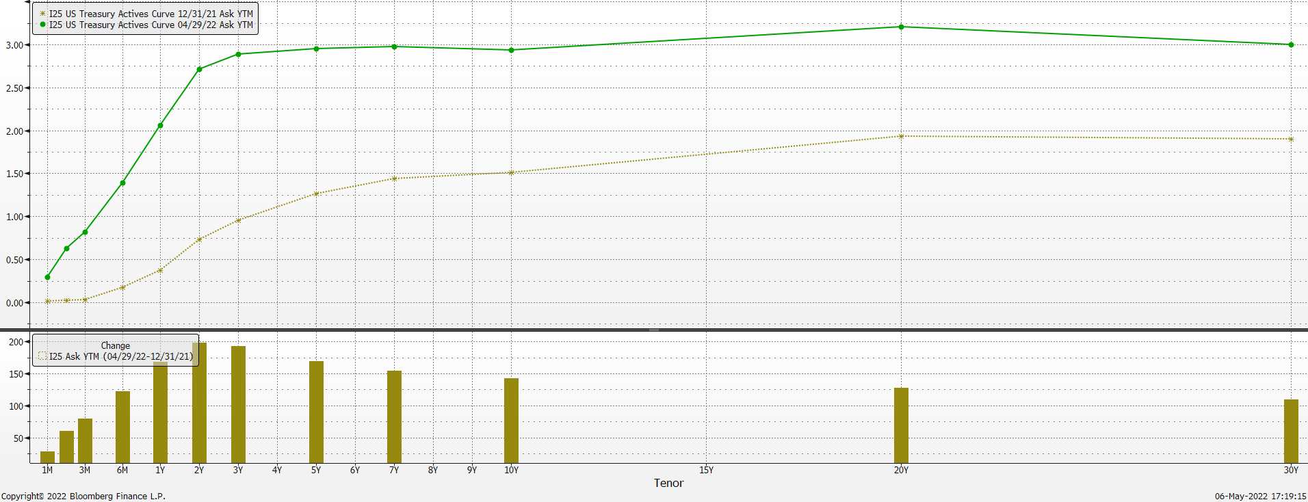
Treasury Yield Curve change YTD

Slide 11
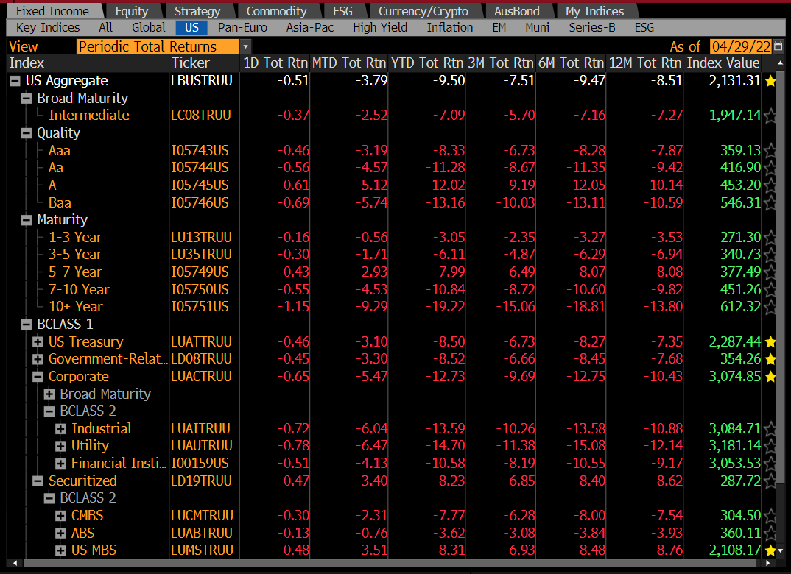
U.S. Fixed Income Markets YTD

Slide 12
Investment Strategy Adopted
Maintained significant amounts of cash while waiting for stability in markets:
 | Pre Covid | End of April 2022
% of Pool in Liquidity and Ultra Short Duration accounts | 35% - 40% | 55%
Increased CP limits for Liquidity account:
    Overall limit increased from $750 million to $1.2 billion
    Single issuer exposure increased by $100 million (AA) and $50 million (A)
Taking advantage of the very steep yield curve in the 0 to 2 year area:
    Moving $7 bln from Liquidity to Ultra Short Duration account
    Implementing a barbell structure to invest surplus moneys within the Liquidity account
Reduced exposure to the longer duration accounts

Slide 13
Investment Pool Allocation
(Pre-Covid vs. Current)

Slide 14
Reallocation of Assets
From Liquidity Portfolio to:
Portfolio | Total Amount | 2021
Ultra Short Duration | $3.35 billion | Feb, Mar, Apr, Jun, Jul, Oct, Nov
Short Duration | $1.5 billion | Feb, Mar, Jun, Jul, Oct, Nov
Intermediate Duration | $3.2 billion | April, Jul, Oct, Nov
Long Duration | $3.8 billion | Jun, Jul, Oct, Nov
Total | $11.85 billion
Portfolio | Total Amount | 2022
Ultra Short Duration | $4.0 billion | Feb and April
Short Duration | $0.5 billion | April
Total | $4.5 billion

Slide 15
Q4 2021 & Q1 2022 Total Returns vs Benchmarks (excl. Time Deposits)

Slide 16
1 Year Total Return Performance ending March 31, 2022

Slide 17
3 Year Total Return Performance ending March 31, 2022

Slide 18
5 Year Total Return Performance ending March 31, 2022

Slide 19
Investment Pool
Distributed Income
Average Balance
Average Return (net of fees)
$21.0 billion | $22.3 billion | $23.6 billion | $24.7 billion | $23.3 billion | $24.1 billion | $26.5 billion | $32.8 billion | $46.1 billion
0.98% | 1.46% | 1.42% | 1.45% | 1.66% | 2.32% | 3.16% | 1.61% | 0.73%

Slide 20
Distributed Income Detail

Slide 21
Pool Key Characteristics

Slide 22
Intermediate Duration Portfolio Net of Fee Performance as of March 31, 2022
Intermediate Duration Portfolio
 | % of |  | Mgr |  |  |  |  |  |  |  |  | Annualized
 | Inv. Pool | Market Value | Rank* | 1 Month |  | 3 Month |  | 6 Month |  | 1 Year |  | 2 Year |  | 3 Year |  | 5 Year |  | 7 Year
IR+M | 3.30% | $1,628,700,202.64 | 4 | -2.401% | 3 | -4.562% | 3 | -5.112% | 3 | -4.269% | 4 | -0.455% | 2 | 1.691% | 2 | 1.984% | 3 | 1.793% | 3
Galliard | 3.09% | $1,521,787,764.37 | 3 | -2.508% | 4 | -4.654% | 4 | -5.185% | 4 | -4.238% | 3 | -0.734% | 3 | 1.588% | 4 | 2.003% | 2 | 1.865% | 1
Sterling Capital | 2.89% | $1,426,946,207.22 | 2 | -2.348% | 2 | -4.416% | 2 | -4.958% | 2 | -3.876% | 1 | -0.257% | 1 | 1.744% | 1 | 2.071% | 1 | 1.856% | 2
MetWest | 2.72% | $1,340,057,578.38 | 1 | -2.302% | 1 | -4.351% | 1 | -4.753% | 1 | -4.040% | 2 | -0.952% | 4 | 1.671% | 3 | 1.982% | 4 | 1.757% | 4
Total | 12.00% | $5,917,491,752.61 |  | -2.394% |  | -4.503% |  | -5.013% |  | -4.114% |  | -0.569% |  | 1.672% |  | 2.013% |  | 1.821%
Benchmark |  |  |  | -2.508% |  | -4.689% |  | -5.170% |  | -4.381% |  | -1.541% |  | 1.214% |  | 1.638% |  | 1.524%
* Based on 1, 3 and 5 Year Risk Adjusted Rankings.

Slide 23
Long Duration Portfolio Net of Fee
Performance as of March 31, 2022
Long Duration Portfolio
 | % of | Market Value | Mgr |  |  |  |  |  |  |  |  | Annualized
 | Inv. Pool |  | Rank* | 1 Month |  | 3 Month |  | 6 Month |  | 1 Year |  | 2 Year |  | 3 Year |  | 5 Year |  | 7 Year |  | 10 Year |  | 15 Year |  | 20 Year |  | 25 Year
Galliard | 3.31% | $1,629,870,316.83 | 2 | -2.848% | 12 | -5.739% | 7 | -5.706% | 7 | -3.677% | 3 | -0.717% | 8 | 2.428% | 1 | 2.742% | 1 | 2.434% | 1 | 2.828% | 1
Sterling Capital | 3.17% | $1,563,192,869.43 | 7 | -2.401% | 3 | -5.705% | 5 | -5.812% | 9 | -3.843% | 8 | -0.252% | 2 | 2.175% | 6 | 2.603% | 4 | 2.346% | 2 | 2.630% | 3 | 4.076% | 3
Fidelity | 2.86% | $1,411,741,967.17 | 1 | -2.530% | 6 | -5.361% | 1 | -5.243% | 1 | -3.387% | 1 | -0.703% | 5 | 2.393% | 2 | 2.641% | 2 | 2.276% | 3 | 2.558% | 4 | 4.157% | 2 | 4.565% | 1 | 5.096% | 2
Manulife | 2.51% | $1,238,469,766.60 | 6 | -2.560% | 7 | -5.574% | 4 | -5.581% | 5 | -3.913% | 9 | -0.975% | 12 | 2.064% | 9 | 2.526% | 7 | 2.205% | 7 | 2.498% | 8 | 3.935% | 5 | 4.422% | 3 | 4.976% | 3
Blackrock | 2.46% | $1,212,690,177.23 | 5 | -2.668% | 11 | -5.982% | 11 | -5.972% | 10 | -4.152% | 11 | -0.749% | 9 | 2.306% | 4 | 2.593% | 5 | 2.195% | 8 | 2.453% | 9 | 3.811% | 7 | 4.257% | 6 | 4.923% | 4
Amundi | 2.36% | $1,164,012,858.05 | 11 | -2.645% | 8 | -5.965% | 10 | -6.031% | 11 | -4.100% | 10 | -0.032% | 1 | 2.118% | 7 | 2.445% | 8 | 2.238% | 4 | 2.687% | 2 | 4.162% | 1 | 4.545% | 2 | 5.123% | 1
Wells Capital | 2.31% | $1,140,119,609.11 | 3 | -2.658% | 10 | -5.786% | 9 | -5.684% | 6 | -3.744% | 6 | -0.708% | 6 | 2.333% | 3 | 2.610% | 3 | 2.228% | 5 | 2.531% | 6 | 3.919% | 6
PGIM | 2.21% | $1,088,500,100.39 | 12 | -2.658% | 9 | -6.217% | 12 | -6.233% | 12 | -4.201% | 12 | -0.361% | 3 | 1.927% | 12 | 2.406% | 10 | 2.129% | 10 | 2.554% | 5 | 3.980% | 4
Western Asset | 1.83% | $901,070,157.39 | 10 | -2.176% | 1 | -5.434% | 2 | -5.528% | 3 | -3.743% | 5 | -0.498% | 4 | 2.004% | 10 | 2.439% | 9 | 2.178% | 9 | 2.524% | 7 | 3.761% | 10 | 4.271% | 4 | 4.897% | 5
Goldman Sachs | 1.67% | $823,639,191.56 | 4 | -2.470% | 5 | -5.718% | 6 | -5.536% | 4 | -3.734% | 4 | -0.792% | 10 | 2.259% | 5 | 2.576% | 6 | 2.211% | 6 | 2.407% | 11 | 3.768% | 9 | 4.257% | 5 | 4.864% | 6
Nuveen | 0.87% | $429,591,318.21 | 9 | -2.373% | 2 | -5.472% | 3 | -5.418% | 2 | -3.533% | 2 | -0.714% | 7 | 1.977% | 11 | 2.353% | 12 | 1.972% | 12 | 2.337% | 12 | 3.778% | 8 | 4.169% | 7 | 4.782% | 7
Insight Investment | 0.47% | $230,445,568.64 | 8 | -2.452% | 4 | -5.752% | 8 | -5.733% | 8 | -3.829% | 7 | -0.890% | 11 | 2.107% | 8 | 2.371% | 11 | 2.025% | 11 | 2.417% | 10
Total | 26.03% | $12,833,343,900.61 |  | -2.568% |  | -5.734% |  | -5.722% |  | -3.828% |  | -0.590% |  | 2.184% |  | 2.526% |  | 2.203% |  | 2.510% |  | 3.777% |  | 4.222% |  | 4.798%
Benchmark |  |  |  | -2.778% |  | -5.934% |  | -5.923% |  | -4.152% |  | -1.751% |  | 1.689% |  | 2.143% |  | 1.872% |  | 2.240% |  | 3.559% |  | 4.004% |  | 4.616%
* Based on 1, 3 and 5 Year Risk Adjusted Rankings.

Slide 24
Pool Key Characteristics

Slide 25
Total Pool Characteristics

Slide 26
BBB Exposure
 | Exposure 10/31/2021 | Exposure 3/30/2022 | Limit
Ultra Short Duration | 1.2% | 1.0% | 3%
Short Duration | 4.7% | 3.8% | 7.5%
Intermediate Duration | 8.9% | 10.0% | 10%
Long Duration | 12.6% | 13.6% | 15%
144a Exposure
 | Total | % of Pool
Total 144a exposure as of Oct. 31, 2021 | $833 million | 1.9%
Total 144a exposure as of Mar. 31, 2022 | $1,438 million | 2.9%

Slide 27
Basket Clause
Statutes allow for 3% in basket clause items

Slide 28
Pool Rating
Policy requirement: A+ or better using S&P rating matrix
S&P Rating as of March 31, 2021 = AA-f
Credit Score as of February 28, 2022 = 53.74 (AAf) (vs. 49.87 Sep. 30, 2021)
S&P rating matrix
Maximum Score | Rating
18.49 | AAAf
37.49 | AA+f
58.49 | AAf
91.49 | AA-f
120.49 | A+f
184.49 | Af
290.49 | A-f
360.49 | BBB+f

