Slide 1
Treasury Investment Council
Meeting Date: November 17, 2022

Slide 2
Florida Economy &
Pool Balances

Slide 3
Florida Economy
December unemployment rate:
  U.S. 3.6%
  FL: 2.8%
Home Ownership--The most recent data for 2021 indicates that the state had notably fallen below the prior year’s level to 67.2 percent; however, this percentage is still above Florida’s long-run average. The first two quarters of 2022 are showing a similar level of 67.3 percent.
  Documentary Stamp Tax collections in FY 2020-21 topped the FY 2005-06 peak reached at the height of Florida’s housing boom.
Consumer Perceptions -- Nationally, the sentiment reading for June 2022 (50.0) dropped to its lowest point since the current series began and well below the Great Recession depths. The lowest point prior to June 2022 was May 1980 at 51.7 during a period with high inflation, rising interest rates, high unemployment and a recession induced in part by the 1979 energy crisis.

Slide 4
FL Treasury Investment Pool Size
(total mkt. value)

Slide 5
Federal Money Received
Portfolio | Total Amount | Dates
CARES ACT Money | $5.9 billion | April 2020
CARE ACT - Rent Assistance Program | $871 million | January 2021
American Rescue Plan – Part I | $4.4 billion | May 2021
American Rescue Plan – Part II | $4.4 billion | May 2022
Total | $15.6 billion

Slide 6
State Net Receipts
(Including Federal Stimulus)

Slide 7
State Operating Accounts

Slide 8
Non-State Operating Accounts*
* Subject to Floor Provision

Slide 9
Bond Accounts

Slide 10
Team Update &
Treasury Initiatives

Slide 11
Team Update
  Thomas Wolff has joined as the new Compliance Officer

Slide 12
Current Initiatives
Investment Accounting system:
  Completed evaluation of the best two Investment Accounting providers. Clearwater Analytics was selected.
  Contract signed and started implementation which involves integration with:
    BNY Mellon (as custody bank), Bloomberg AIM (order management system) and PALM (as general ledger for State)

Slide 13
Current Initiatives (continued)
Hiring of two new Intermediate Duration Managers:
  Completed the selection process. Firms selected:
    Reams Asset Management
    Wellington Management Co
  Treasury’s Investment Manager Agreement (IMA) was revised and updated
  Currently finishing Contract signing and opening the two new accounts in BNY and AIM.
  Funding will take place on December 1st and January 3rd.

Slide 14
Current Initiatives (continued)
Adding exposure to Asset Backed Securities in our Internally Managed accounts:
  Ultra Short and Short Duration will own totality of these accounts. Decided the portfolio permissible ranges for this sector:
        Ultra Short Duration: 0% to 10%
        Short Duration: 0% to 20%
  Decided to create two (instead of one) separately managed accounts to invest in this space
  Finalized Investment Policy and benchmark selection for this new mandate (see next three slides)
  Decided on Manager Fee structure
  Narrowed number of finalists from initial 20 to 6 firms that are currently responding to an RFP
  Final steps: selection of the finalist Firm / Contract signing / Funding
  Expected date of initial funding: January 3rd 2023

Slide 15
Investment Policy for Asset-Backed Securities Portfolio
OBJECTIVES:
The objective of the Asset-Backed Securities Portfolio is to be actively managed, to provide total net rate of return in excess of the benchmark, while maintaining an effective duration of less than 3 years.
PERMITTED SECURITIES
Investment Vehicles and Restrictions – All securities must be U.S. dollar-denominated
Only those securities identified below may be purchased.
Asset-Backed Securities
Must be registered with the SEC or issued under Rule 144A.
Must be rated in the highest rating classification (AAA/Aaa) by at least two nationally recognized rating services.
ABS containing any mortgage related Sub-prime or Alt-A components are not permitted.
Subprime Auto ABS is restricted to the following:
  Bank entity issuer or captive finance companies of automakers only
  Weighted Average life less than two (2) years
  Minimum per issue size of $500 million and a minimum of $2 billion outstanding ABS issues
  Limited to sequential pay trusts.
The securities of any one Trust shall not comprise more than 2.0% of the account’s market value.
SECTOR ALLOCATION
Securities within the asset-backed sector will comprise 100% of the sector allocation. Investment in securities of sectors other than the Asset-Backed Securities sector is prohibited with the exception of Cash Equivalent securities. For purposes of cash securities implementation, the Manager will participate in the Florida Treasury Cash Sweep Program. Investment in the Cash Equivalent securities sector is limited to 2% maximum as Cash Equivalent securities should only be used for frictional transaction purposes. The target allocation to Cash Equivalent securities is 0%.

Slide 16
Investment Policy for Asset-Backed Securities Portfolio (continued)
OTHER RESTRICTIONS
Options, Futures, Swaps or any derivative products, Reverse Repurchase Agreements, Repurchase Agreements, Collateralized Debt Obligations, Collateralized Bond Obligations, Collateralized Loan Obligations, Structured Investment Vehicles, Special Purpose Entity Obligations, swaps or other derivative contracts and any securities collateralized with any portion of Alt-A or Sub-Prime Mortgages are not permitted.
Florida Treasury does not permit the use of Soft Dollar agreements in conjunction with trading in our portfolios by any manager.
No explicit or implicit use of leverage is permitted.
No securities issued by the entities on the list of “Scrutinized Companies”, as provided by Protecting Florida’s Investments Act (PFIA) (F.S. 215.473), may be purchased or held in the portfolio.
No securities issued by entities on the list of “Scrutinized Companies that Boycott Israel” as provided by the prohibited investments by the Florida State Board of Administration (SBA); Companies that Boycott Israel (F.S. 215.4725).
Monthly net realized losses are limited to a maximum of 75% of a Manager’s income unless approved by the Treasury.
RATING LIMITS
Each Asset-Backed Securities Manager account should hold 100% of the market value in securities rated within the AAA range by at least two nationally recognized rating services.
MAXIMUM DURATION
The account’s effective duration must be less than three (3) years.
REQUESTS FOR CONSENT, NO OPT-OUT PROVISIONS
Managers are not permitted, under any circumstances, to include an Opt-Out clause, wherein consent is deemed to be granted if no response is provided within a designated time frame, when requesting Treasury’s consent to any change. Managers requesting Treasury’s consent to any modification or change to the Investment Manager Agreement (i.e., Consent to Assignment), operational activities or any related matter (i.e., cross trading, etc.) must obtain written approval before consent is deemed granted.

Slide 17
Investment Policy for Asset-Backed Securities Portfolio (continued)
Monthly Compliance Certification
Managers will be required to provide to Treasury a signed monthly certification that:
  All assets held in their account are either in compliance with applicable Florida Statutes and this Investment Policy, or have been approved for Basket Clause status, or are in the process of review for Basket Clause consideration with the Investment Work Group,
  No securities issued by the entities on the list of “Scrutinized Companies”, as provided by Protecting Florida’s Investments Act (PFIA), are held in the portfolio.
EVALUATION
The investment performance of the individual Asset-Backed Securities Managers will be evaluated by comparison with the ICE BofA AAA Asset-Backed Securities Index on a total return basis and against the other managers in the Program. Treasury will incorporate risk measures as deemed appropriate in the evaluation process comparing Program managers to their peers, as well as managers in comparable fixed income universes.

Slide 18
Securities Lending
Review

Slide 19
SECURITIES LENDING OVERVIEW
as of September 30, 2022
 | Market Value Securities on Loan | Market Value Collateral Received | Collateral Coverage | Market Value of Cash Reinvestments | NAV
Cash | $2,402,165,098 | $2,453,370,779 | 102.13% | $2,453,030,688 | 0.9999
Non - Cash | $4,034,175,469 | $4,149,951,877 | 102.87% | N/A | N/A
Total | $6,436,340,568 | $6,603,322,655

Slide 20
Securities Lending Income

Slide 21
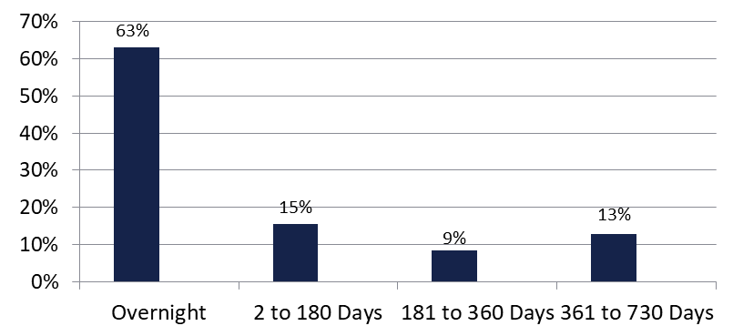

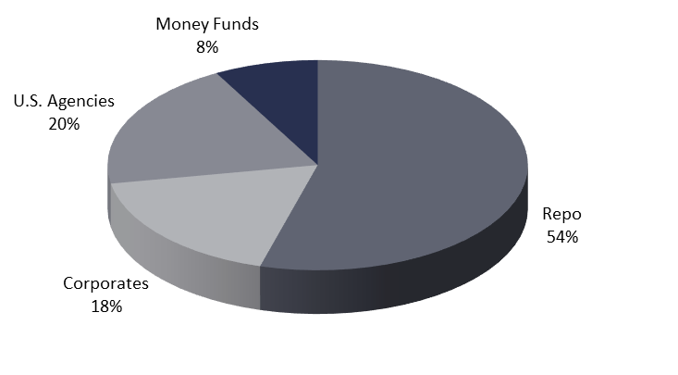
Securities Lending - Cash Collateral Portfolio As of September 30, 2022
Portfolio Characteristics
Credit Quality (S&P) | % of Cost | Cost (in mil.)
U.S. Govt. Securities* | 82.04% | $2,012.7
AAA | 0% | $0
AA | 4.66% | $114.4
A | 13.30% | $326.3
Total Market Value $2,453.4 million
NAV .9999
Yield (360 basis) 3.008%
WAM 5 days
* Includes Repos that are collateralized by U.S. Govt. Securities.
Asset Class
Final Maturity Schedule

Slide 22
Investment Pool
Review

Slide 23
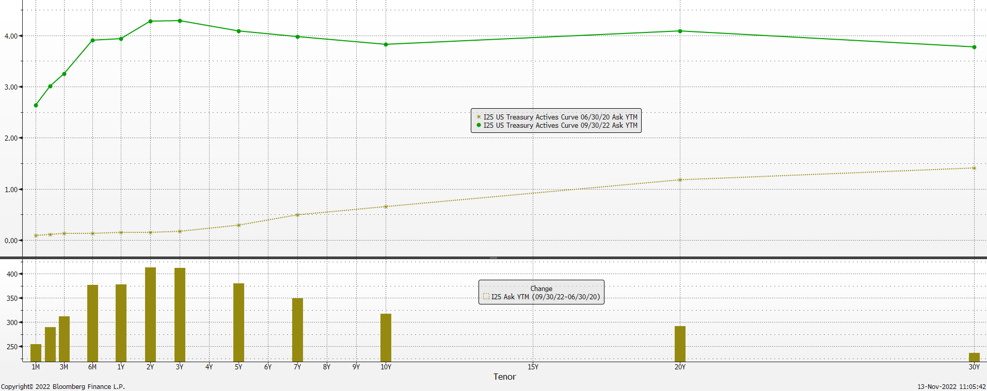
Treasury Yield Curve change (Jun 2020 vs Sep 2022)

Slide 24
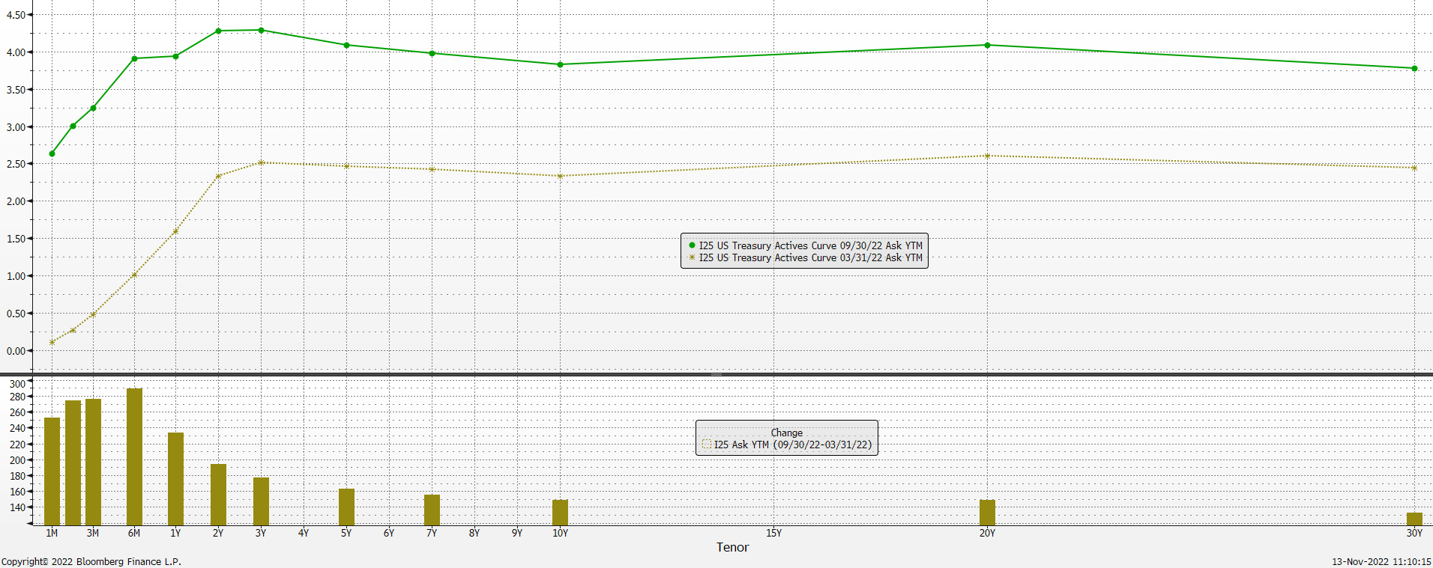
Treasury Yield Curve change (March 31 vs Sep. 30, 2022)

Slide 25
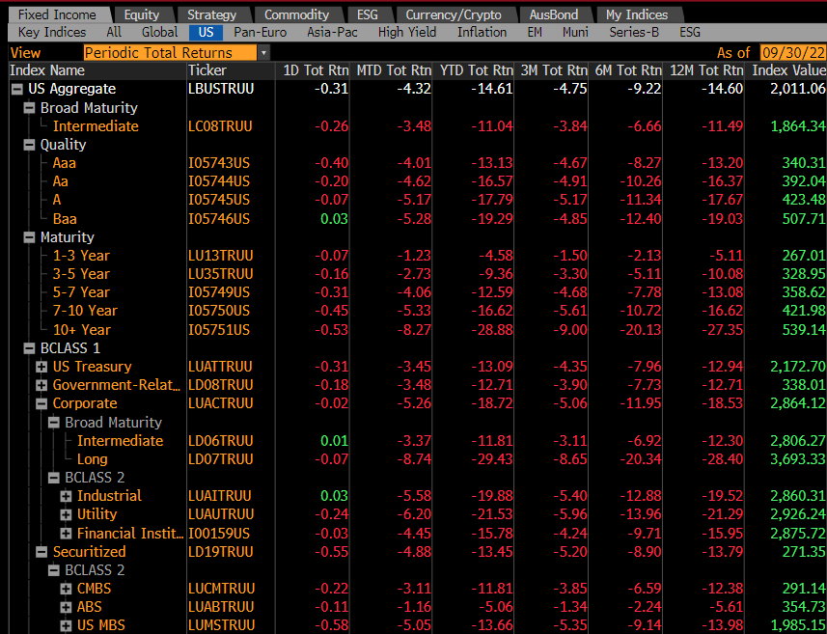
U.S. Fixed Income Markets Returns

Slide 26
Investment Strategy (Macro level)
Maintained a conservative allocation profile to protect against the rising interest rate environment:
  Keeping an elevated % of the pool in the shortest duration portfolios:
 | Pre-Covid | End of Sep 2022
% of Pool in Liquidity and Ultra Short Duration accounts | 35% - 40% | 53%
Maintained reduced exposure to the Long Duration account

Slide 27
Investment Pool Allocation
(Pre-Covid vs. Current)

Slide 28
Reallocation of Assets
From Liquidity Portfolio to:
Portfolio | 2021 | 2022 | Total
Ultra Short Duration | $3.35 billion | $4.0 billion + $1 billion* | $8.35 billion
Short Duration | $1.5 billion | $0.5 billion + $1 billion* | $3.0 billion
Intermediate Duration | $3.2 billion | $1 billion* | $4.2 billion
Long Duration | $3.8 billion | $3.25 billion* | $7.05 billion
 |  | Total | $22.6 billion
* Since last Investment Council Meeting (May 2022)

Slide 29
Portfolio % vs. Allocation Ranges as of September 30, 2022
* avg. of previous 12 end-of-month balances for Liquidity Portfolio.

Slide 30
Investment Strategy (Macro level)
Took advantage of the steepness of the yield curve in the 0 to 2-year area. Increased yield and earnings power in the front end to allow higher duration portfolios to exceed loss limits and accelerate repositioning. This was done by:
    Moving $8.4 billion from Liquidity to Ultra Short Duration account
    Implementing a laddered structure to invest surplus moneys within the Liquidity account
Allowed Managers to go over the realized loss constraint

Slide 31
Liquidity Portfolio Income Earned

Slide 32
Distributed Income Detail (YTD)

Slide 33
Investment Pool
Distributed Income
Pool Average Balance (in billions)
Average Return (net of fees)
$21.0 | $22.3 | $23.6 | $24.7 | $23.3 | $24.1 | $26.5 | $32.8 | $48.3 | $60.5
0.98% | 1.46% | 1.42% | 1.45% | 1.66% | 2.32% | 3.16% | 1.61% | 0.73% | 1.13%

Slide 34
Investment Pool Q2 2022 & Q3 2022 Total Return
(excl. Time Deposits)

Slide 35
5-Year Total Return Performance ending September 30, 2022

Slide 36
Fixed Income Yields and Spreads
December 2021 vs September 2022
Yield (%)

Slide 37
Investment Strategy (Macro level)
Laying the foundation for sustainable higher returns:
  Planning to increase allocation % to the Intermediate and Long Duration accounts to take advantage of the higher yielding investment opportunities:
    $2 billion to fund new Intermediate Duration Managers (15% of Pool)
    $3 billion in the Q1 2023 to the Long Duration mandate (30% of Inv. Pool)
  Continue to allow external Managers to exceed the realized loss constraint
Will start seeing the benefits of adding ABS to the Ultra Short and Short Duration
Other small changes to Investment Policies:
  Increased the Intermediate and Long Duration maximum duration:
    Inter. Duration from 4.5 to 5 years and Long Duration from 6 to 7 years

Slide 38
Total Pool Characteristics

Slide 39
BBB Exposure
 | Exposure 3/31/2022 | Exposure 9/30/2022 | Limit
Ultra Short Duration | 1.07% | 0.38% | 3%
Short Duration | 3.8% | 3.07% | 7.5%
Intermediate Duration | 10.0% | 8.56% | 10%
Long Duration | 13.6% | 12.16% | 15%
144a Exposure
 | Total | % of Pool
Total 144a exposure as of Oct. 31, 2021 | $833 million | 1.9%
Total 144a exposure as of Mar. 31, 2022 | $1,438 million | 2.9%
Total 144a exposure as of Sept. 30, 2022 | $1,546 million | 2.7%

Slide 40
Basket Clause
Statutes allow for 3% in basket clause items

Slide 41
Pool Rating
Policy requirement: A+ or better using S&P rating matrix
S&P Rating as of August 31, 2021 = AA-f
Credit Score as of August 31, 2022 = 49.09 (AAf) (vs. 53.74 Feb. 28, 2022)
S&P rating matrix
Maximum Score | Rating
18.49 | AAAf
37.49 | AA+f
58.49 | AAf
91.49 | AA-f
120.49 | A+f
184.49 | Af
290.49 | A-f
360.49 | BBB+f

Slide 42
Individual Mandates Review

Slide 43
Liquidity Portfolio (as of Sep. 30, 2022)
Liquidity Portfolio
Primary goal is to provide funds to cover disbursements and help the entire pool maximize income. Performance versus benchmark is sometimes a secondary concern.
Prefunded big outflows related to new external managers funding. Increased earnings (yield) to allow other portfolios to realize higher losses.
The result was extension into the 3 to 12-month area which led to significantly higher earnings but increased interest rate risk.
The portfolio was also buying longer than benchmark securities from other portfolios to avoid selling these higher yielding investments into a somewhat illiquid market.
There were also several unexpected large payments that require securities to be sold at a disadvantageous level.
The portfolio fulfilled its mission of liability covering and earnings generation but due to the significant rise in 3 to 12-month treasury rates, it underperformed its very short duration benchmark (0 to 3-month T-bill).
The achieved portfolio’s yield advantage will lead to significant outperformance once short rates stop their ascending trajectory.
 | 6 Mo* | 1 Year | 3 Year | 5 Year
Portfolio | 0.29 | 0.30 | 0.46 | 1.06
Benchmark | 0.48 | 0.65 | 0.56 | 1.10
Excess Return | -0.19 | -0.35 | -0.10 | -0.04
Information provided by BNY Mellon.
* not annualized.
Key Characteristics (as of 11/16/22)
 | Yield | 0-3 month % | 4-12 month % | Duration
Portfolio | 4.5% | 56% | 44% | 0.31
Benchmark | 3.7% | 100% | 0% | 0.12

Slide 44
Ultra-Short & Short Duration Portfolios (as of Sep. 30, 2022)
Ultra Short Portfolio
Strategies adopted that led to outperformance for these two Internally Managed portfolios:
  Kept an overall short duration position. Slight overweight to the 3 and 4-year part of the curve and underweight to the 2-year area. Currently, starting to reduce duration underweight in the Short Duration account.
  Maintaining yield advantage by being slightly overweight in single A or better corporate bonds. Reduced exposure to BBB.
  Preference for financials over industrials / utility sectors.
  Historically low overweight to credit while waiting for better re-entry level.
  New purchases done almost exclusively in the primary market to take advantage of reasonable new issue concession.
  Maximized the use of “swing” trades to save on trading costs.
  Benefiting from ability to distribute higher losses thanks to Liquidity account earnings.
 | 6 Mo* | 1 Year | 3 Year | 5 Year
Portfolio | -0.80 | -2.01 | 0.19 | 0.97
Benchmark | -0.81 | -2.04 | 0.14 | 0.91
Excess Return | 0.01 | 0.03 | 0.05 | 0.06
Short Duration Portfolio
 | 6 Mo* | 1 Year | 3 Year | 5 Year
Portfolio | -2.06 | -4.79 | -0.33 | 0.74
Benchmark | -2.11 | -4.93 | -0.42 | 0.67
Excess Return | 0.05 | 0.14 | 0.09 | 0.07
Information provided by BNY Mellon.
* not annualized.

Slide 45
Intermediate Duration Portfolio Net of Fee Performance as of September 30, 2022
 | % of |  | Mgr |  |  |  |  |  |  |  |  | Annualized
 | Inv. Pool | Market Value | Rank* | 1 Month |  | 3 Month |  | 6 Month |  | 1 Year |  | 2 Year |  | 3 Year |  | 5 Year |  | 7 Year
Galliard | 2.95% | $1,709,130,832.90 | 4 | -3.537% | 3 | -3.822% | 3 | -6.552% | 3 | -11.398% | 4 | -5.841% | 4 | -1.946% | 4 | 0.284% | 3 | 0.830% | 2
IR+M | 2.88% | $1,668,182,277.14 | 3 | -3.470% | 2 | -3.743% | 2 | -6.396% | 2 | -11.181% | 3 | -5.690% | 2 | -1.807% | 2 | 0.327% | 2 | 0.804% | 3
MetWest | 2.82% | $1,631,726,598.56 | 1 | -3.587% | 4 | -4.006% | 4 | -6.733% | 4 | -11.166% | 2 | -5.774% | 3 | -1.913% | 3 | 0.267% | 4 | 0.701% | 4
Sterling Capital | 2.56% | $1,482,683,123.58 | 2 | -3.325% | 1 | -3.437% | 1 | -6.192% | 1 | -10.843% | 1 | -5.371% | 1 | -1.727% | 1 | 0.429% | 1 | 0.898% | 1
Total | 11.20% | $6,491,722,832.18 |  | -3.484% |  | -3.760% |  | -6.475% |  | -11.163% |  | -5.678% |  | -1.854% |  | 0.325% |  | 0.810%
Benchmark |  |  |  | -3.478% |  | -3.842% |  | -6.662% |  | -11.488% |  | -6.097% |  | -2.332% |  | -0.062% |  | 0.483%
* Based on 1, 3 and 5 Year Risk Adjusted Rankings.

Slide 46
Long Duration Portfolio Net of Fee
Performance as of September 30, 2022
 | % of | Market Value | Mgr |  |  |  |  |  |  |  |  | Annualized
 | Inv. Pool |  | Rank* | 1 Month |  | 3 Month |  | 6 Month |  | 1 Year |  | 2 Year |  | 3 Year |  | 5 Year |  | 7 Year |  | 10 Year |  | 15 Year |  | 20 Year |  | 25 Year
Galliard | 3.04% | $1,762,332,700.34 | 2 | -4.492% | 8 | -4.949% | 9 | -9.261% | 5 | -14.439% | 6 | -7.822% | 8 | -2.628% | 3 | 0.271% | 2 | 1.012% | 2 | 1.356% | 1
Fidelity | 3.03% | $1,753,775,852.25 | 1 | -4.331% | 3 | -4.906% | 7 | -9.247% | 4 | -14.006% | 3 | -7.622% | 5 | -2.606% | 2 | 0.206% | 3 | 1.012% | 3 | 1.141% | 5 | 3.296% | 3 | 3.664% | 1 | 4.448% | 1
Sterling Capital | 2.87% | $1,665,836,388.60 | 7 | -4.006% | 1 | -4.312% | 1 | -8.642% | 1 | -13.952% | 1 | -7.151% | 1 | -2.601% | 1 | 0.275% | 1 | 1.074% | 1 | 1.325% | 2 | 3.311% | 2
Wells Capital | 2.59% | $1,503,466,799.10 | 3 | -4.488% | 7 | -4.929% | 8 | -9.508% | 10 | -14.652% | 8 | -7.564% | 4 | -2.763% | 4 | 0.103% | 6 | 0.865% | 7 | 1.139% | 6 | 3.065% | 6 | 3.450% | 4
Blackrock | 2.47% | $1,430,067,104.07 | 6 | -4.426% | 4 | -4.853% | 5 | -9.347% | 7 | -14.761% | 10 | -7.874% | 11 | -2.801% | 5 | 0.117% | 4 | 0.811% | 9 | 1.058% | 9 | 2.966% | 7 | 3.324% | 7 | 4.269% | 4
Manulife | 2.43% | $1,408,886,035.65 | 5 | -4.476% | 6 | -4.901% | 6 | -9.148% | 3 | -14.218% | 4 | -7.623% | 6 | -2.903% | 8 | 0.100% | 7 | 0.895% | 4 | 1.143% | 4 | 3.146% | 4 | 3.499% | 3 | 4.327% | 3
Amundi | 2.06% | $1,195,411,324.04 | 11 | -4.650% | 12 | -4.967% | 10 | -9.457% | 9 | -14.917% | 11 | -7.756% | 7 | -2.850% | 6 | -0.048% | 10 | 0.884% | 5 | 1.221% | 3 | 3.316% | 1 | 3.581% | 2 | 4.440% | 2
Goldman Sachs | 1.94% | $1,123,477,052.96 | 4 | -4.637% | 11 | -5.042% | 12 | -9.425% | 8 | -14.440% | 7 | -7.868% | 10 | -2.854% | 7 | 0.114% | 5 | 0.839% | 8 | 1.013% | 10 | 2.899% | 10 | 3.416% | 5 | 4.204% | 6
PGIM | 1.86% | $1,078,125,145.32 | 12 | -4.549% | 10 | -4.996% | 11 | -9.617% | 12 | -15.251% | 12 | -7.916% | 12 | -3.235% | 12 | -0.180% | 12 | 0.754% | 10 | 1.093% | 8 | 3.139% | 5
Western Asset | 1.74% | $1,006,120,840.96 | 9 | -4.436% | 5 | -4.790% | 4 | -9.313% | 6 | -14.326% | 5 | -7.558% | 3 | -3.020% | 10 | -0.018% | 8 | 0.879% | 6 | 1.116% | 7 | 2.931% | 9 | 3.341% | 6 | 4.242% | 5
Nuveen | 1.00% | $580,053,135.87 | 8 | -4.210% | 2 | -4.613% | 2 | -9.072% | 2 | -13.999% | 2 | -7.551% | 2 | -2.946% | 9 | -0.027% | 9 | 0.707% | 11 | 0.974% | 12 | 2.962% | 8 | 3.248% | 8 | 4.142% | 7
Insight Investment | 0.36% | $208,530,461.88 | 10 | -4.546% | 9 | -4.759% | 3 | -9.510% | 11 | -14.697% | 9 | -7.854% | 9 | -3.042% | 11 | -0.097% | 11 | 0.676% | 12 | 1.009% | 11
Total | 25.40% | $14,716,082,841.04 |  | -4.423% |  | -4.841% |  | -9.266% |  | -14.458% |  | -7.657% |  | -2.822% |  | 0.075% |  | 0.878% |  | 1.113% |  | 2.959% |  | 3.340% |  | 4.147%
Benchmark |  |  |  | -4.321% |  | -4.752% |  | -9.223% |  | -14.600% |  | -8.002% |  | -3.256% |  | -0.270% |  | 0.542% |  | 0.890% |  | 2.736% |  | 3.084% |  | 3.966%
* Based on 1, 3 and 5 Year Risk Adjusted Rankings.

Slide 47
Watch List Worksheet – Intermediate Duration (September 30, 2022)

Slide 48
Watch List Worksheet – Long Duration (September 30, 2022)
LONG DURATION |  |  |  |  | Danger Zone 6 - 8 Months
QUANTITATIVE FACTORS |  |  |  |  | Max Exceeded for 9 Months
Any of the Following Conditions
(#1) Trailing 5-Year Annualized Net Performance Below Benchmark for 6 of 12 Months
AmundiPioneer | Blackrock | Fidelity | Galliard | Goldman | Insight Investment | Manulife | Nuveen | PGIM | Sterling | Wells | Western Asset
(#2) Trailing 3-Year Annualized Net Performance Below Benchmark for 9 out of 12 Months
AmundiPioneer | Blackrock | Fidelity | Galliard | Goldman | Insight Investment | Manulife | Nuveen | PGIM | Sterling | Wells | Western Asset
(#3) Mgr's (1 & 3 Year) Risk-Adjusted Ranking in Bottom Two for 9 out of 12 Months
AmundiPioneer | Blackrock | Fidelity | Galliard | Goldman | Insight Investment | Manulife | Nuveen | PGIM | Sterling | Wells | Western Asset
Sept, April, Mar 22 |  |  |  |  | June, Jan 22, Dec 21 |  | Nov, Oct 21 | Sept, Aug, July, June, May, April, Mar, Feb 22 | Aug, July, May 22 |  | Feb, Jan 22, Dec, Nov, Oct 21
(#4) Trailing 1-Year Net Performance Below Benchmark & Bottom Quartile (Bottom 2) of Mandate for 9 out of 12 Months
AmundiPioneer | Blackrock | Fidelity | Galliard | Goldman | Insight Investment | Manulife | Nuveen | PGIM | Sterling | Wells | Western Asset
Sept 22 |  |  |  |  | June, Jan 22, Dec 21 |  |  | Sept, Aug, July, June, May, April, Mar 22 | May 22 |  | Dec, Nov 21

