Slide 1
Treasury Investment Council
Meeting Date: November 16, 2023

Slide 2
Florida Economy &
Pool Balances

Slide 3
Florida Economy
July 2023 unemployment rate:
  U.S. 3.5%
  FL: 2.7%
Consumer Perceptions -- Over the past fourteen months, consumer sentiment has improved to 71.6 in July 2023 and 71.2 in August 2023, but still remains below its long-run average (85.1).
Population Growth -- In the three years since the 2020 Census, Florida’s strong migration trends have continued. In the first two years alone, these gains increased population by over 700,000 net new residents—despite the losses in natural increase (more deaths than births). Between 2022 and 2030, growth is forecast to average 1.27% per year.

Slide 4
FL Treasury Investment Pool Size
(total mkt. value)

Slide 5
State Net Receipts
(Including Federal Stimulus)

Slide 6
State Operating Accounts

Slide 7
Non-State Operating Accounts*
* Subject to Floor Provision

Slide 8
Bond Accounts

Slide 9
Non-State Operating & Bond Accounts by type
Non-State Operating
Bond
Participant | 9/30/23 balance | % of Pool
Universities | $2,046,175,479.52 | 3.25%
School Boards | $310,611,984.00 | 0.49%
Colleges | $208,437,535.89 | 0.33%
University Component Units | $95,989,924.48 | 0.15%
Miscellaneous | $75,936,174.60 | 0.12%
State Component Units | $48,472,931.40 | 0.08%
College Component Units | $24,233,659.07 | 0.04%
Counties | $9,097,345.39 | 0.01%
Cities | $4,115,019.24 | 0.01%
Grand Total | $2,823,070,053.59 | 4.48%
Participant | 9/30/23 balance | % of Pool
Florida Housing Finance Corp. | $1,479,947,868.56 | 2.35%
Universities | $68,932,038.22 | 0.11%
University Component Units | $41,388,161.39 | 0.07%
State Component Units | $3,676,251.82 | 0.01%
School Boards | $527.23 | 0.00%
Grand Total | $1,593,944,847.22 | 2.53%
*Miscellaneous includes various associations, foundations, and finance corporations.

Slide 10
Summary of Macro Risks to the Investment Pool
Risk | Status | Risk Level
Florida Economy | Unemployment rate continues to be stable/low Population continues to grow | Low
State Net Receipts | Continues to be strong, although slight decrease in first quarter | Low
Pool Balance | The total Pool balance has continued to grow in the past year due to a net influx of State operating funds. | Low
Non State Agency SPIA | Non-State Agency Operating accounts has decreased to around 4.5%. | Low

Slide 11
Current Initiatives

Slide 12
Current Initiatives
New Investment Accounting system:
  Implementation complete. Started accounting for FY 23/24 on July 1st.
Global Custody and Securities Lending contract will end on January 2024.
  Currently under solicitation.
Continue to invest and maximize use of technology:
  Completed implementation of compliance tool in Clearwater
  Completed integration of Clearwater and Bloomberg AIM
  Evaluating stress test and scenario analysis solutions.

Slide 13
Current Initiatives (continued)
Adding exposure to Asset Backed Securities in our Internally Managed accounts:
  Funded Public Trust Advisors (Feb.) and Galliard (May and June) with $700 million each.
  Selected and signed contract with a third Firm – Sterling
  Funded Sterling with $500 million (Aug. and Sept.)
  Ultra Short Duration and Short Duration accounts have now a combined exposure to the sector of $1.9 billion.
Short Term Investment Fund:
  Started managing the STIF account on Dec. 1, 2022
  Decided to continue to manage this portfolio internally.
 | Jan 22 – Sep 22 | Jan 23- Sep 23
STIF | 0.3968 | 4.0022
Benchmark | 0.6402 | 3.6800
Excess Return | -0.2434 | 0.3222

Slide 14
Securities Lending
Review

Slide 15
SECURITIES LENDING OVERVIEW
as of September 30, 2023
 | Market Value Securities on Loan | Market Value Collateral Received | Collateral Coverage | Market Value of Cash Reinvestments | NAV
Cash | $2,551,338,687 | $2,604,835,366 | 102.10% | $2,605,139,827 | 1.0001
Non - Cash | $5,449,907,981 | $5,577,229,345 | 102.34% | N/A | N/A
Total | $8,001,246,668 | $8,182,064,712

Slide 16
Securities Lending Income

Slide 17
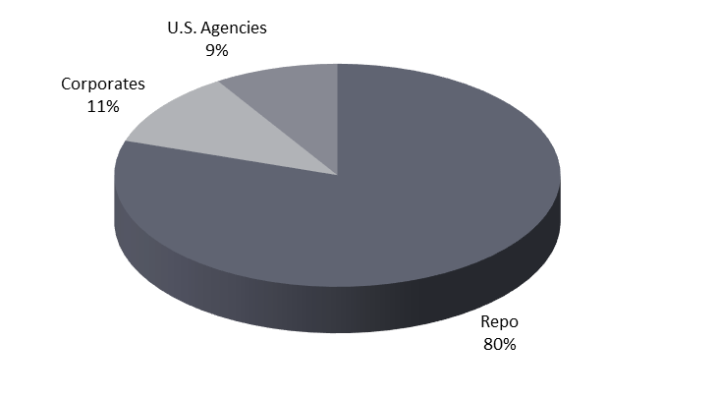
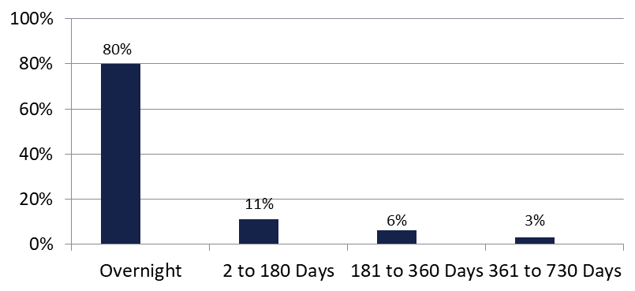

Securities Lending - Cash Collateral Portfolio As of September 30, 2023
Portfolio Characteristics
Credit Quality (S&P) | % of Cost | Cost (in mil.)
U.S. Govt. Securities* | 89.16% | $2,322.5
AAA | 0% | $0
AA | 4.06% | $105.7
A | 6.78% | $176.6
Total Market Value $2,604.8 million
NAV 1.0001
Yield (360 basis) 5.363%
WAM 42 days
* Includes Repos that are collateralized by U.S. Govt. Securities.
Asset Class
Final Maturity Schedule

Slide 18
Investment Pool
Review

Slide 19
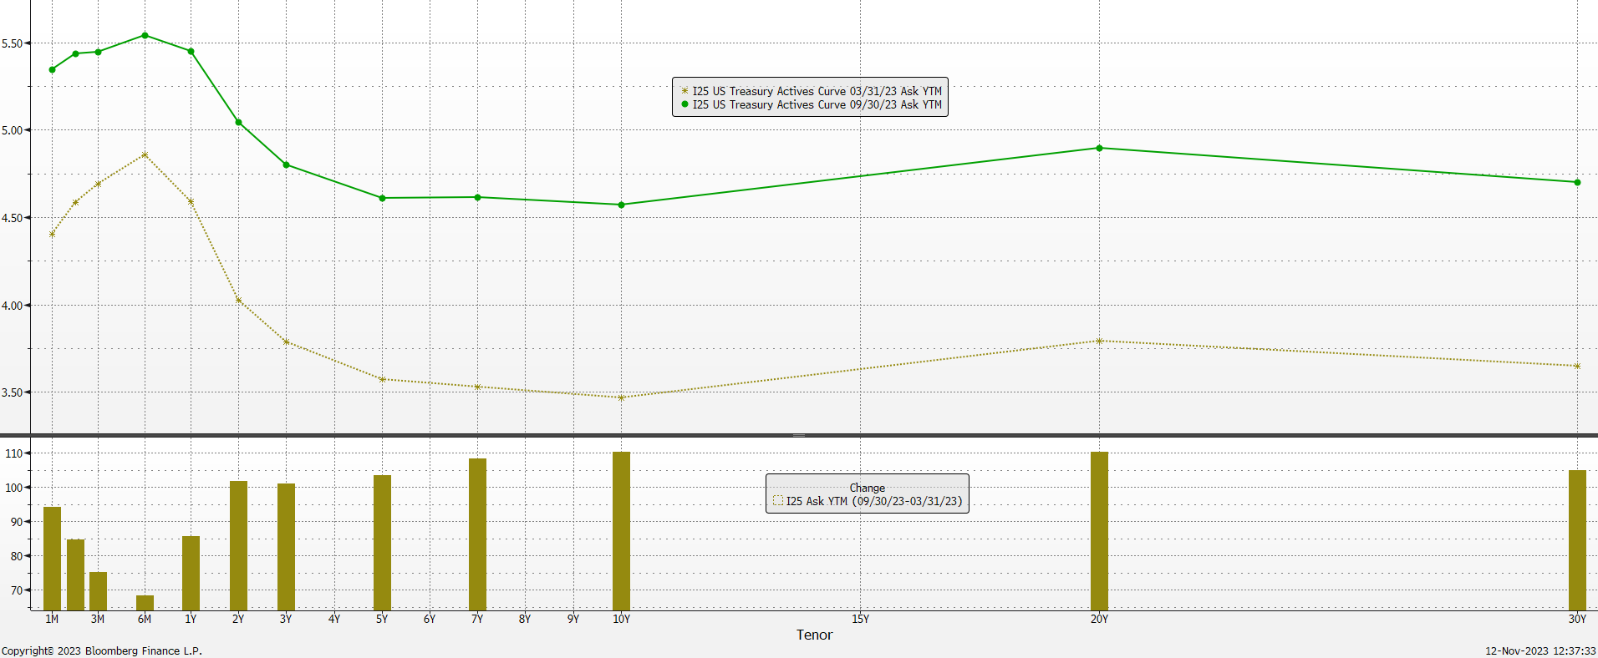
Treasury Yield Curve change (Mar 2023 vs Sep 2023)

Slide 20
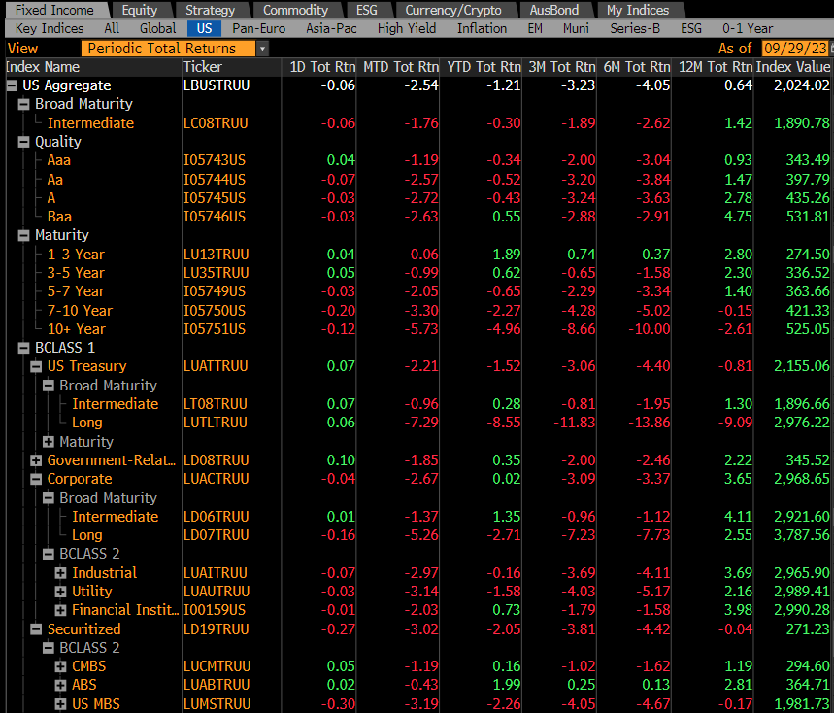
U.S. Fixed Income Markets Returns

Slide 21
Investment Strategy (Macro level)
Continued to lay the foundation for sustainable higher returns:
  After maintaining a conservative allocation profile during 2021 and most of 2022 to protect against the rising interest rate environment, we started increasing allocation to the longer duration mandates to lock-in attractive long-term returns.
  Continued to allow external Managers to realize losses in excess of generated income (although reducing the allowance from $2 million to $1 million in July).
  Completed the allocation to ABS sector in the Internally managed accounts.

Slide 22
Investment Pool Allocation
(Pre-Covid / Sep. 22 / Mar. 23)

Slide 23
Reallocation of Assets
From Liquidity Portfolio to:
Portfolio | 2021 & 2022 | 2023 (through Sep 2023) | Total
Ultra Short Duration | $8.35 billion | $2.2 billion | $10.55 billion
Short Duration | $3.0 billion | $1.7 billion | $4.7 billion
Intermediate Duration | $4.2 billion | $3 billion | $7.2 billion
Long Duration | $7.05 billion | $4.505 billion | $11.555 billion
Totals | $22.6 billion | $11.405 billion | $34.005 billion

Slide 24
Portfolio % vs. Allocation Ranges as of September 30, 2023
* avg. of previous 12 end-of-month balances for Liquidity Portfolio.

Slide 25
Distributed Income Detail (Past 12 months)

Slide 26
Investment Pool
Distributed Income
Pool Average Balance (in billions)
Average Return (net of fees)
$22.3 | $23.6 | $24.7 | $23.3 | $24.1 | $26.5 | $32.8 | $48.3 | $62.6 | $65.1
1.46% | 1.42% | 1.45% | 1.66% | 2.32% | 3.16% | 1.61% | 0.73% | 1.64% | 2.50%

Slide 27
Investment Pool Q2 & Q3 2023 Total Returns vs Benchmarks (excl. Time Deposits)

Slide 28
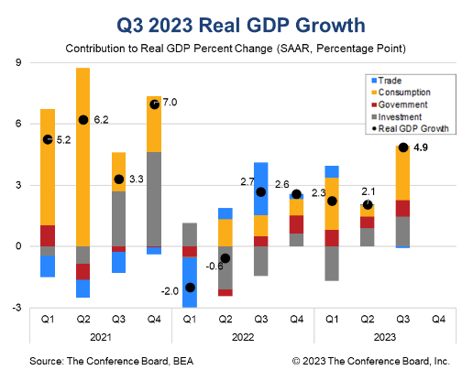
Economic Outlook
U.S. 3Q 2023 Real GDP growth of 4.9% (annualized) surpassed analyst expectations of 4.5%, led by strong consumption growth.
Demand for goods (4.8%) and services (3.6%) both expanded in 3Q, after a lull in 2Q.

Slide 29
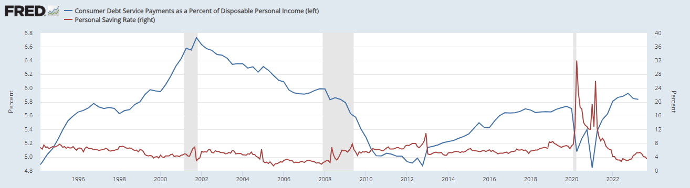
Is This Sustainable?
Personal Savings rates decline below pre-pandemic levels, as Debt Service rises.
*Shaded areas represent U.S. Recessions*

Slide 30
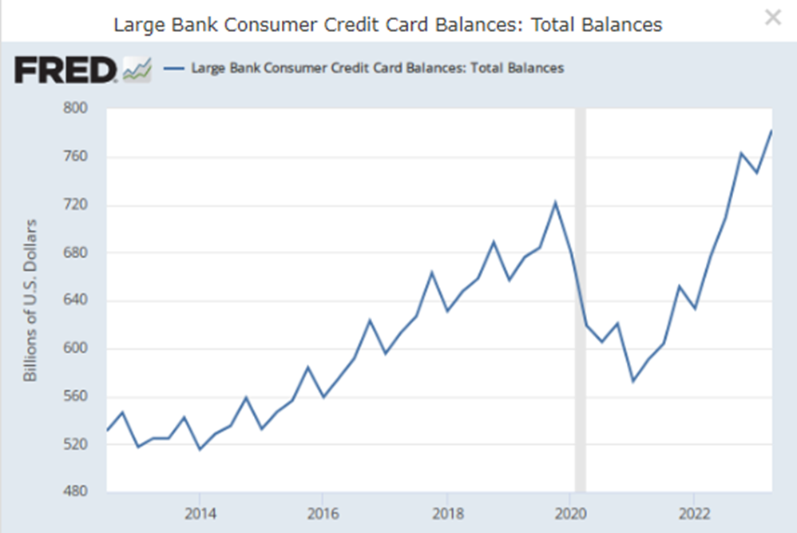
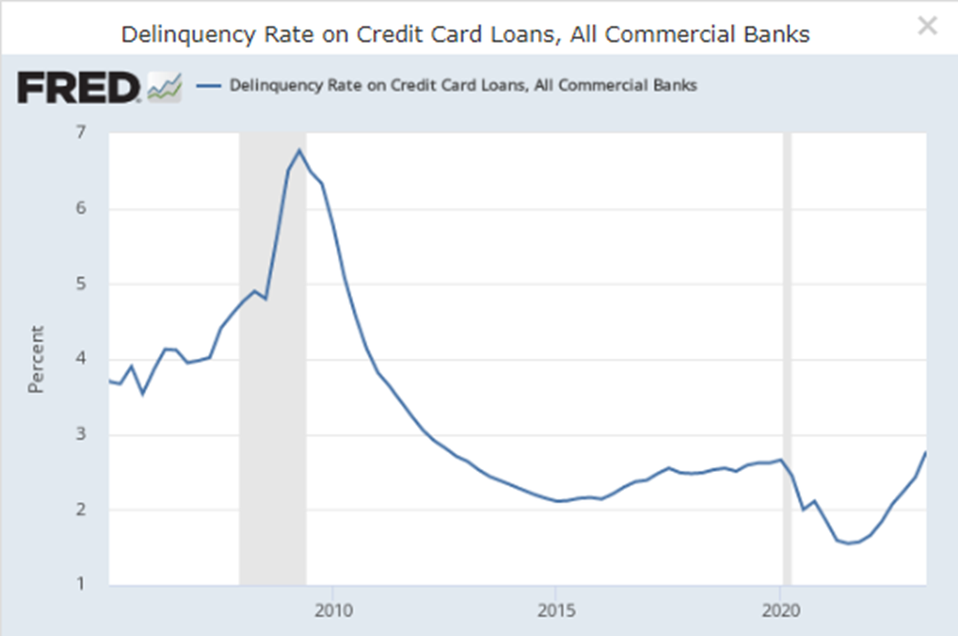
Excess Savings Running Out
With pandemic savings and stimulus money running out, consumers are turning back to credit cards to maintain their spending habits.

Slide 31
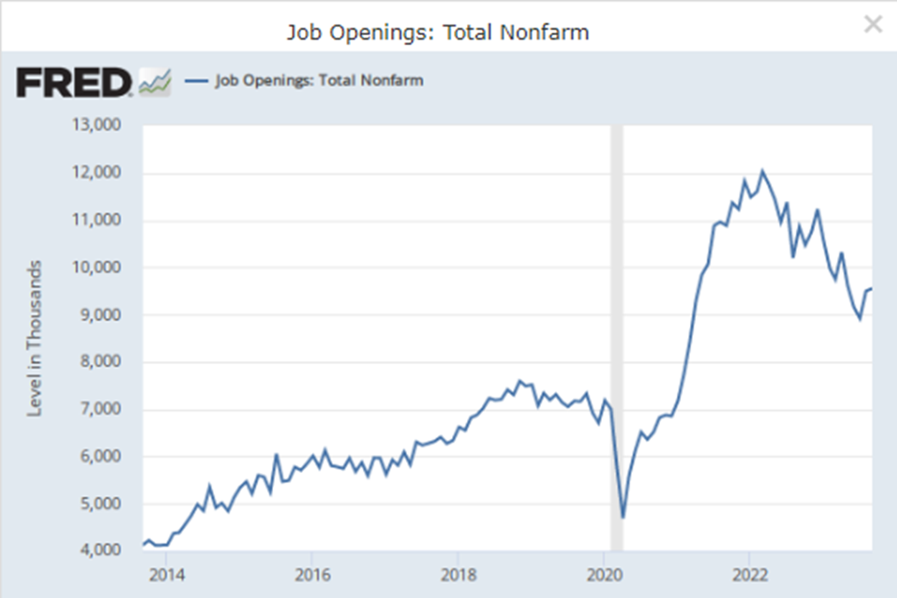
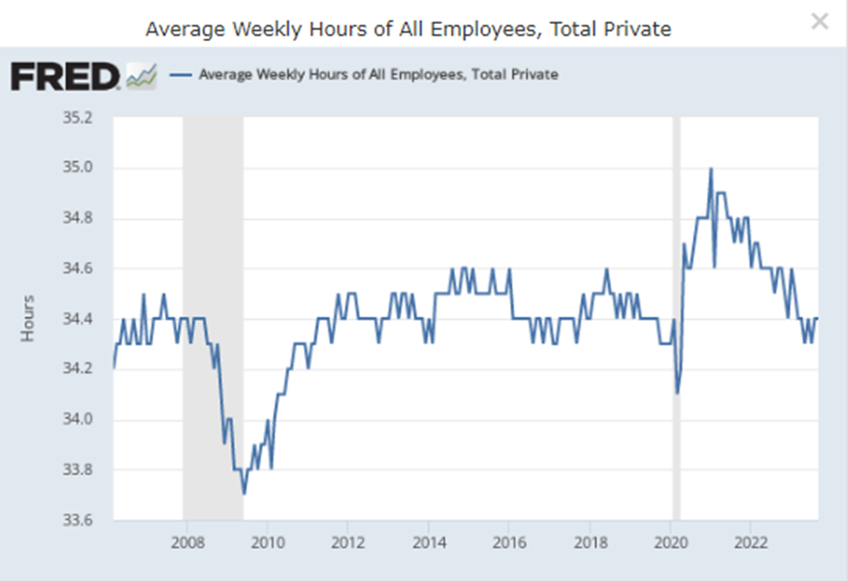
Labor
The previously red-hot labor market is returning to a more normal state.

Slide 32
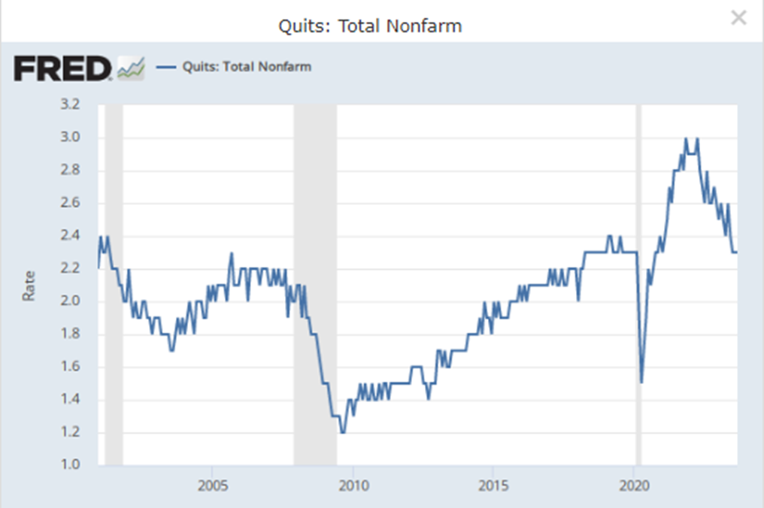
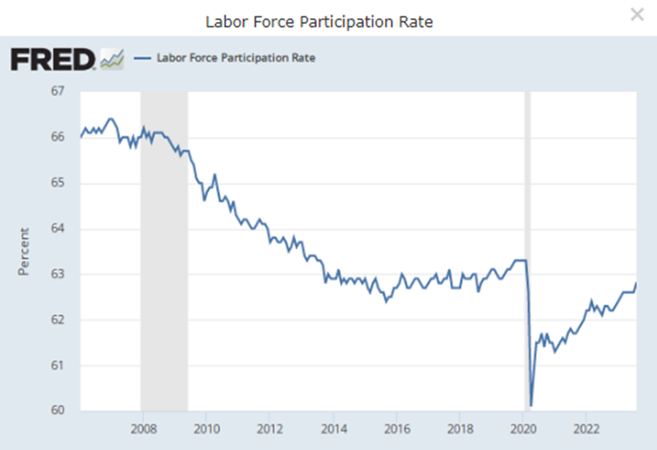
“Job Switchers” Losing Leverage
A less robust market for “job switchers” and holdouts may help to ease wage inflation.

Slide 33
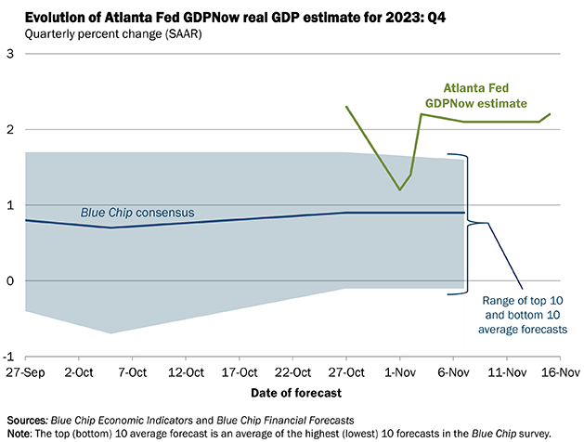
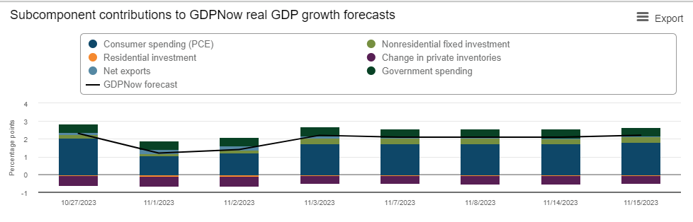
ATL Fed GDPNow 4Q Forecast
The model projects GDP growth above consensus expectations once again for 4Q 2023. Led by strong consumer spending around the holidays.

Slide 34
Fixed Income Yields and Spreads
December 2021 vs March 2023 vs September 2023
Yield (%)

Slide 35
Individual Mandate Key Characteristics

Slide 36
Investment Strategy (Macro level)
We are now better positioned for what is an expected decline in rates from these elevated levels over time. We significantly reduced our exposure to the shortest duration portfolios:
We believe the biggest risk is now credit risk, with the worse of interest rate risk behind us. At the moment, we are not considering reallocating more assets to the higher risk portfolios.
Maintain elevated exposure to the ABS sector in our Internally managed accounts.
Will continue to evaluate the realized loss allowance for the external Managers and the need to further reduce it.
 | Pre-Covid | Sep 2022 | Mar 2023 | Sep 2023
% of Pool in Liquidity and Ultra Short Duration Portfolios | 35% - 40% | 53% | 45% | 40%

Slide 37
Total Pool Characteristics

Slide 38
BBB & Lower Exposure
 | Exposure 3/31/2023 | Exposure 9/30/2023 | Limit
Ultra Short Duration | 0.2% | 0.2% | 3%
Short Duration | 3.1% | 2.2% | 7.5%
Intermediate Duration | 9.0% | 8.7% | 10%
Long Duration | 13.1% | 13.3% | 15%
Basket Clause
Statutes allow for 3% in
basket clause items

Slide 39
Pool Rating
Policy requirement: A+ or better using S&P rating matrix
S&P Rating as of September 30, 2023 = AA-f
Credit Score as of September 30, 2023 = 56.83 (AAf) (vs. 55.89 Mar. 31, 2023)
S&P rating matrix
Maximum Score | Rating
18.49 | AAAf
37.49 | AA+f
58.49 | AAf
91.49 | AA-f
120.49 | A+f
184.49 | Af
290.49 | A-f
360.49 | BBB+f

Slide 40
Individual Mandates Review

Slide 41
Liquidity Portfolio (as of September 30, 2023)
Liquidity Portfolio
 | 6 Mo* | 1 Year | 3 Year | 5 Year
Portfolio | 2.56 | 4.60 | 1.64 | 1.66
Benchmark | 2.56 | 4.59 | 1.75 | 1.71
Excess Return | 0.04 | 0.01 | -0.11 | -0.05
Primary goal is to provide funds to cover disbursements and help the entire pool maximize income. Performance versus benchmark is sometimes a secondary concern.
Portfolio is starting to outperform as short-term rates have slow down pace of increase and portfolio maintains a slight yield advantage.
Exposure to the 3 -12 month part of the yield curve added to performance as this part of the curve exhibited higher and more stable yields. This exposure will greatly benefit performance if and when Federal Reserve initiates next rate-cut cycle.
Taking advantage of some dislocations in T-bill market due to debt ceiling concerns. Maximizing Commercial Paper and finding attractive rates in Repos. Opportunistically taking advantage of Agency discount notes.
Information provided by BNY Mellon.
* not annualized.
Key Characteristics (as of 09/30/23)
 | Yield | 0-3 month % | 4-12 month % | Duration
Portfolio | 5.2% | 61.5% | 38.5% | 0.21
Benchmark | 5.1% | 100% | 0% | 0.15

Slide 42
Ultra-Short & Short Duration Portfolios (as of September 30, 2023)
Ultra Short Portfolio
 | 6 Mo* | 1 Year | 3 Year | 5 Year
Portfolio | 1.58 | 3.65 | 0.57 | 1.46
Benchmark | 1.49 | 3.54 | 0.52 | 1.42
Excess Return | 0.09 | 0.11 | 0.05 | 0.04
  Covered the short duration positioning as rates approach peak levels. Looking to gradually extend duration to a slight overweight positioning.
  Maintained a barbell structure in both portfolios to take advantage of the inverted yield curve.
  Maintaining a neutral to slightly underweight position in corporates bonds while waiting for a better re-entry point. New purchases done almost exclusively in the primary market to take advantage of reasonable new issue concession.
  After detracting slightly from performance during implementation period, ABS outperformed similar duration IG corporates and positively added to performance during the 2nd and 3rd quarter.
  Maximized the use of “swing” trades to save on trading costs.
  Benefiting from ability to rotate out of positions and distribute higher losses thanks to Liquidity account earnings.
Short Duration Portfolio
 | 6 Mo* | 1 Year | 3 Year | 5 Year
Portfolio | 0.52 | 2.90 | -0.63 | 1.26
Benchmark | 0.30 | 2.66 | -0.75 | 1.16
Excess Return | 0.22 | 0.24 | 0.12 | 0.10
Information provided by BNY Mellon.
* not annualized.

Slide 43
Intermediate Duration Portfolio Net of Fee Performance as of September 30, 2023
 | % of |  | Mgr |  |  |  |  |  |  |  |  | Annualized
 | Inv. Pool | Market Value | Rank* | 1 Month |  | 3 Month |  | 6 Month |  | 1 Year |  | 2 Year |  | 3 Year |  | 5 Year |  | 7 Year
IR+M | 3.09% | $1,897,571,626.32 | 2 | -1.696% | 1 | -1.676% | 1 | -2.263% | 4 | 1.976% | 1 | -4.830% | 2 | -3.201% | 2 | 0.868% | 2 | 0.565% | 2
MetWest | 3.01% | $1,850,297,306.04 | 4 | -1.934% | 6 | -2.097% | 6 | -2.683% | 6 | 1.402% | 4 | -5.090% | 4 | -3.440% | 4 | 0.684% | 4 | 0.440% | 4
Galliard | 2.83% | $1,738,034,445.18 | 3 | -1.733% | 4 | -1.691% | 3 | -2.205% | 2 | 1.691% | 3 | -5.079% | 3 | -3.395% | 3 | 0.715% | 3 | 0.497% | 3
Sterling Capital | 2.78% | $1,707,889,448.88 | 1 | -1.713% | 3 | -1.686% | 2 | -2.015% | 1 | 1.940% | 2 | -4.666% | 1 | -2.994% | 1 | 0.902% | 1 | 0.639% | 1
Reams Asset Mgmt | 1.92% | $1,182,319,919.83 | NR | -1.701% | 2 | -1.781% | 4 | -2.218% | 3
Wellington Mgmt Co | 1.92% | $1,180,022,391.15 | NR | -1.751% | 5 | -1.825% | 5 | -2.403% | 5
Total | 15.55% | $9,556,135,137.40 |  | -1.759% |  | -1.793% |  | -2.302% |  | 1.770% |  | -4.916% |  | -3.258% |  | 0.792% |  | 0.538%
Benchmark |  |  |  | -1.762% |  | -1.887% |  | -2.622% |  | 1.418% |  | -5.254% |  | -3.656% |  | 0.414% |  | 0.190%
* Based on 1, 3 and 5 Year Risk Adjusted Rankings.

Slide 44
Long Duration Portfolio Net of Fee
Performance as of September 30, 2023
 | % of | Market Value | Mgr |  |  |  |  |  |  |  |  | Annualized
 | Inv. Pool |  | Rank* | 1 Month |  | 3 Month |  | 6 Month |  | 1 Year |  | 2 Year |  | 3 Year |  | 5 Year |  | 7 Year |  | 10 Year |  | 15 Year |  | 20 Year |  | 25 Year
Galliard | 4.08% | $2,504,672,481.41 | 1 | -2.569% | 6 | -3.069% | 4 | -3.793% | 5 | 0.916% | 5 | -7.078% | 5 | -4.996% | 7 | 0.669% | 1 | 0.340% | 2 | 1.612% | 1
All Spring (Wells) | 4.07% | $2,501,992,471.79 | 4 | -2.565% | 5 | -3.099% | 6 | -3.659% | 4 | 0.796% | 7 | -7.249% | 10 | -4.858% | 3 | 0.441% | 5 | 0.223% | 6 | 1.383% | 5 | 2.866% | 9 | 3.167% | 4
Fidelity | 3.91% | $2,401,367,858.98 | 6 | -2.626% | 8 | -3.196% | 8 | -3.859% | 8 | 0.542% | 10 | -7.016% | 3 | -4.977% | 6 | 0.509% | 3 | 0.262% | 3 | 1.375% | 6 | 3.055% | 5 | 3.337% | 2 | 4.060% | 2
Sterling Capital | 3.61% | $2,217,426,108.04 | 5 | -2.559% | 4 | -3.063% | 3 | -3.565% | 2 | 0.843% | 6 | -6.848% | 1 | -4.560% | 1 | 0.543% | 2 | 0.405% | 1 | 1.570% | 2 | 3.120% | 3
Manulife | 3.12% | $1,916,649,144.73 | 10 | -2.753% | 10 | -3.374% | 10 | -3.987% | 10 | 0.436% | 11 | -7.180% | 8 | -5.012% | 11 | 0.349% | 7 | 0.215% | 7 | 1.337% | 8 | 3.133% | 2 | 3.205% | 3 | 3.919% | 3
Goldman Sachs | 2.97% | $1,824,066,696.84 | 3 | -2.653% | 9 | -3.330% | 9 | -3.820% | 6 | 0.992% | 3 | -7.043% | 4 | -5.004% | 9 | 0.501% | 4 | 0.237% | 4 | 1.314% | 9 | 2.889% | 8 | 3.092% | 5 | 3.839% | 5
Western Asset | 2.65% | $1,628,608,696.23 | 9 | -2.758% | 11 | -3.479% | 11 | -4.041% | 11 | 0.667% | 8 | -7.132% | 6 | -4.894% | 4 | 0.250% | 10 | 0.147% | 8 | 1.397% | 4 | 3.111% | 4 | 3.068% | 6 | 3.839% | 4
Amundi | 2.37% | $1,454,300,660.25 | 2 | -2.444% | 1 | -2.771% | 1 | -3.500% | 1 | 1.330% | 1 | -7.148% | 7 | -4.822% | 2 | 0.415% | 6 | 0.231% | 5 | 1.493% | 3 | 3.423% | 1 | 3.373% | 1 | 4.101% | 1
PGIM | 2.20% | $1,353,265,457.95 | 8 | -2.512% | 2 | -3.049% | 2 | -3.650% | 3 | 1.093% | 2 | -7.439% | 11 | -5.006% | 10 | 0.245% | 11 | 0.093% | 9 | 1.343% | 7 | 3.050% | 6
Nuveen | 1.25% | $768,645,579.46 | 11 | -2.518% | 3 | -3.093% | 5 | -3.946% | 9 | 0.615% | 9 | -6.978% | 2 | -4.905% | 5 | 0.286% | 9 | 0.042% | 11 | 1.205% | 11 | 3.009% | 7 | 3.061% | 7 | 3.766% | 6
Insight Investment | 1.09% | $667,680,208.41 | 7 | -2.580% | 7 | -3.166% | 7 | -3.829% | 7 | 0.969% | 4 | -7.194% | 9 | -5.002% | 8 | 0.322% | 8 | 0.071% | 10 | 1.271% | 10
Total | 31.30% | $19,238,675,364.09 |  | -2.602% |  | -3.158% |  | -3.776% |  | 0.809% |  | -7.138% |  | -4.917% |  | 0.422% |  | 0.213% |  | 1.379% |  | 3.024% |  | 3.068% |  | 3.779%
Benchmark |  |  |  | -2.541% |  | -3.231% |  | -4.048% |  | 0.644% |  | -7.290% |  | -5.206% |  | 0.103% |  | -0.091% |  | 1.127% |  | 2.535% |  | 2.846% |  | 3.591%
* Based on 1, 3 and 5 Year Risk Adjusted Rankings.

Slide 45
Fixed Income Characteristics (as of Sept 30, 2023)
Intermediate Duration Composite
 | Portfolio | Benchmark
Coupon | 3.36% | 2.91%
YTM | 5.65% | 5.36%
Effective Duration | 4.66 years | 4.56 years
Long Duration Composite
 | Portfolio | Benchmark
Coupon | 3.58% | 3.07%
YTM | 5.65% | 5.39%
Effective Duration | 6.21 years | 6.09 years

Slide 46
Sector Allocation

Slide 47
Credit Quality (Moody’s)

Slide 48
Watch List Worksheet – Intermediate Duration (September 30, 2023)
INTERMEDIATE DURATION |  |  | Danger Zone 6 - 8 Months
QUANTITATIVE FACTORS |  |  | Max Exceeded 9 Months
Any of the Following Conditions
(#1) Trailing 5-Year Annualized Net Performance Below Benchmark for 6 of 12 Months
Galliard | IR+M |  |  | MetWest/TCW |  |  | Sterling
(#2) Trailing 3-Year Annualized Net Performance Below Benchmark for 9 out of 12 Months
Galliard | IR+M |  |  | MetWest/TCW |  |  | Sterling
(#3) Mgr's (1 & 3 Year) Risk-Adjusted Ranking LAST for 9 out of 12 Months
Galliard | IR+M |  |  | MetWest/TCW |  |  | Sterling
Aug, July, June, May, Mar, Feb, Jan 23, Dec, Nov, Oct 22 |  |  |  | Sept, April 23
(#4) Trailing 1-Year Net Performance Below Benchmark & Bottom Quartile (Last) of Mandate for 9 out of 12 Months
Galliard | IR+M |  |  | MetWest/TCW |  |  | Sterling
April 23, Nov, Oct 22 |  |  |  | Sept 23

Slide 49
Watch List Worksheet – Long Duration (September 30, 2023)
LONG DURATION |  |  |  | Danger Zone 6 - 8 Months
QUANTITATIVE FACTORS |  |  |  | Max Exceeded for 9 Months
Any of the Following Conditions
(#1) Trailing 5-Year Annualized Net Performance Below Benchmark for 6 of 12 Months
AmundiPioneer | Fidelity | Galliard | Goldman | Insight Investment | Manulife | Nuveen | PGIM | Sterling | All Spring (Wells) | Western Asset
(#2) Trailing 3-Year Annualized Net Performance Below Benchmark for 9 out of 12 Months
AmundiPioneer | Fidelity | Galliard | Goldman | Insight Investment | Manulife | Nuveen | PGIM | Sterling | All Spring (Wells) | Western Asset
 |  |  |  |  |  |  | Jan 23, Nov, Oct 22
(#3) Mgr's (1 & 3 Year) Risk-Adjusted Ranking in Bottom Two for 9 out of 12 Months
AmundiPioneer | Fidelity | Galliard | Goldman | Insight Investment | Manulife | Nuveen | PGIM | Sterling | All Spring (Wells) | Western Asset
Oct 22 | Sept, July, June, April, Mar 23 |  |  | May, Jan 23 | Sept, July, June 23 | Aug 23 | Aug, Feb, Jan 23, Dec, Nov, Oct 22 |  | May, April, Mar, Jan 23, Dec 22
(#4) Trailing 1-Year Net Performance Below Benchmark & Bottom Quartile (Bottom 2) of Mandate for 9 out of 12 Months
AmundiPioneer | Fidelity | Galliard | Goldman | Insight Investment | Manulife | Nuveen | PGIM | Sterling | All Spring (Wells) | Western Asset
Oct 22 | Sept, July, June, April 23 |  |  |  | Sept, July, June 23 |  | May, Feb, Jan 23, Dec, Nov, Oct 22 |  | May, April, Mar, Feb, Jan 23, Dec, Nov 22

