Slide 1
Tips & Tricks for Disinvestments

Slide 2
Investing
Agency Trust Funds
Treasury Investment Pool

Slide 3
Reporting Tools - Investments
GLR082 – Apportionment Report:
Reports the interest and administrative fees
GLR083 – Investment Activity Report:
Reports the investment transactions and balances by pool and participant
Used to monitor trust fund balances and activity for investments and disinvestments

Slide 4
Disinvesting
Agency Trust Funds
Treasury Investment Pool

Slide 5
How do we disinvest?
Do your research
1
Initiate Disinvestment in Florida PALM
2
Verify the Disinvestment in Central FLAIR
3
Update Departmental FLAIR
4

Slide 6
Research – Step 1
Determine the FLAIR account code associated with the disinvestment
Tip: Disinvest to the same Fund and Budget Entity that the investment originated
Determine Florida PALM ChartField values that coincide with the FLAIR account codes
Tip: Can this information be used again?
Determine the accounting information needed for the Florida PALM entries
Tip: Which accounts should be positive and negative?

Slide 7
Research – Tips & Tricks

Slide 8
Florida PALM Entries – Step 2
Agency’s GL Journal Processor must input the four lines of the disinvestment
Agency’s GL Journal Approver must review and approve the disinvestments
Step-by-step instructions:
Florida PALM End User Manual
People First LMS:
PALM TECH - Agency GL Journal Processor
PALM TECH - Agency GL Journal Approver

Slide 9
Florida PALM Entries – Tips & Tricks
Total of four lines, two lines per fund
Two lines for Treasury Fund will ALWAYS be the same two lines for each disinvestment
Debits must equal credits
Negative values must be input for credit side of transactions
Double check entries before submitting
Budget checking takes place upon final approval
Entries create a TR25 and TR45 in Central FLAIR

Slide 10
Accounting with Disinvestments
Agency Fund
Treasury Fund
Line 1: InterUnit Cash Act.
#101013
Line 2: Pool 1 Disinv-Treasury
#104001
Line 3: Return
Investment Fund
#304001
Line 4:InterUnit Cash Acct.
#101013
$5,000
(Debit)
-$5,000
(Credit)
$5,000
(Debit)
-$5,000
(Credit)

Slide 11
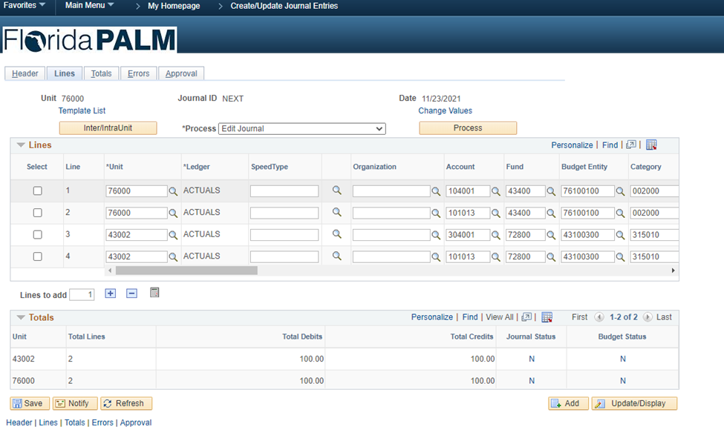
Florida PALM Entries

Slide 12
Florida PALM Entries

Slide 13
Verification – Step 3
Central FLAIR remains the book of record for Appropriations, Releases, Reserves, and Cash during the CMS Wave
Pull and review reports to verify disinvestments
Agencies must verify the receipt of the TR45 in Central FLAIR
Determine where the error was made, and which system is out of balance
Map out corrections if they are needed

Slide 14
Reporting Tools - Disinvestments
Florida PALM Report - GLR083 – Investment Activity Report
Agency unique reports
RDS Central Standard Reports:
CNPPPJT2 - Posted JT's by SWDN within Initiating
CNPPPJT4 - Posted JT's by SWDN within Benefiting
WebFocus (MRE):
CMPTTRN - shows all comptroller transactions
State Accounts Screen

Slide 15
Florida PALM Corrections – Tips & Tricks
Reversal entries in Florida PALM must have four lines
The original journal date must be used when correcting entries
When reversing an entry, flip the signs
Use the RED source code when applicable to adjust investment balances in Florida PALM
Once reversed, reprocess the disinvestment
Disinvest to the same Fund and Budget Entity as the original investment

Slide 16
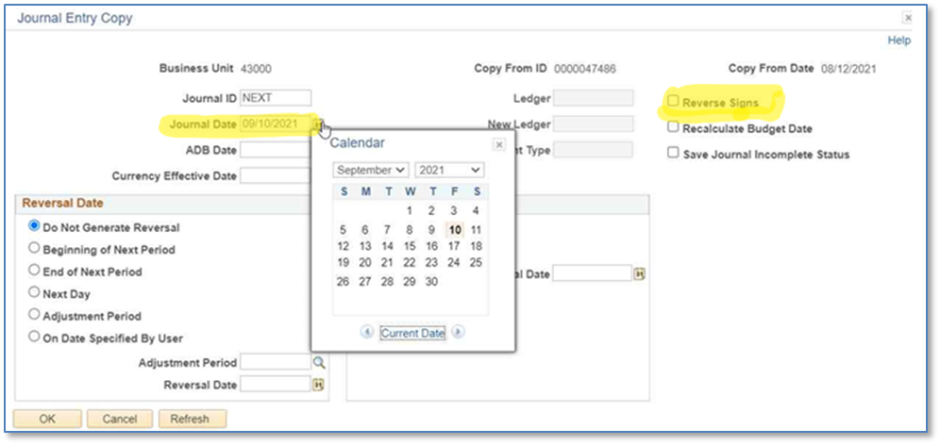
Florida PALM Corrections – Tips & Tricks

Slide 17
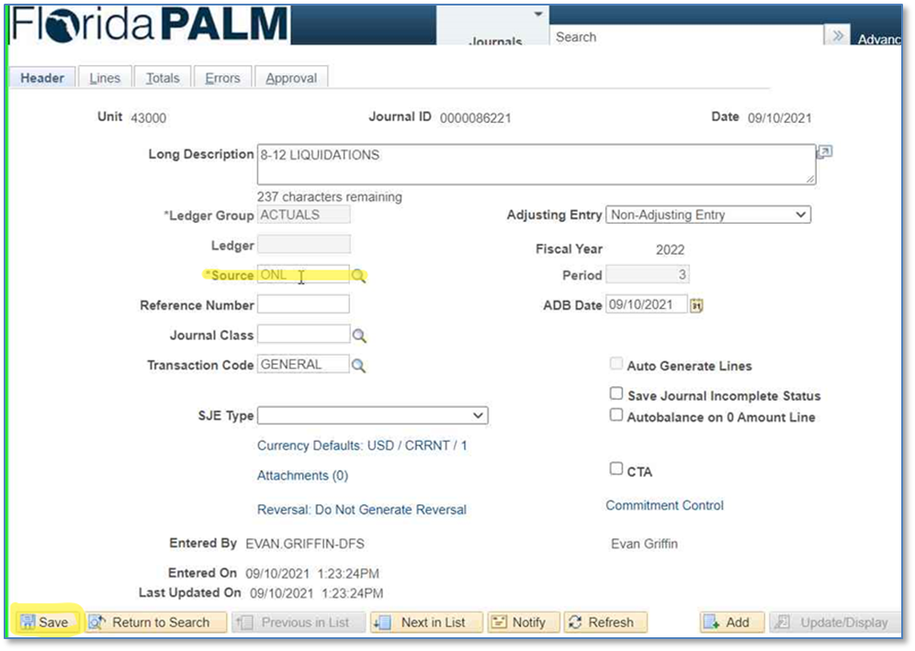
Florida PALM Corrections – Tips & Tricks

Slide 18
Update Departmental – Step 4
Departmental must be updated to reflect the disinvestment
Agencies will process the receipt, TR96 in Departmental
Departmental should match Central

Slide 19
We’ve come full circle…
Invest
Monitor Investments
Disinvest in FL PALM
Verify Central FLAIR
Update Departmental
Agency Fund Restored
Research Disinvestment Information

Slide 20
Tips & Tricks for Disinvestments

Slide 21
Contact Information
Contact us
FloridaPALM@myfloridacfo.com
Project Website
www.myfloridacfo.com/floridapalm/

