Slide 1
Tips & Tricks: Explaining the
Chart of Accounts (COA)

Slide 2
Tips and Tricks : Explaining the COA
Select Agency
Business
Systems
COA Crosswalk
Bank Account Balances and Transactions
Investment Participants Balances
Interest Apportionment
Securities
Departmental FLAIR Deposits
DOR Deposits on behalf of Agencies
Treasury & Returned Item Deposits
Central FLAIR Cash Transactions
Crosswalked
Legacy
FLAIR
Financial
Institutions
Agency Transactions
Agency Users
Disinvestment Transactions
Reporting
Treasury Forms

Slide 3
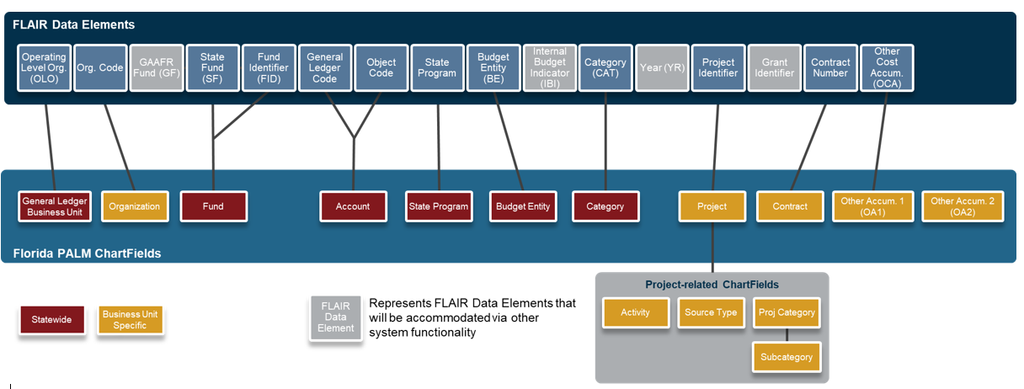
CMS Wave ChartField Values

Slide 4
Tips & Tricks : Business Unit
Used to define an organization or organizational subset that is independent with regards to one or more accounting or operational functions
Operating Level Organization (OLO)
Enforce security and data segregation
One business unit per agency
Agency level for legislative financial reporting
Required field in Florida PALM
Prepopulated field
Manual Input required

Slide 5
Tips & Trick : Business Unit
Treasury Business Units
Dept of Fin Svc Trs Inv Disinv (INV DISINV) - 43002
Represents Treasury internal operations to clear cash for Trust Fund investing and disinvesting activities

Slide 6
Tips & Tricks : Budget Entity
Used to represent an organization and/or function to which appropriations are made
Unique to each agency
Used the same as today

Slide 7
Tips & Tricks : Category
Used as a dual-purpose code that either sub-defines appropriations made to a budget entity or identifies a specific source of revenue funding
Expenditures Category
Identifies money going out
Revenue Category
Identifies money coming in

Slide 8
Tips & Tricks : Fund
Used to segregate and capture specific activities or classify certain objectives in accordance with regulations, restrictions, or limitations (e.g., restricted Fund)
Budgetary Fund
Used to store appropriations, releases, and reserves
Transactional Fund*
Used to record accounting entries
* CMS Wave ChartField Value

Slide 9
Tips & Tricks : Fund
FLAIR Fund Value
20-2-021001
GF-SF-FID
Florida PALM Fund
20210
Budgetary Fund
Florida PALM Fund
02101
Transactional Fund

Slide 10
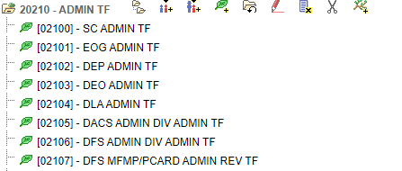
Tips & Tricks : Fund
Example: Admin Trust Fund Tree Structure
Budgetary Fund
Transactional
Funds

Slide 11
Tips & Tricks : Accounts
Classifies the nature of a transaction by identifying type of asset, liability, fund balance, receipt, expense, transfer, or statistical measurement involved in a transaction
Budgetary Account
Used only when recording budgetary entries
Transactional Accounts*
Used to record financial accounting entries or budget entries
* CMS Wave ChartField Value

Slide 12
Tips & Tricks : Accounts
Account Type Grouping | Account Type Description | Account Type Code | Account Value Range
Balance Sheet Accounts | Assets | A | 100000 – 1ZZZZZ
Balance Sheet Accounts | Deferred Outflows of Resources | O | 200000 – 2ZZZZZ
Balance Sheet Accounts | Liabilities | L | 300000 – 3ZZZZZ
Balance Sheet Accounts | Deferred Inflows of Resources | I | 400000 – 4ZZZZZ
Balance Sheet Accounts | Equity | Q | 500000 – 5ZZZZZ
Income Statement Accounts | Revenues | R | 600000 – 6ZZZZZ
Income Statement Accounts | Expenditures | E | 700000 – 7ZZZZZ
Income Statement Accounts | Transfers | T | 800000 – 8ZZZZZ

Slide 13
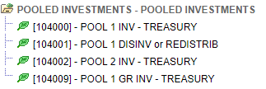
Tips & Tricks : Accounts
Example: Investment Account Tree Structure
Transactional
Accounts

Slide 14
Tips & Tricks : Accounts
Interunit Cash Account - 101013
Used to support cash accounting transactions across different business units or within a business unit
Treasury Pool 1 – 104001
Used to manage Trust Fund and General Revenue investments and disinvestments, including interest apportionment and fees
Treasury Liability Due to Pool 1 Disinv – 304001
Used to track the liability that treasury is holding for agency investments

Slide 15
Tips & Tricks : Budget Structure
Budget Definition Rules
Ledger Group | Holds posted invested balance, which maintains the relationship with the actuals ledger. | CC_INVEST
Control Options | Control – Strict. Fails when transaction amount exceeds invested balance. | Control
Control ChartField | The control ChartField determines whether a given transaction line is subject to invested balance checking. | Fund
Key ChartFields | Key ChartFields are ChartFields that are required for a budget journal. These Key ChartFields are what source transactions use to identify the appropriate budget line/row subject to invested balance checking. | Fund Account
Account Types | Defines the Account ChartField values which are subject to invested balance checking. | Asset – Investment / Disinvestment
Calendars | The feature that defines the availability duration for invested balance. | None

Slide 16
Tips & Tricks : Things to Remember
Funds must be created
GLR083 – Investment Activity Report
GLR091 – ChartField Value Report
GLR121 – Crosswalk Value Report

Slide 17
Tips & Tricks : Explaining the COA

Slide 18
Contact Information
Contact us
FloridaPALM@myfloridacfo.com
Project Website
www.myfloridacfo.com/floridapalm/

