Slide 1
Department of Financial Services (DFS) PROPER SpeedKey Approach September 2024
Notes:
Good afternoon. My name is Sheila Cole and I work for Florida Department of Financial Services (Proper). We are not Accounting and Auditing (Enterprise) or Florida PALM Project. Proper is an Agency just like each of you are.
Today I am going to share with you how OUR agency approached SpeedKeys and how we developed our naming convention.
Before I start, by a raise of hands, who in the audience may still be contemplating your naming convention or struggling with a methodology? Come on don’t be shy…I know we were too.
Okay thank you for your honesty. I hope that what I'm about to share with you today will help you with getting your creative juices flowing so you too can create your own agency methodology for SpeedKey use and naming convention.

Slide 2
Agency Knowledge Share DFS SpeedKey Approach
Started Asking Ourselves:
Where will SpeedKeys be required in Florida PALM?
What ChartField values are mandatory on Payroll and PCard SpeedKeys?
What a are the Florida PALM requirements and field length conditions?
What types of Payrolls do we have?
What types of PCard Transactions do we have?
What ABS will need a SpeedKey for remediation purposes?
What will be meaningful for stakeholders to use?
What is the potential data volume?
Why do we want to use SpeedKeys beyond the required transactions/BPMs? Where is the value?
What are the expectations and dependencies of a SpeedKey?
Notes:
During our approach process, we went back to the basics, putting pen to paper but in our case, we put marker to white board during our brainstorming session.
Here are some of the questions we asked ourselves. We analyzed each question and combined our resources to answer the questions. Some Key points I want to point out to you in this slide, is that we took the approach of what is REQUIRED at this time. We know Payroll and PCard are both required, and the project is depended on our SpeedKey values to continue their process, so we wanted to focus on those two areas first and foremost.
During our brainstorming session, we pulled transactional data from FLAIR to start our evaluation process.
For Payroll we identified potentially 537 different SpeedKeys for payroll alone, DFS has 269 Organizational codes (that was an eye opener), 10 categories, 18 funds, and 32 BE’s. We broke down the data to the level of the SpeedKey required for payroll.
We did the same process for PCard by pulling FLAIR detail for K1 vouchers and reviewed the data at the SpeedKey required level. We identified 64 potential SpeedKeys for PCARD.
At this point we identified the need, what our current data looks like and what the volume could be, we then turned back and asked ourselves. What will be meaningful to our stakeholders, how will they know which SpeedKeys to use, what is the expectation of our SpeedKey and will we as an agency use additional SpeedKeys outside of what is required by Florida PALM project.
During our agency business system remediation meetings, we identified some business systems that will utilize SpeedKeys. This is our agency decision to go this route and not every business system we are remediating will use a SpeedKey.
Our agency also knew we did not want a messy SpeedKey file and wanted to establish a naming convention that will work for any type of SpeedKey that is created.
Okay now that I gave you our approach, let me show you our naming convention.

Slide 3
Agency Knowledge Share DFS SpeedKey Approach
DFS has identified the proposed naming methodology:
SpeedKey Business Module Type: 2 Alpha Character: Represents the first two-character fields of the SpeedKey name. SpeedKey type will identify the business module the speed key will be used in.
Division Level Acronym: 3 Alpha Character: Represents the third through fifth character fields of the SpeedKey name. Division level will be the highest level of the Florida PALM Organizational tree structure or comparison to the FLAIR L2 level.
SpeedKey Transactional Type: 1 Alpha Character: Represents the sixth character field of the SpeedKey name. This identifies the agency transactional type within the business module being used.
Count: 4 Numerical Character: Represents the seventh through tenth character fields of the SpeedKey name. Will be a sequential number order of adding and maintained. This will be the approach for every SpeedKey combination value created. The count allows up to 9999 sequential values to be added within the SpeedKey Business Module for each Division level transactional type.
09/11/2024
Notes:
Okay so now you can see how we plan to break out the SpeedKey length and identify what each character(s) represents.
Go through these.

Slide 4
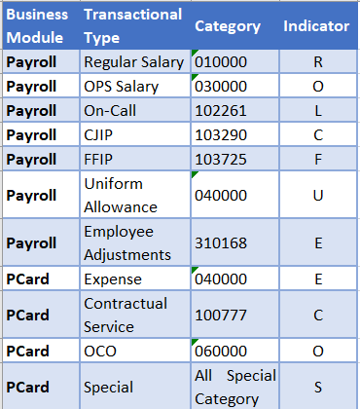
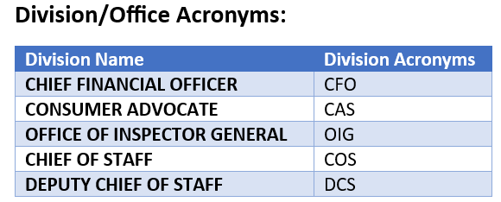
Agency Knowledge Share DFS SpeedKey Approach
Defining Tables
09/11/2024
Notes:
To ensure standardized structure, we have created defining tables that will be maintained and updated as needed. Each of our identified naming convention will have a defining table.
Business Module Type Indicator is the first two characters of the naming convention so the indicator will be limited to 2 characters.
Business module type Payroll will be PY
Business module type PCard will be PC
The next three characters of the naming convention is our Divisions Acronyms, This is just a snippet of some of the divisions names
The 6th character of the naming convention is the transactional type by business module.
Let's look a Payroll first: Regular Salary will be represented on the SpeedKey with an R. OPS Salary will be represented on the SpeedKey with an O, On Call we chose L because both O and C are used by other representatives.
Now look at PCard: You will see we have 4 transactional types within PCard for our agency. We broke it out to Expense would be represented by an E, Contractual Services will have a C, OCO will have an O and special categories will have an S.

Slide 5
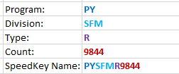
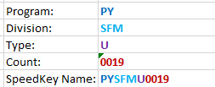
Agency Knowledge Share DFS SpeedKey Approach
Example – Payroll (Regular):
DFS has created a new organization code within Division of State Fire Marshals (SFM) and the following payroll SpeedKeys are needed as the position is qualified for the following payment types: Regular Salary, CJIP, FFIP, Uniform Allowance.
Each payment type will need a new SpeedKey as there is no existing SpeedKey identified.
The following ChartField values will be included in each SpeedKey: Organization, Account, Fund, Budget Entity, State Program.
Four separate SpeedKeys will be created.
Note: The last added “count” value for State Fire Marshals SpeedKey related to Regular salary was “9843”. The next available count value for the new SpeedKey will be “9844” and Uniform Allowance was “0018” so the next available count value to the new SpeedKey will be “0019”.
Regular Payroll Uniform Allowance
09/11/2024
Notes:
Read this slide

Slide 6
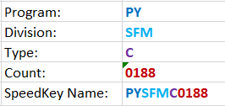
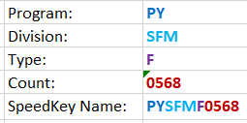
Agency Knowledge Share DFS SpeedKey Approach
Example – Payroll (CJIP) & (FFIP):
The last added count value for State Fire Marshals SpeedKey related to CJIP was “0187”. The next available count value for the new SpeedKey will be “0188” and FFIP was “0567” so the next available count value to the new SpeedKey will be “0568”.
CJIP Payroll FFIP Payroll
For the Payroll example outlined above, the four SpeedKeys that will be added to the employee funding page are:
09/11/2024
Notes:
Read this Slide

Slide 7
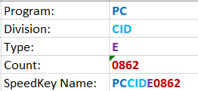
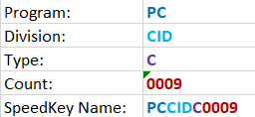
Agency Knowledge Share DFS SpeedKey Approach
Example – PCard:
Agency merged one bureau with another bureau and established a new budget entity for the new bureau within Division of Criminal Investigation (CID). This bureau will be utilizing their state issued purchasing cards and will need to notify OFB to request the creation of new SpeedKeys so that end-users can process charges within PCard WORKS. The new bureau will be utilizing their PCard for Expenses and travel with occasional drycleaner services for uniforms Contractual Services.
This will require OFB to establish two (2) new SpeedKeys for PCard charges with the following ChartField values: Fund, Budget Entity, Category, State Program.
Note: The last added value for Division of Criminal Investigation SpeedKey related to “Expenses” was “0861”. The next available count value to the new SpeedKey will be “0862” & “Contractual Services” was “0008”. The next available count value to the new SpeedKey will be “0009”.
Expense Contractual Services
09/11/2024

Slide 8
Agency Knowledge Share DFS SpeedKey Approach
Questions?
Sheila Cole
Sheila.Cole@MyFloridaCFO.com
(850) 413-2115
09/11/2024

