Slide 1

Department of Financial Services
Road Show analysis Division Groups
July 2024
Notes:
Today you will learn more about Florida PALM and answer questions you might have on the impact of the new accounting system and you.

Slide 2
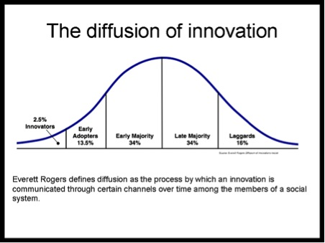
All Change Initiatives Have 5 Groups of the Same Stakeholders
The theory is based on arranging our stakeholders into 5 groupings;
1. Innovators
2. Early Adopters
3. Early Majority
4. Late Majority
5. Laggards
If we can find stakeholders that could fit into the first two categories – Innovators and Early Adopters. Why would you NOT choose them to become your senders of information and your first level of receiving internal information?

Slide 3
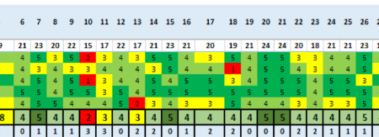
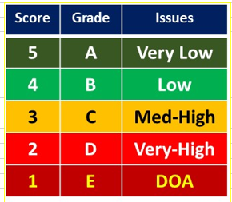
Road Show End-user Survey Approach
250 surveys used, 268 collected
Conducted 17 road shows to 10 groupings that consisted of division/offices
DFS used a 1-5 Likert rating scale
Used Prosci ADKAR methodology and questions
Small group settings, to engage dialogue.
Captured question responses using heat maps.
  That will give a visual representation of the responses and a way to analyze the data to update and target solutions and OCM/Training efforts.

Slide 4
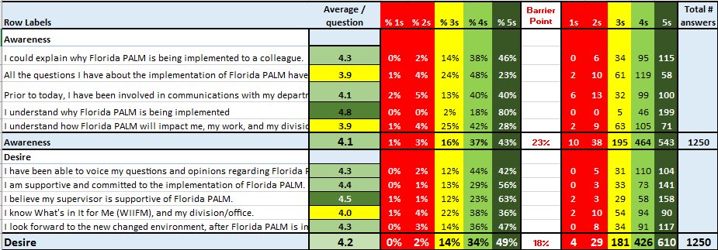
DFS Total Awareness & Desire Scores

Slide 5
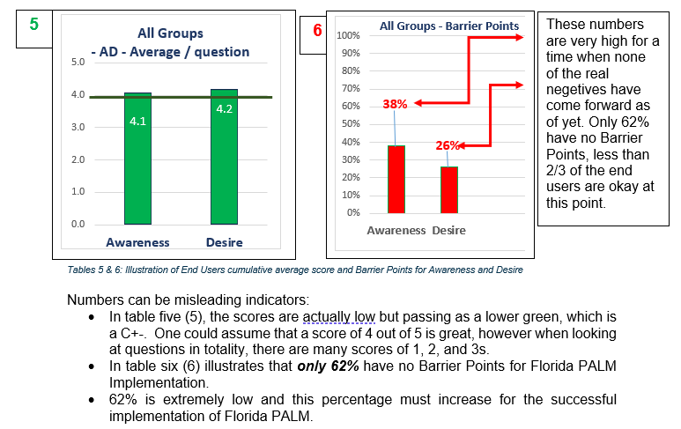
Numbers can be Misleading
Average vs percent of barrier points
Total count of responses with 1, 2, 3
Awareness = 243
Desire = 214
Only 62% have no barrier points. This is low and must increase for the successful implementation of the technology and change to people.

Slide 6
Division/Group Results

Slide 7

Next Steps
CCN to meet with POC, CCN Coordinators, CCN Trainers and each Group Division Director to review report and low scoring questions.
Continue with targeted communications using the heat maps of the survey analysis.
Continue dialogue with stakeholders and seek ideas to address the lower scores.
Establish two-way feedback sessions; i.e. Lunch & Learns, games, publications.
Re-do assessments to measure actions taken after road shows to see if scores improve.

Slide 8

Questions
&
Feedback
Contact us at: DFS.CCN4U@myfloridacfo.com

