Slide 1
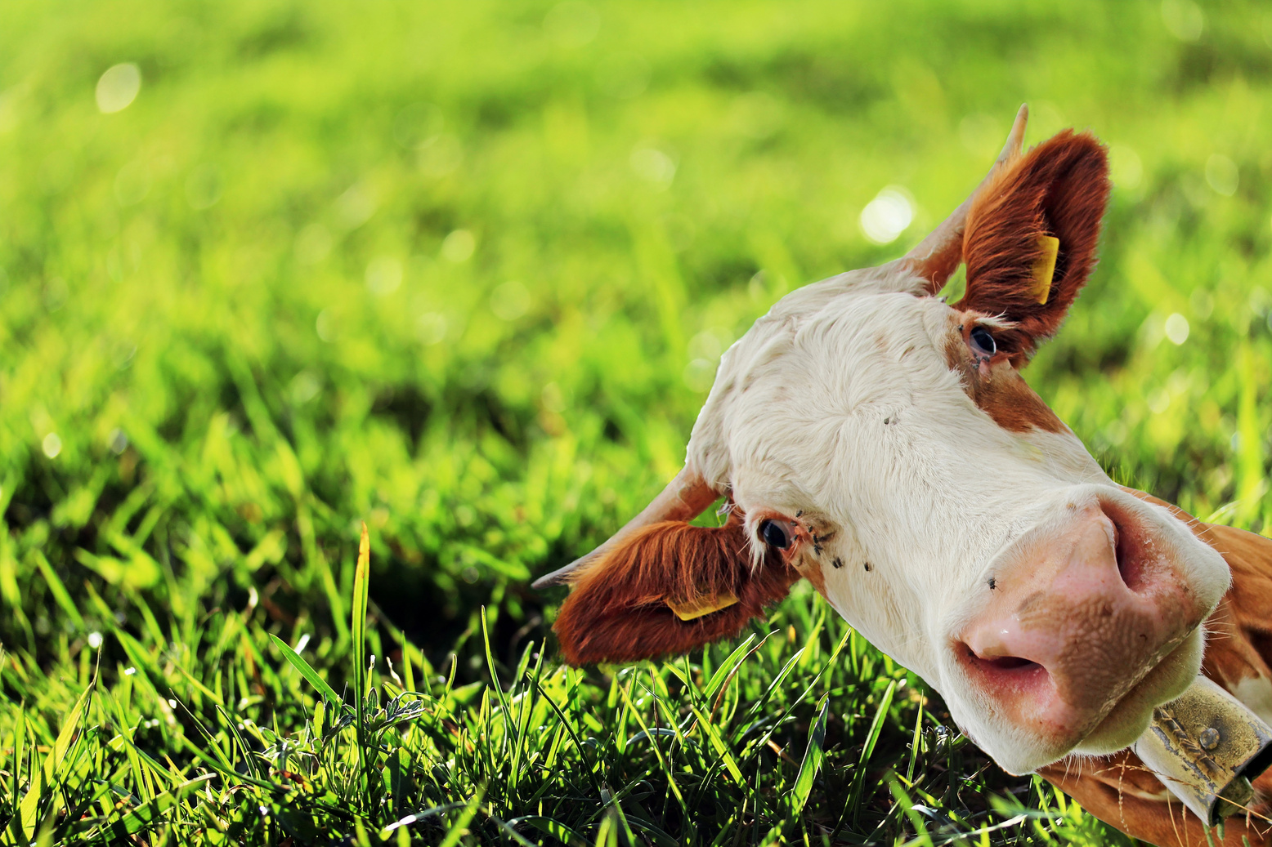
MOVING MOTIVATORS

Slide 2
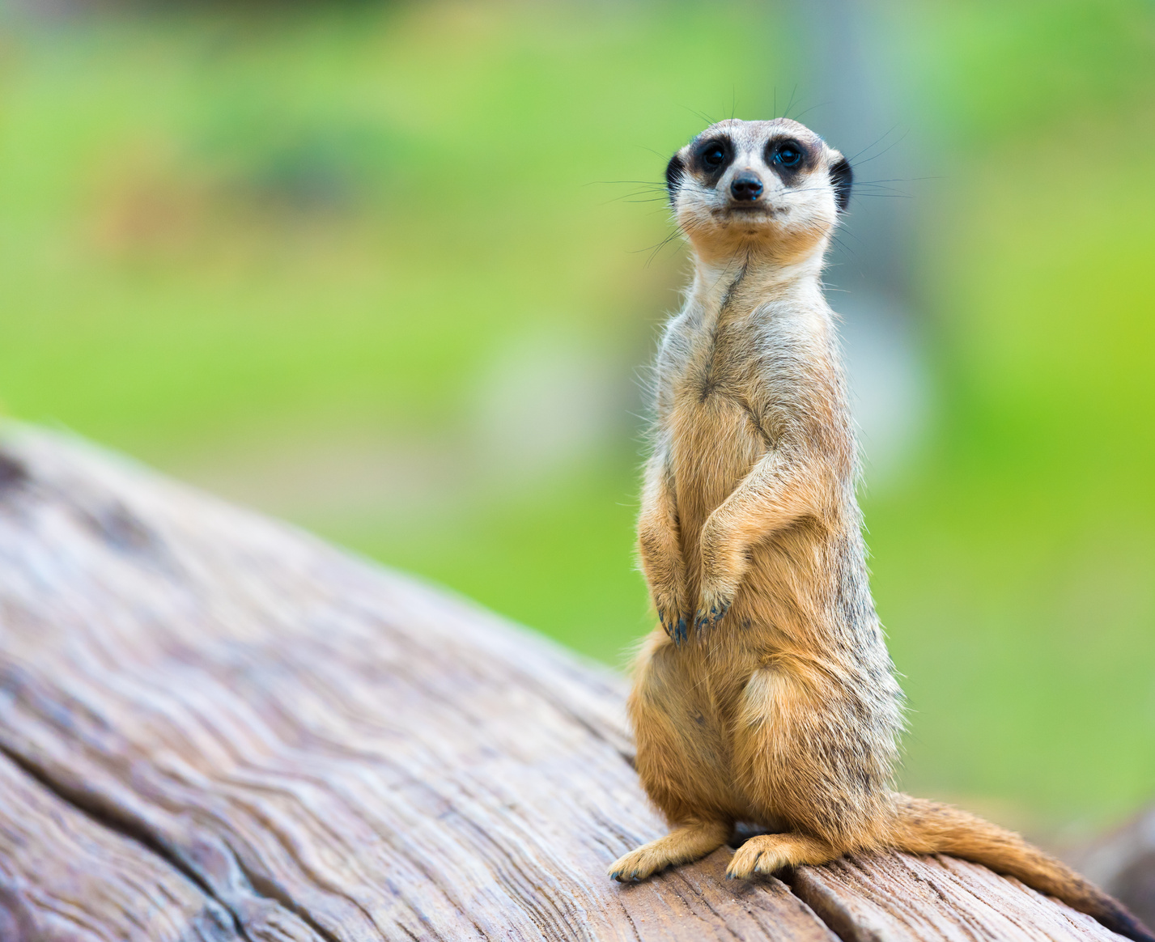
OUR GOAL
To think about what motivates us and what impact Florida PALM might have on our motivations

Slide 3
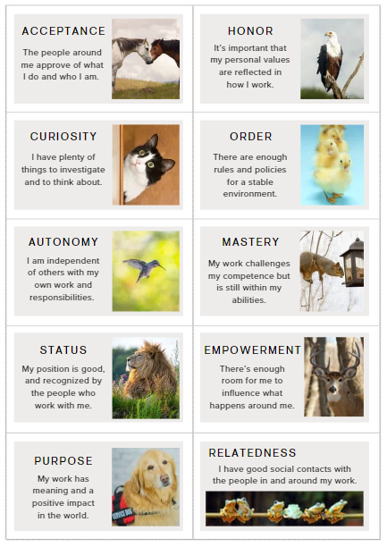
HOW?
Review the 10 Motivation Cards
Arrange the cards in the order of importance to your work today
Notes:
Review the cards - we'll talk about the meaning, but you are free to ascribe whatever meaning works for you
After we review I'll ask you to arrange the cards in the order of importance to your work today
- left to right
- top down
whatever works for you!

Slide 4
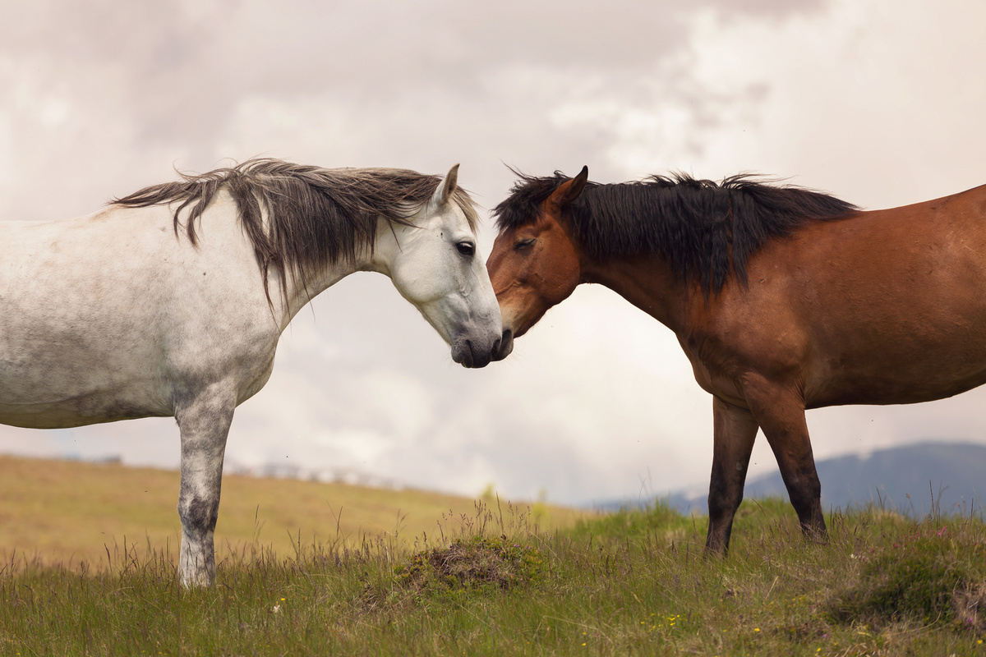
ACCEPTANCE
The people around me approve of what I do and who I am.
Notes:
Acceptance
The people around me approve of what I do and who I am.
Acceptance is about the need for self-esteem and having a positive self-image. It’s about being accepted for who you are. Other words might be:
* Affirmation
* Self-worth
* Validation
* Approval

Slide 5
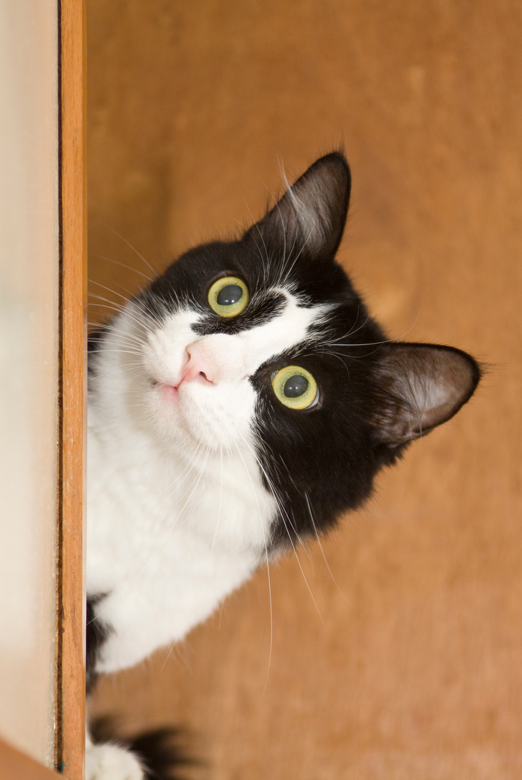
CURIOSITY
I have plenty of things to investigate and to think about.
Notes:
Curiosity
I have plenty of things to investigate and to think about.
Curiosity is about the joy of learning and understanding how things work. Other words might be:
* Invention
* Exploration
* Knowledge
* Discovery
* Inquisitiveness
* Learning

Slide 6
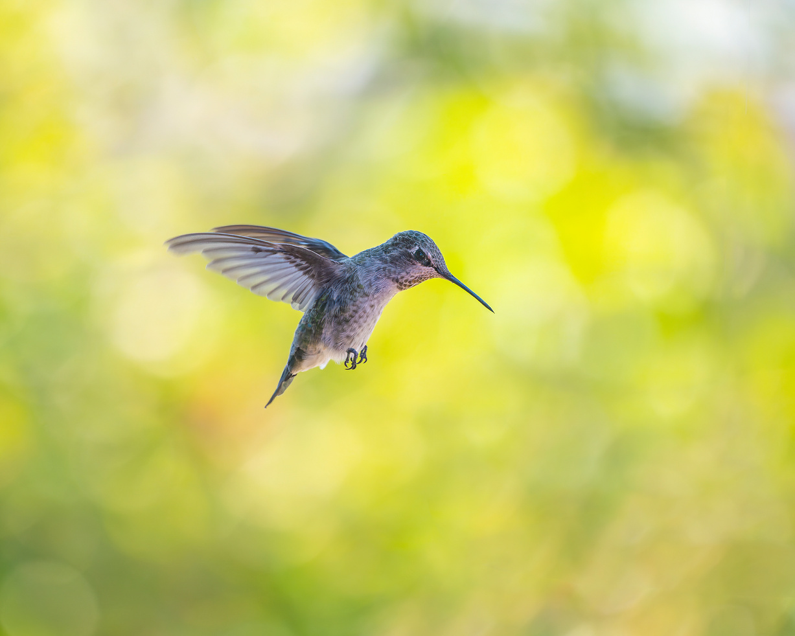
AUTONOMY
I am independent of others with my own work and responsibilities.
Notes:
Autonomy
I am independent of others with my own work and responsibilities.
Autonomy is about being able to be independent and self-directed in your work. Other words might be:
* Self-Sufficiency
* Self-Determination
* Prerogative
* Latitude
* Freedom
* Choice

Slide 7
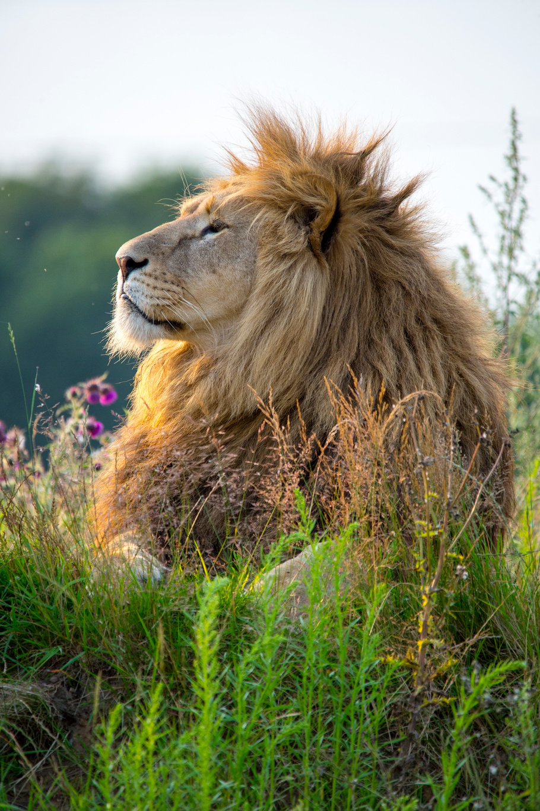
STATUS
My position is good and recognized by the people who work with me.
Notes:
Status
My position is good and recognized by the people who work with me.
Status is about recognition, privilege, and rewards, often in the form of titles, badges, awards, and increased social standing. Other words might be:
* Position
* Prestige
* Stature
* Reputation

Slide 8
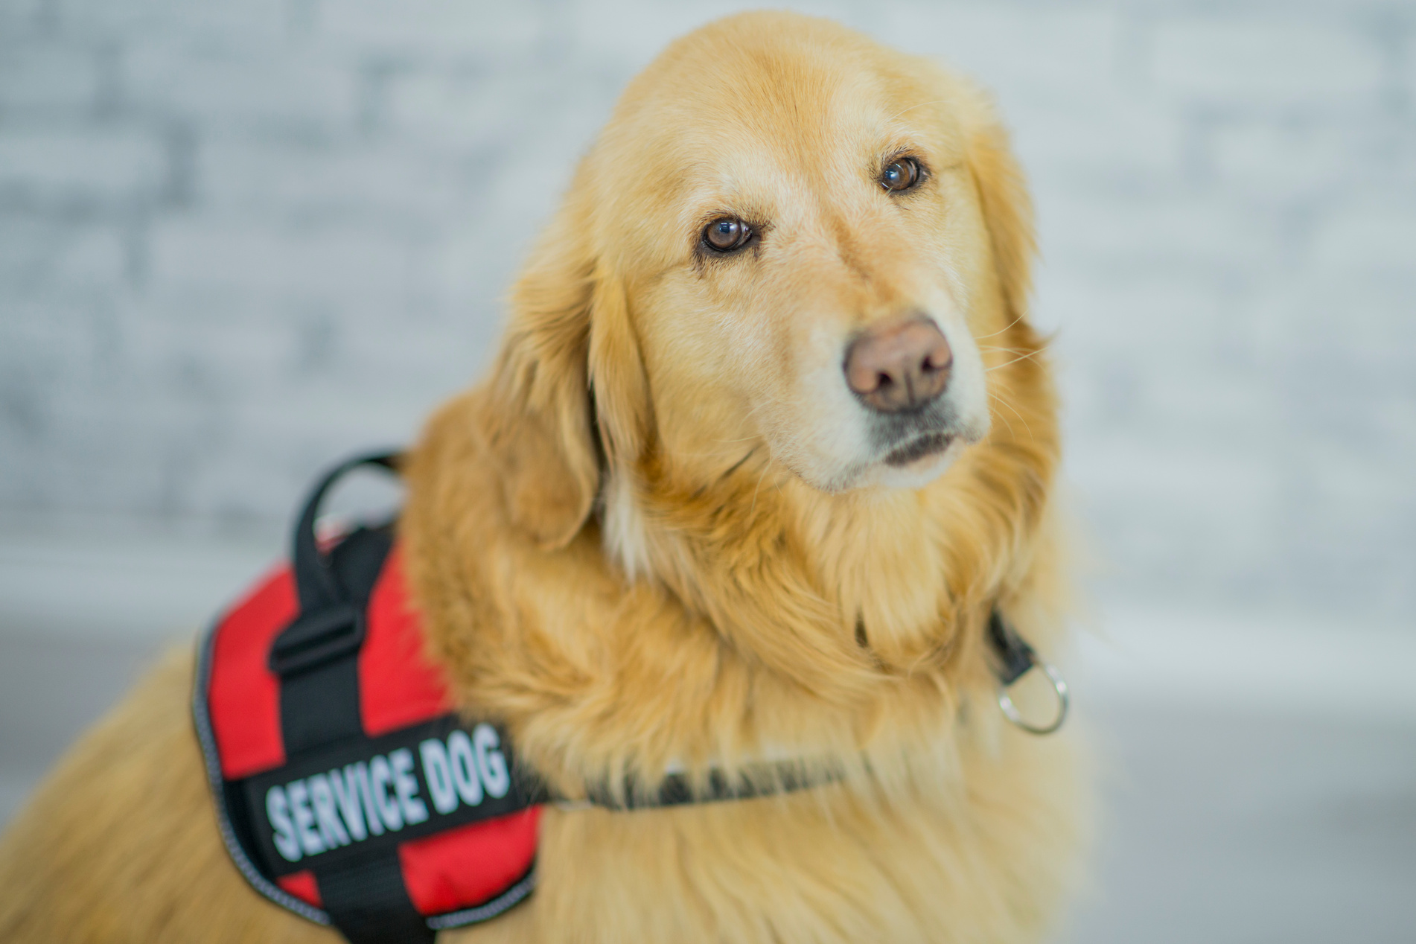
PURPOSE
My work has meaning and a positive impact in the world.
Notes:
Purpose
My work has meaning and a positive impact in the world.
Purpose is about having a connection to something that is bigger than yourself or something that has greater meaning. Other words might be:
* Calling
* Aspiration
* Duty
* Lifework

Slide 9
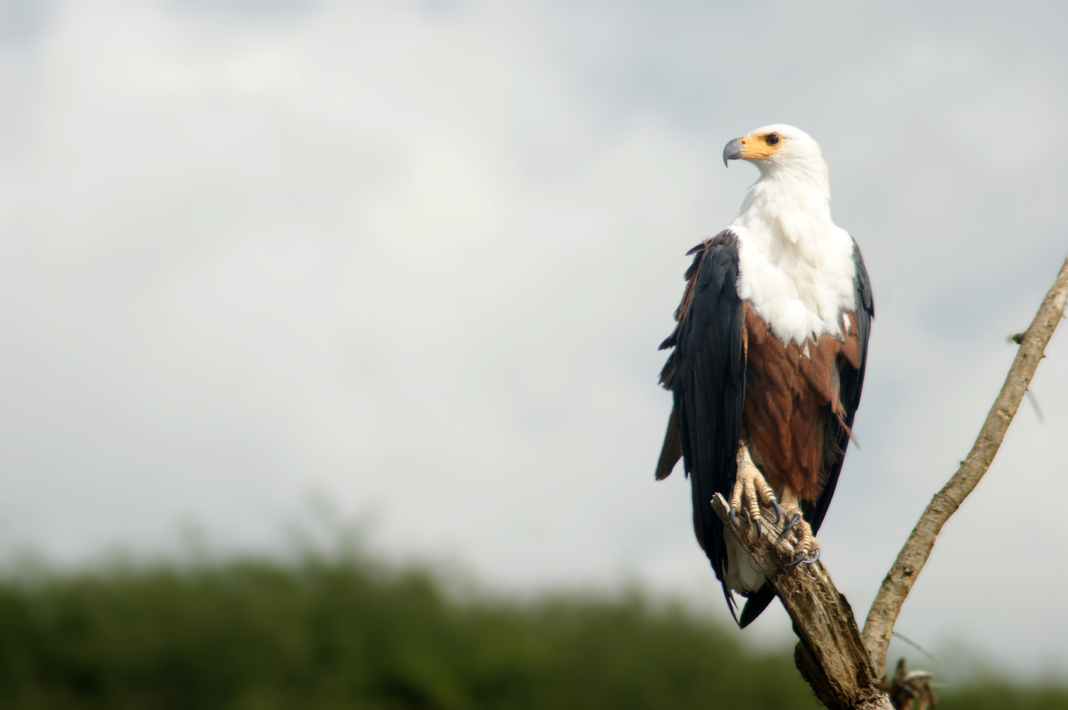
HONOR
It’s important that my personal values are reflected in how I work.
Notes:
Honor
It’s important that my personal values are reflected in how I work.
Honor is about loyalty to a group and integrity of one’s behaviors according to your moral code or values. Other words might be:
* Character
* Principles
* Morality
* Virtue

Slide 10
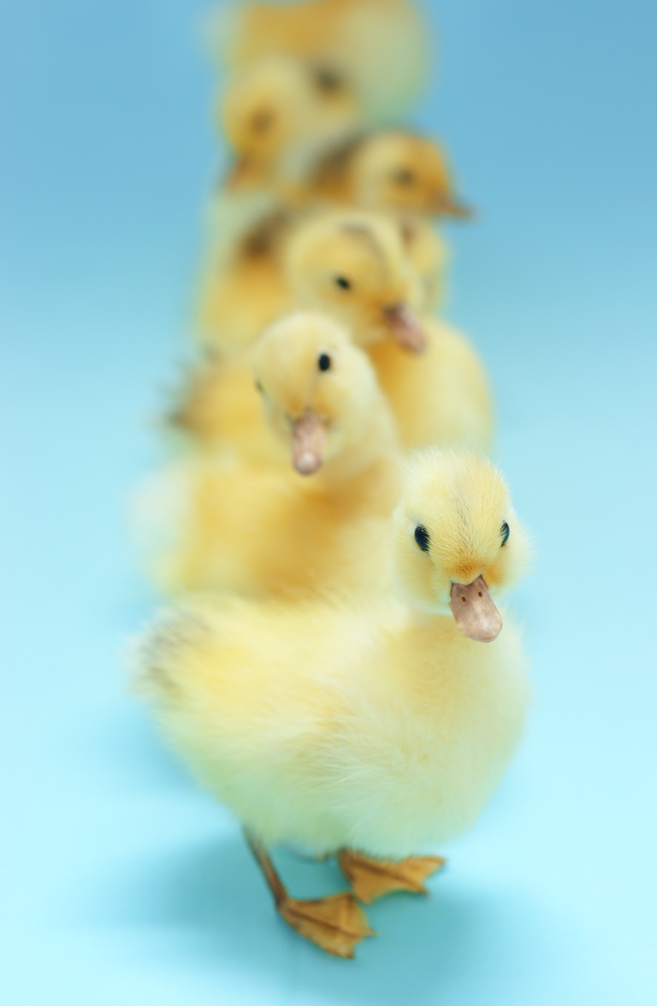
ORDER
There are enough rules and policies for a stable environment.
Notes:
Order
There are enough rules and policies for a stable environment.
Order is about a need for certainty and stability in our environment. Other words might be:
* Structure
* Security
* Organization
* Constancy
* Procedural
* Permanence

Slide 11
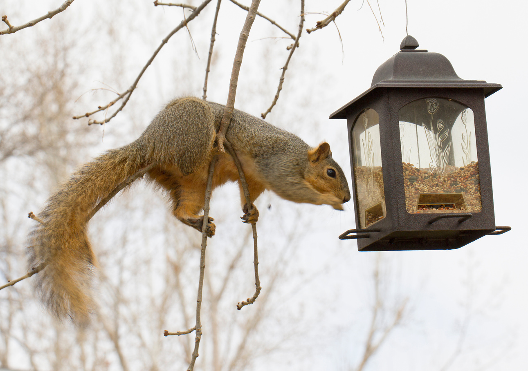
MASTERY
My work challenges my competence but is still within my abilities.
Notes:
Mastery
My work challenges my competence but is still within my abilities.
Mastery is about growing your level of competence and being challenged in your work. Other words might be:
* Challenge
* Aptitude
* Ability
* Proficiency
* Skill
* Expertise

Slide 12
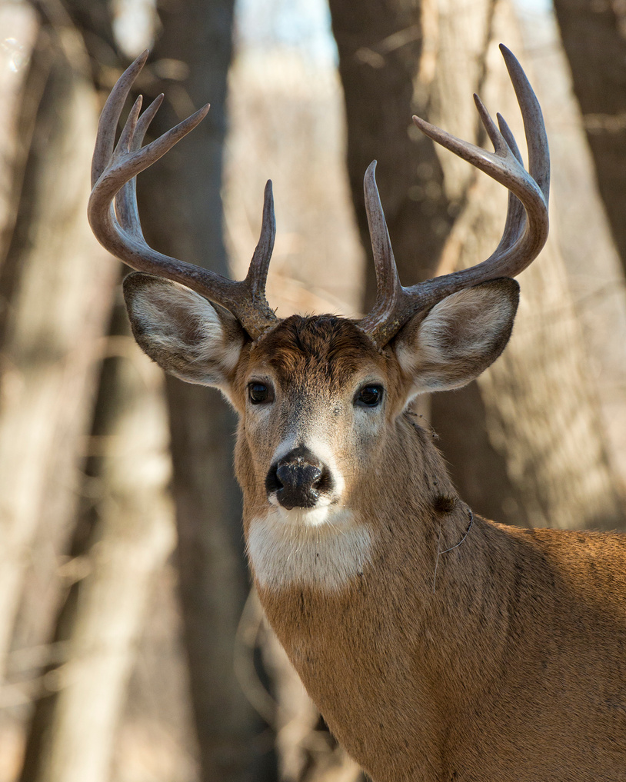
EMPOWERMENT
There’s enough room for me to influence what happens around me.
Notes:
Empowerment
There’s enough room for me to influence what happens around me.
Empowerment is about leadership and the ability to make changes in the world. Other words might be:
* Influence
* Power
* Coaching
* Potential
* Control
* Leverage

Slide 13
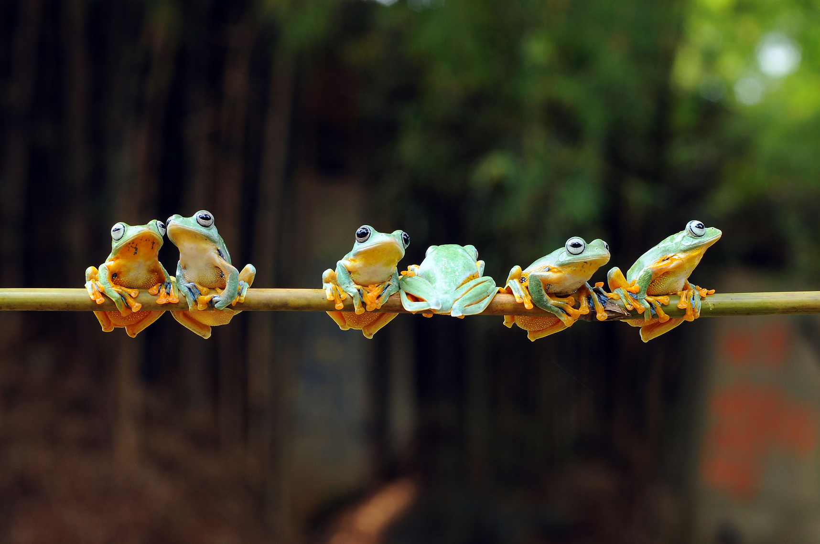
RELATEDNESS
I have good social contacts with the people in and around my work.
Notes:
Relatedness
I have good social contacts with the people in and around my work.
Relatedness is about feeling like you belong and enjoying interactions with others. Other words might be:
* Belonging
* Affinity
* Association
* Inclusion
* Rapport
* Friendship

Slide 14
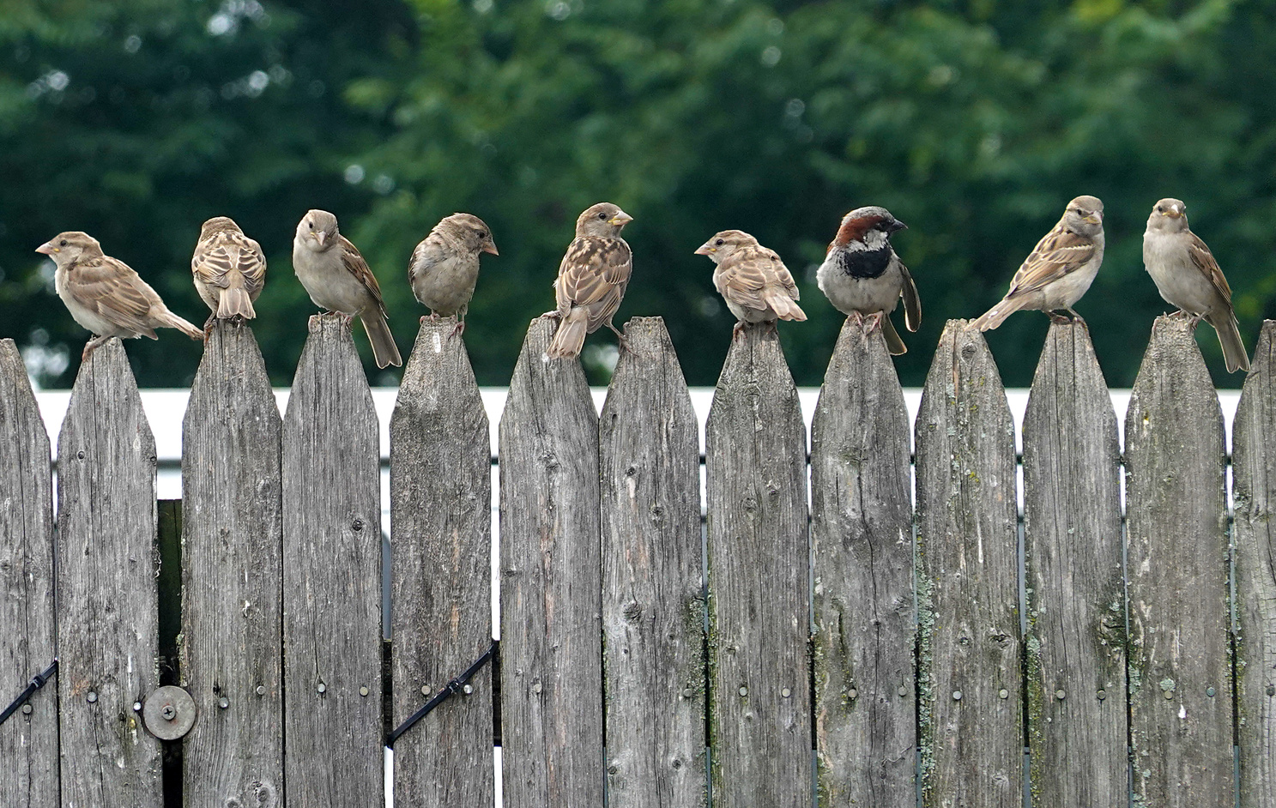
What motivates you at work?
Arrange cards in order of importance.
  There’s no right or wrong
  You decide on the meaning of the words
  You can arrange the cards from top to bottom or left to right
Notes:
Think about what motivates you at work?
Arrange cards in order of importance:
* There's no right or wrong
* You decide the meaning of the words
* You can arrange the cards from top to bottom or left to right

Slide 15
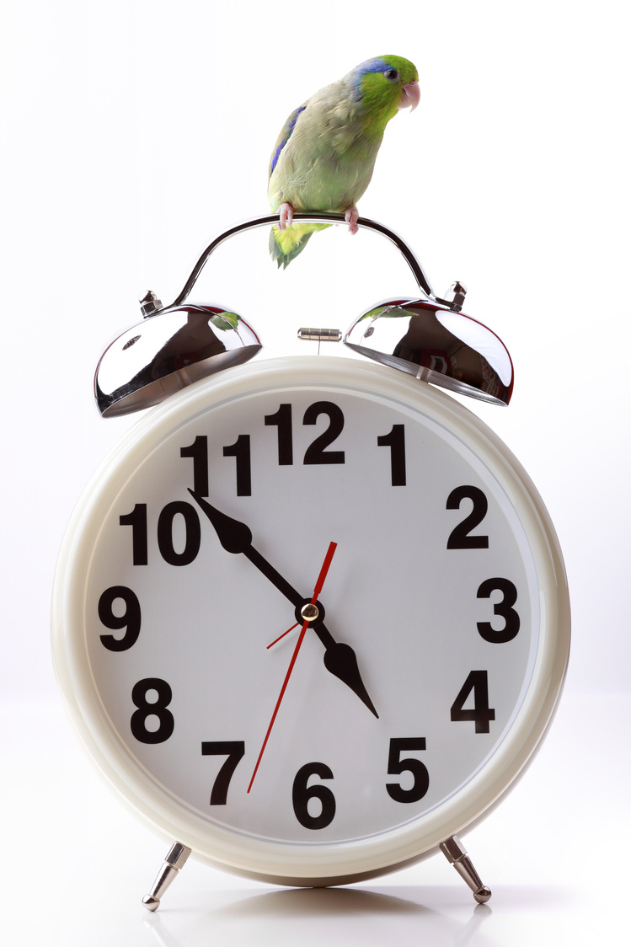
On Florida PALM Go-Live Day
What Changes?
  If the impact is positive, move the cards up (or to the right)
  If the impact is negative move
the cards down (or to the left)
  Feel free to rearrange the order of your cards
  Gather in groups and share your reasoning.
Notes:
Now think about the day Florida PALM goes live. It's January 6, 2026, and you're working in a new system. What changes? Are these things more or less important? How are your motivators impacted?
FIRST - rearrange your cards
* If the impact is positive, move the cards up (or to the right)
* If the impact is negative move the cards down (or to the left)
For example:
Mastery - If you've been working in FLAIR for 20 years and you've memorized the keys and you know all the codes - what happens now?
Curiosity - How do you feel about getting to play in a new system?
Honor - would moving to PALM impact this at all? It's okay if it doesn't change.
* Feel free to rearrange the order of your cards
SECOND - Gather in groups and share your reasoning.

Slide 16
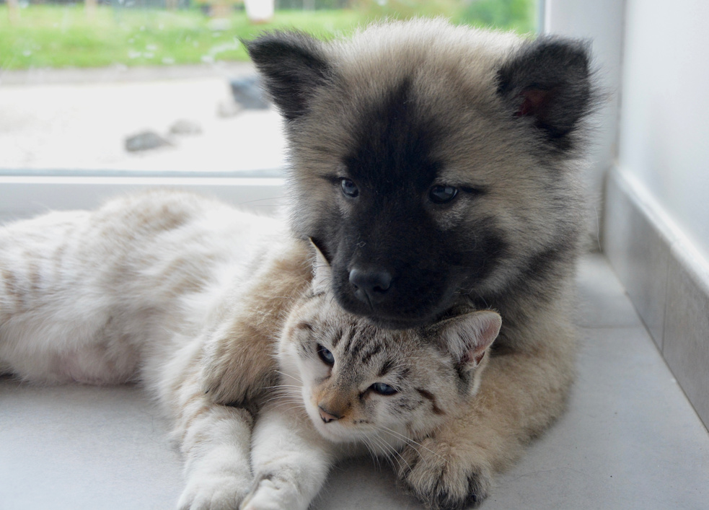
What can we do to support each other before and after go-live?
  Relatedness and Acceptance: Support groups, snacks, and affirmations
  Order and Mastery: Job aids and training to provide a feeling of order and constancy
  Autonomy and Curiosity: Explore and learn, join the training team or participate in UAT
  Purpose and Empowerment: Help others navigate the new system
  Honor and Status: Ensure rules
and statutes are followed
Notes:
Share out discussion and talk through ways we can support each other up to and after go-live.

Slide 17
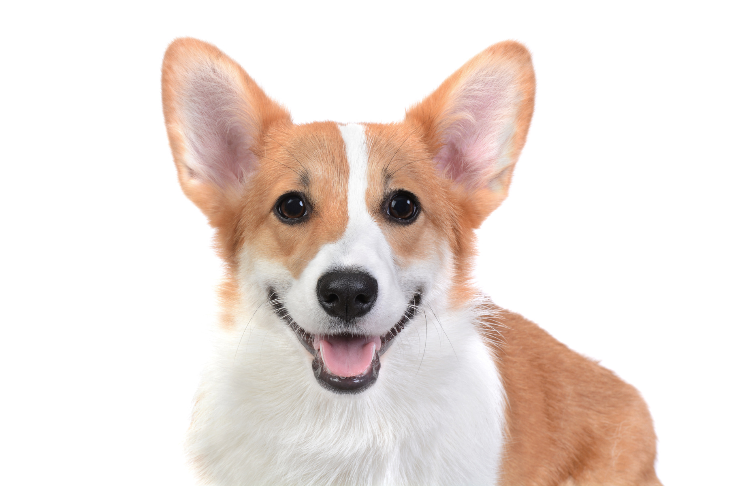
Thank you!

