Slide 1
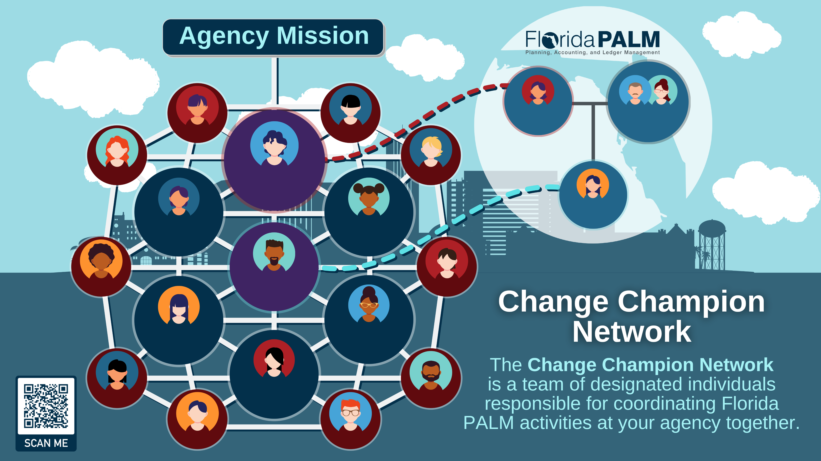
Executive Sponsor
Director &
Deputy Director
SME
SME
SME
Agency Sponsor
SME
Readiness Coordinator
Business Liaison
Training Liaison
SME
Agency Liaison
SME
Technical Liaison
Change Management Liaison
Project Management Liaison
SME
SME
SME
SME

Slide 2
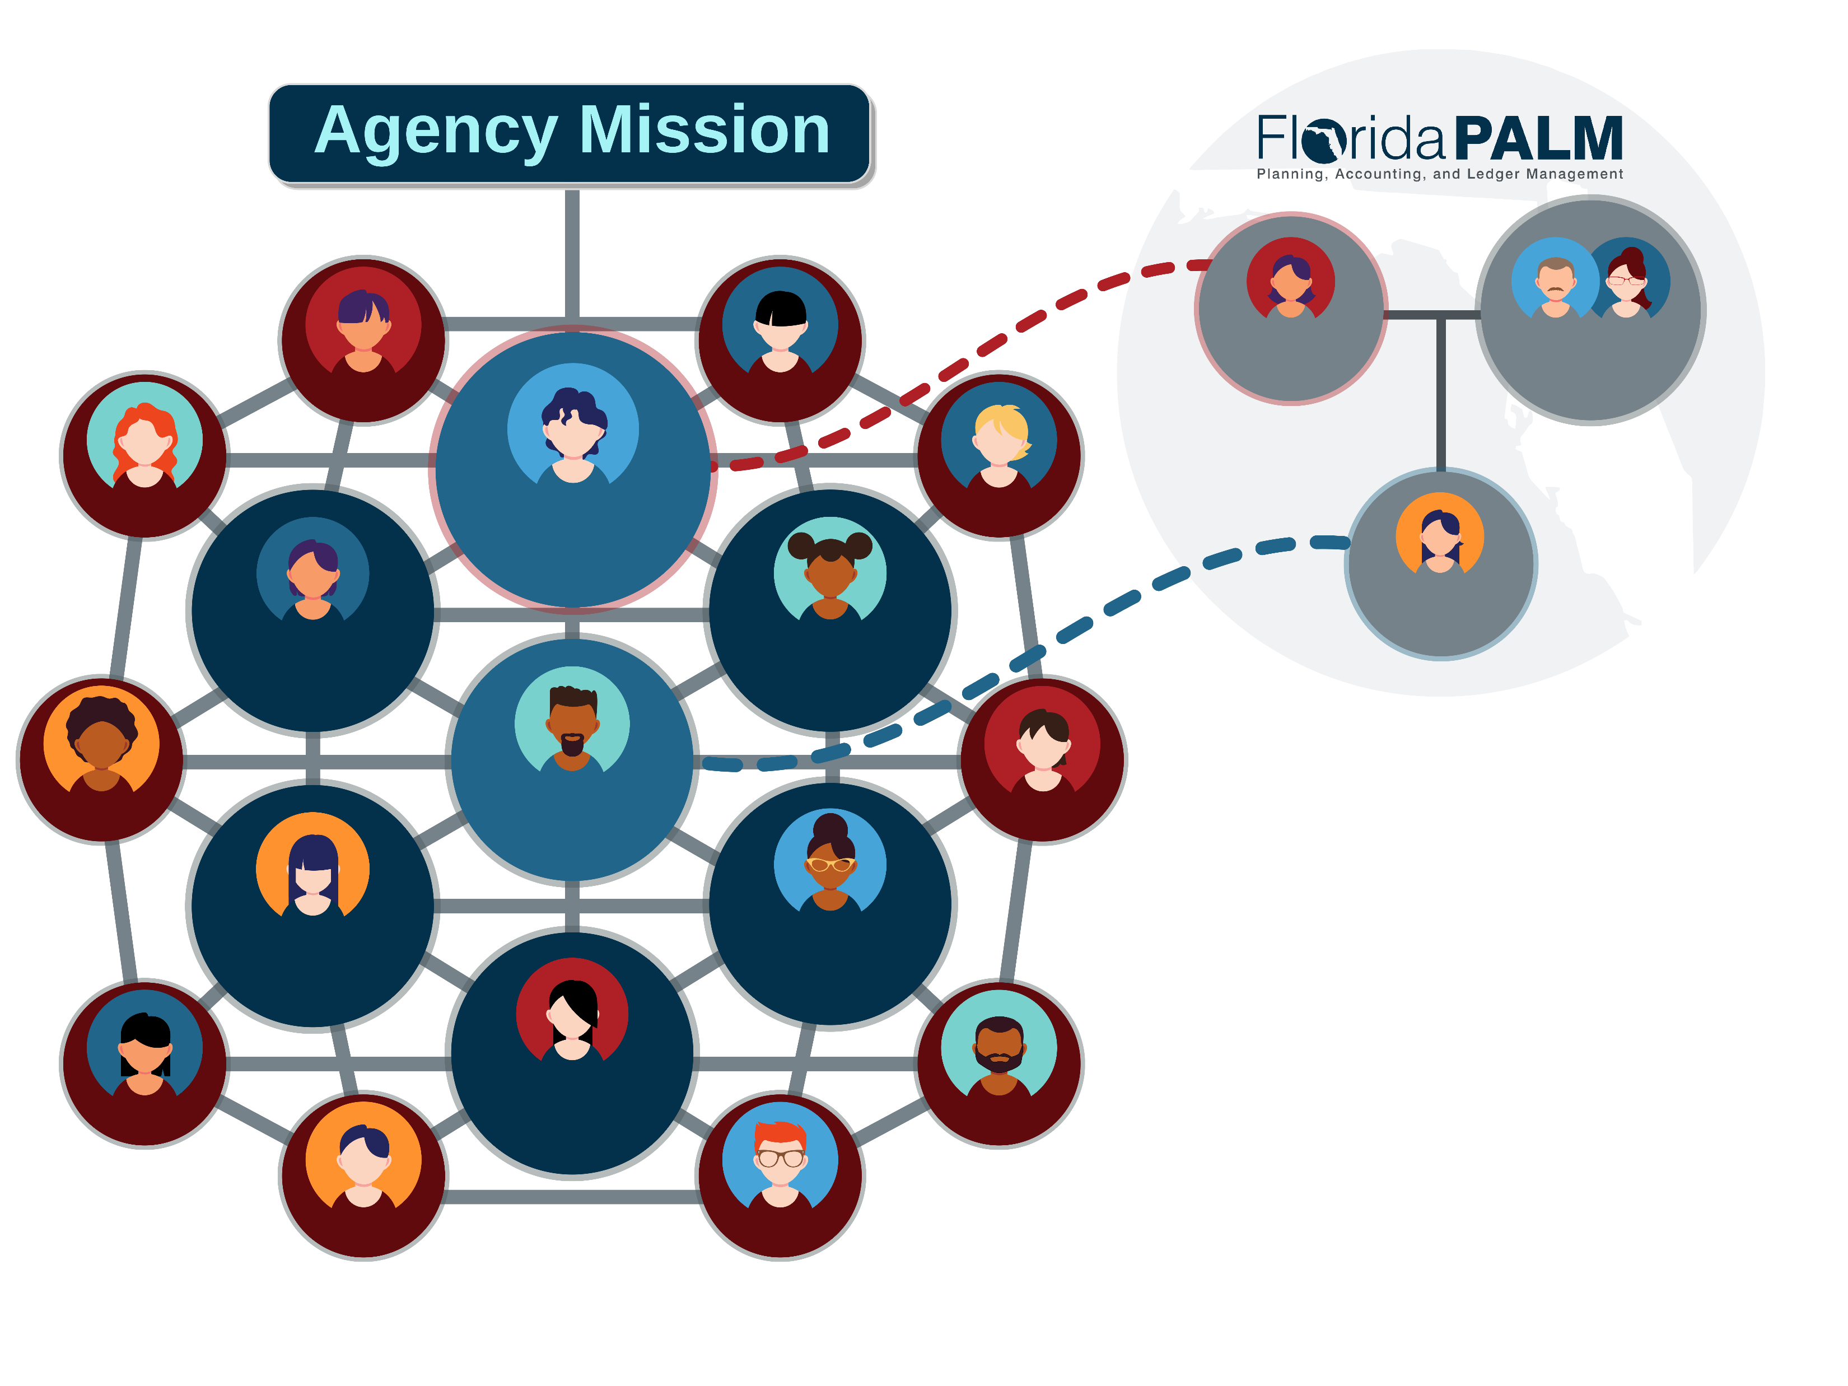
Executive Sponsor
Director &
Deputy Director
SME
SME
SME
Agency Sponsor
SME
Readiness Coordinator
Business Liaison
Training Liaison
SME
Agency Liaison
SME
Technical Liaison
Change Management Liaison
Project Management Liaison
SME
SME
SME
SME

