Slide 1
FDACS Wilton Simpson, Commissioner
Approach to Planning and Preparation for Florida PALM
FASM
September 29, 2023
Notes:
Thank you for this opportunity to share Agriculture’s approach to planning and preparation for Florida PALM.

Slide 2
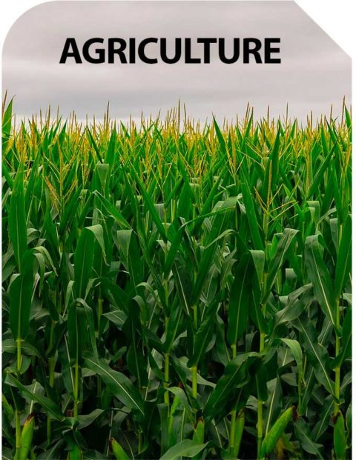
Agenda
The department and its challenges
CCN approach
Communications approach
Technology approach
How to lose sleep
Notes:
For this presentation I am going to speak on the following points.

Slide 3
Department Structure
16 Divisions and Offices with vastly different missions
Notes:
FDACS does more than manage cows, although we do that too. We have 16 divisions and offices with vastly different missions.

Slide 4
Department Structure
Divisions and Offices
Commissioner’s Office / Division of Administration | Division of Agricultural Environmental Services
Office of Agricultural Law Enforcement (AgLaw) | Division of Consumer Services
Office of Water Policy | Division of Fruit and Vegetables
Division of Licensing | Division of Marketing
Office of Energy | Division of Aquaculture
Division of the Florida Forest Service | Division of Animal Industry
Office of Ag Technology Services (OATS) | Division of Plant Industry
Division of Food Safety | Division of Food, Nutrition, and Wellness
Notes:
Of our many divisions and offices that do meaningful and impactful work. For example, the division of Licensing offers a permit to carry a concealed weapon whereas the division of Food, Nutrition, and Wellness manages the National School Lunch Program for the state of Florida. AgLaw is our law enforcement branch, and the Forest Service manages over 1 million acres of state forests.

Slide 5
Department Structure – AIMS
AIMS is to FDACS what MFMP is to everyone else (and more)
Contract routing/approval workflow
Handles multi-year contracts and encumbrances
Disbursements processing for both encumbered and unencumbered disbursements
Document repository for all supporting documentation
Batch uploads to FLAIR daily
Notes:
AIMS is our MFMP. It is a homegrown, enterprise, Oracle system in place since 2002. AIMS is a one-stop shop for contract approval flow, multi-year agreements, disbursements processing, document storage, and performs batch uploads to FLAIR daily.

Slide 6
Department Structure – REV
REV is the FDACS revenue processing system
Processes revenue and creates reports for division use
Ability to track payments
Creates receivables in FLAIR
Processes and tracks refunds
Batch uploads to FLAIR daily
Notes:
REV is our revenue system used by only our Revenue Section in Finance and Accounting. This system records all department revenues, creates reports for each division’s different missions, creates receivables in FLAIR, processes and tracks refunds, and batch uploads to FLAIR daily.

Slide 7
CCN
13 core
8 Aug
3 OPS
Shelf SMEs
Inclu 30 div
FLORIDA
Notes:
Now to the Change Champion Network. We will change the Florida! The FDACS CCN has 13 core members, 8 staff aug positions, 3 OPS, and shelf SMEs. The term “shelf SME” refers to SMEs who are engaged for their specific expertise as needed and may not be involved in every single task, function, or process. This includes over 30 division representatives which include IT staff, fiscal staff, and division directors as needed.

Slide 8
Change Champion Network Approach
Flat Org Chart
Book Club
Advisory Council-like
Knowledge rebuilding (separations and hiring)
Notes:
We have built our CCN using a flat org chart. The CCN includes division directors, bureau chiefs, managers, analysts, and frontline staff, all of whom are encouraged to contribute. Everyone has a voice. We don’t just try to think outside the box… we got rid of the box. The craziest ideas are welcomed, discussed, and vetted.
We have had our “book club” for 3 years now. PALM tasks for example, are not assigned to one person. Every member of the CCN reads and interprets the task from their SME perspective, and then it is discussed to ensure we have the most complete understanding from the best, most impactful perspective.
While the CCN makes many decisions in the details, it also acts as an advisory council to executive leadership for policy and enterprise IT changes regarding PALM. We present all the options with the CCN favorite as the recommendation.
We have also begun what we call “knowledge rebuilding”. When anyone separates, the new employee taking their place is immediately exposed to PALM, its many resources, and the agency approach.

Slide 9
Communications Approach
No new wheels
PALM tools
Email updates
Scheduled meetings
Honesty & Transparency
Every discussion on current processes or issues comes with a
#WhatAboutPALM to think forward about every process and issue
Notes:
We are not reinventing the wheel. We just got better tires.
We use PALM tools (posters, website, recordings) to communicate coming changes.
We use email updates to keep PALM at the forefront of everyone’s mind.
Every scheduled meeting either has an agenda item to speak about PALM, or we look for openings to explain how PALM will impact what we are discussing.
We are honest and transparent. We don’t give concrete answers with incomplete information. If we are conceptualizing an idea, we make sure that is known.
Lastly, every discussion on current processes or issues comes with “What will PALM change what we are talking about?”.

Slide 10
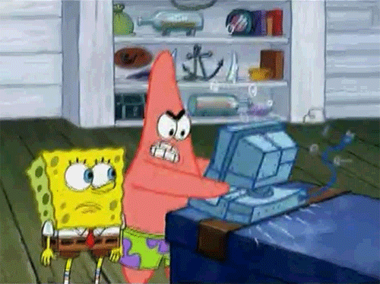
Technology Approach
PRT (PALM Readiness Team)
DIOs (Division Information Officers)
Fiscal Liaisons
Notes:
The PRT is our staff aug group of PMs, developers, and business analysts assisting with system remediation.
DIOs (Division Information Officers) reside in each division, and we engage them to ensure impacted technical processes are captured.
Fiscal Liaisons reside in each division to manage the financial process of divisions.
The division of Administrations DIO is a member of the core CCN, and we all work collaboratively to ensure we are mapping systems and associated processes for analysis of the impact PALM will have. We are planning some enhancements for better integration with PALM as well as ensuring FDACS can speak the new PALM language of the COA.

Slide 11
How to Lose Sleep?
PALM
Notes:
FDACS is ahead of the game in some areas and on time in others. I admit that I lose sleep on occasion or have those 2am ideas that wake me up because I know there will be obstacles and issues that get in the way. It is the goal of each person involved on the FDACS side of this project, that we have the best seat on the bus possible.

Slide 12
THANK YOU!
Jim.Lewandowski@FDACS.gov
(850) 617-7227

